Slide 1
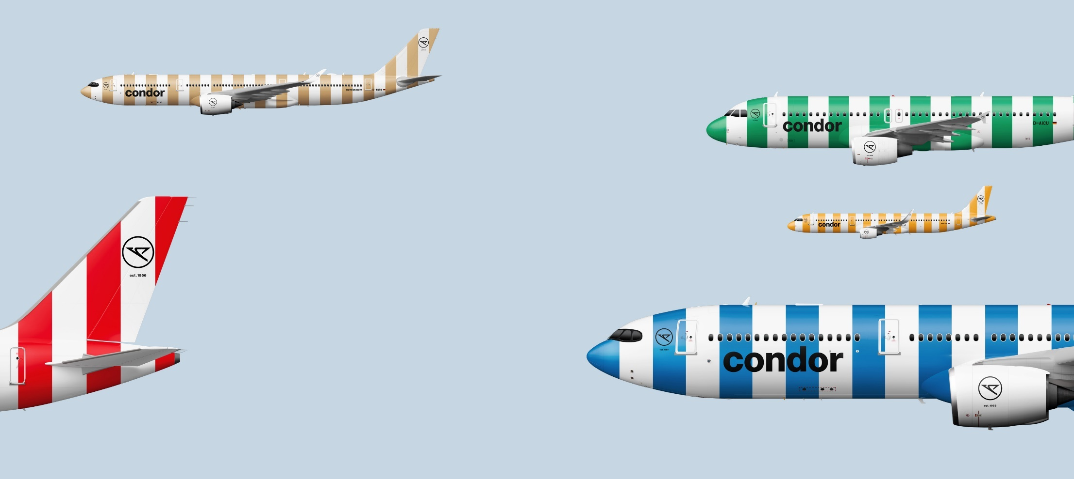

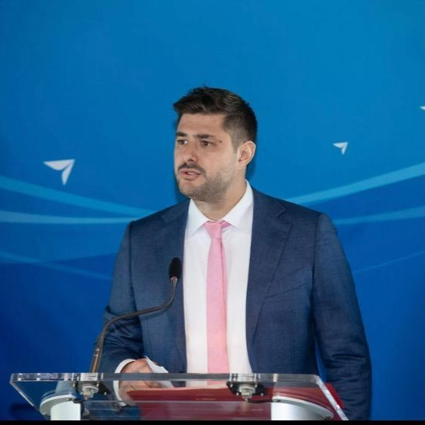

Condor NA Team
Mikko Turtiainen – Director of Sales, the Americas
Christian Cirillo – Sales Manager, the Americas
Silvia Funke - Sales Manager, The Americas

Slide 2
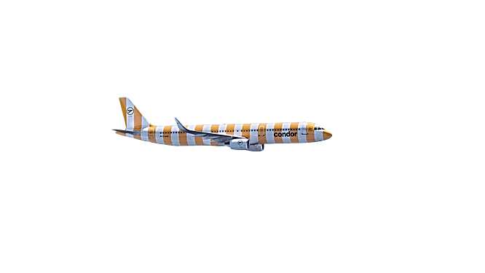
Born to Fly
who we are
Every year, around 9.4 million passengers fly with Condor from eight German airports to around 90 destinations in Europe, Africa and America.
Condor has been flying its guests to the most beautiful holiday destinations in the world since 1956. According to a survey conducted by the German Institute for Service Quality, Condor has repeatedly been named Germany's most popular holiday airline for many years.
Condor operates a fleet of more than 50 aircrafts, which are maintained by its subsidiary Condor Technik GmbH according to the highest safety standards at its Frankfurt and Düsseldorf locations.

Slide 3
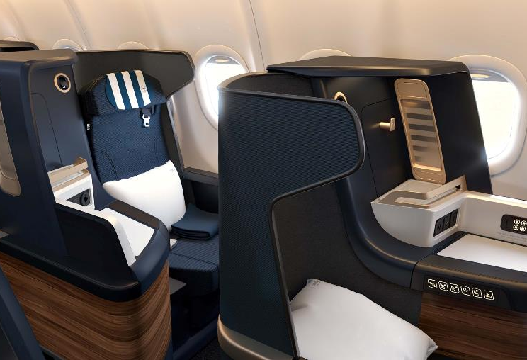





The Facts
Our hub in Frankfurt [ FRA ]
Most of the European capitals can be reached in less than 3 hours flight time from our chosen european hub.
18 Gateways in North America
Condor flies non-stop to NA Gateways with seasonal and full year schedules from twice a week to daily.
Affordable comfort across the Atlantic
Many corporate partners value our well priced Business and Premium Class to and from Europe.
Complete renewal of the Condor fleet
From summer 2024, Condor will operate all long haul NA flights with the brand new A330-900 NEO. 310 seats total with 94 premium seats.

Slide 4





North American Gateways
Edmonton
Anchorage
Calgary
Vancouver
Minneapolis
Frankfurt
Toronto
Halifax
Seattle
Portland
Boston
San Francisco
Las Vegas
New York
Los Angeles
Baltimore
Phoenix
Year-Round Service
New York
Toronto
Seattle
Miami
San Antonio
Miami
Additional Partner-Airlines NETWORK between FRANKFURT and many other EU-Gateways

Slide 5
HIGHLIGHTS:
50% growth for 2024! SAT, YYC, MIA the newest!
All A330 NEO operations
Business class grows +30%
Premium eco grows nearly 80%
Economy grows 13%

Slide 6
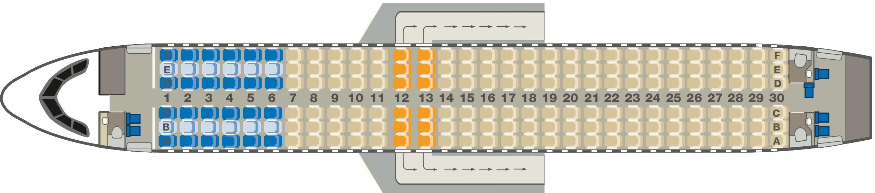
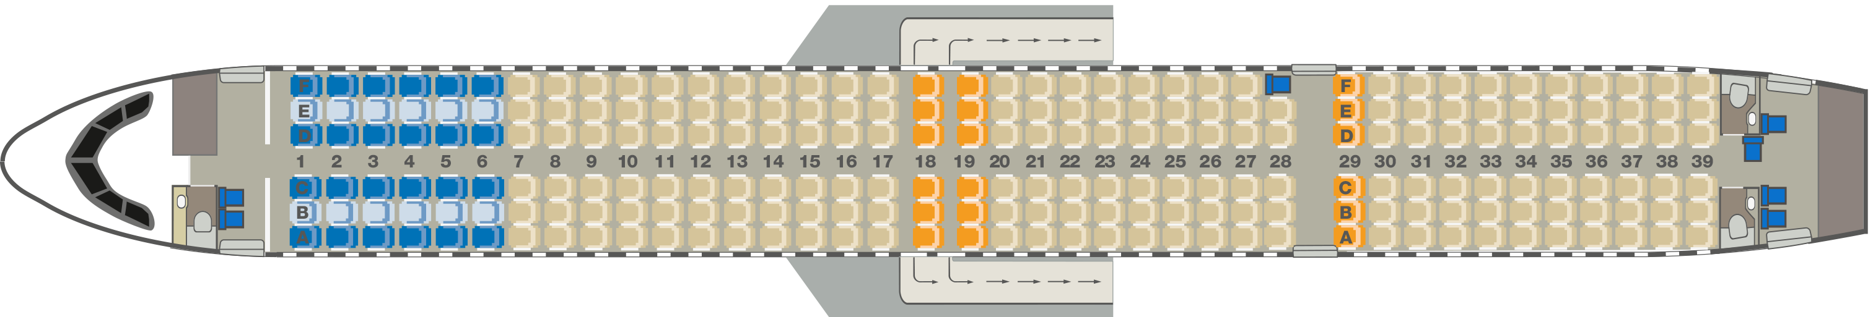

New Short and Medium-Haul Fleet (A32Xneo)
Airbus A320neo
180 seats, with up to
24 in Business Class
Airbus A321neo
233 seats, with up to
24 in Business Class

Slide 7
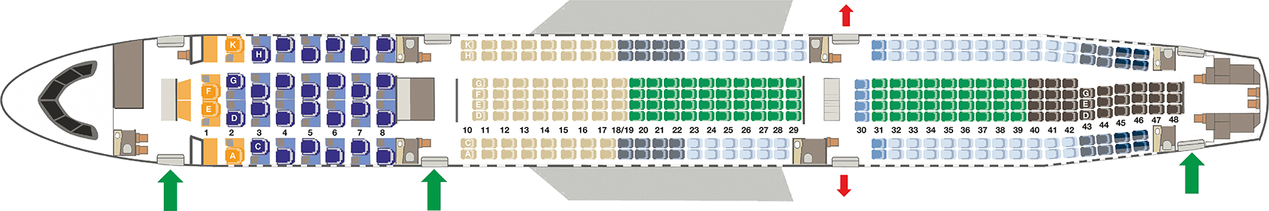
Long-Haul Fleet
Since March
2024:
Efficient all-A330neo
fleet on all Condor
long-haul routes
Airbus A330neo
310 seats, with
64 in Premium Economy Class
30 in Business Class, including
4 Prime Seats
Business Class
Free middle seat
Unaccompanied
children*
Front cabin
Windows/aisle
seats mid cabin
Middle seats
mid cabin
Rear cabin
Unavailable
Emergency exits

Slide 8





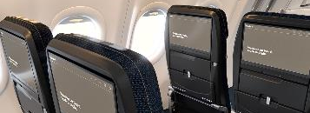
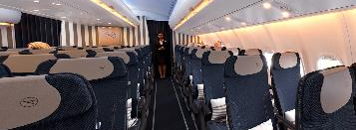
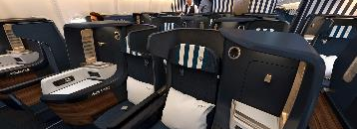
Long-Haul Product:
Special Features of the A330neo Cabin
Economy Class
Premium Economy Class
Business Class
Up to 30 in seat pitch
4-way adjustable headrests
8.5° tilting backrests
Larger hand luggage compartments
35 in seat pitch
6-way adjustable headrests
12° tilting backrest with
memory foam
Personal adjustable footrest
Fully lie flat bed with 79 in
recline position
6-way adjustable headrests
1-2-1 Each seat has access to aisle
Small and stylish cocktail table
Seat comfort
Inflight entertainment
Personal
13.3-inch, in-seat 4K monitor
Personal
13.3-inch, in-seat 4K monitor
17.3” 4K monitor – 24” monitor in prime, pajamas, snack basket etc
USB-A und
USB-C ports
Mobile
device holder

Slide 9
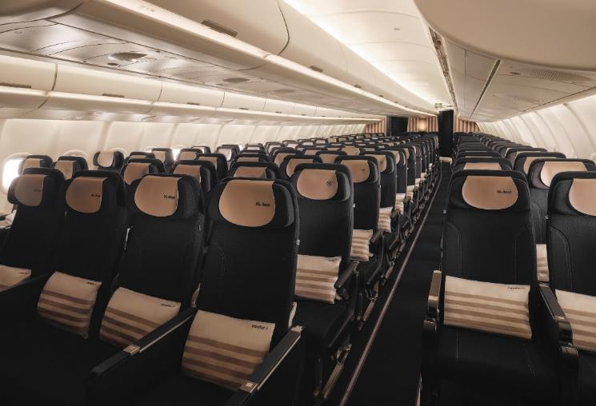
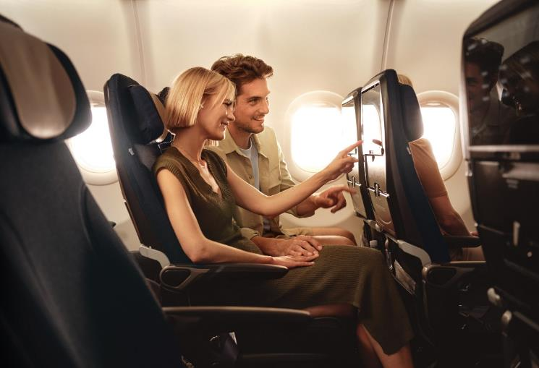
Our Fleet: Airbus A330neo
Economy Class

Slide 10
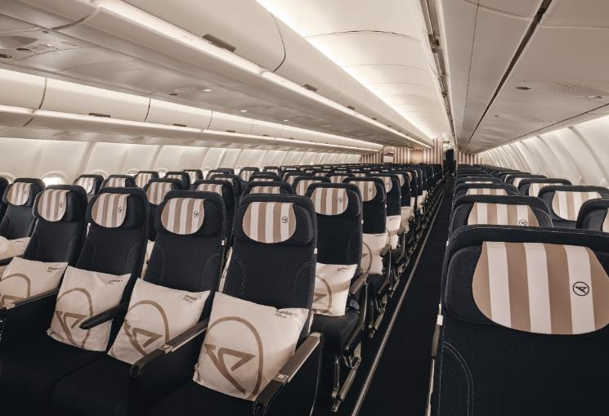
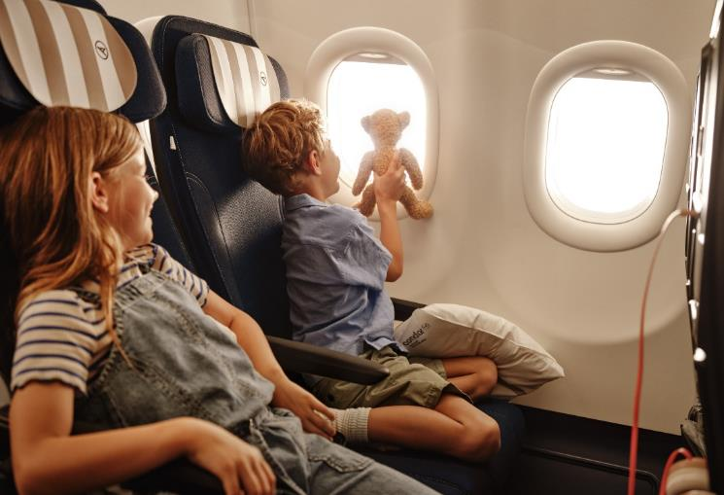
Our Fleet: Airbus A330neo
Premium Economy Class

Slide 11
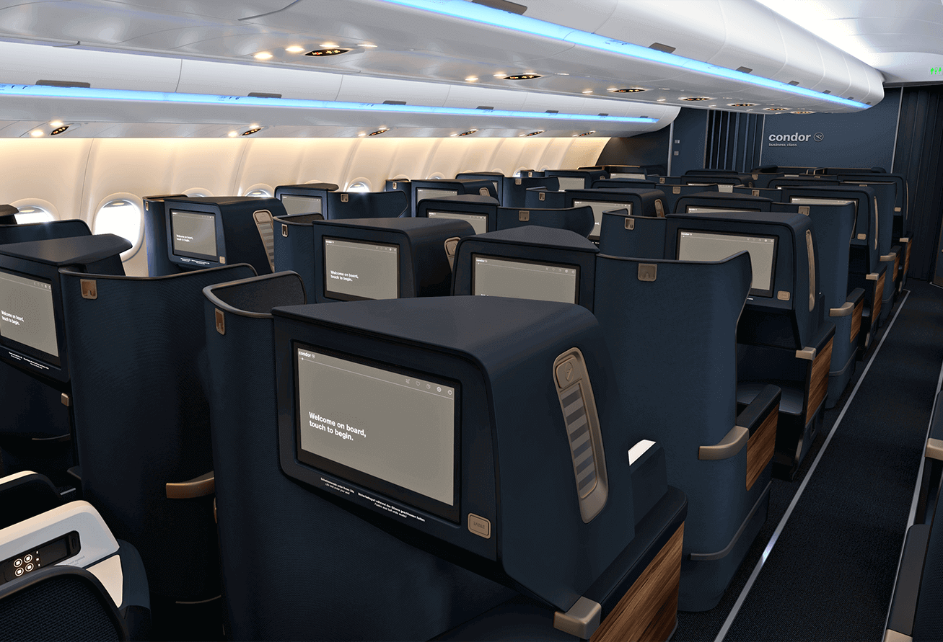
Our Fleet Airbus A330neo
Business Class

Slide 12
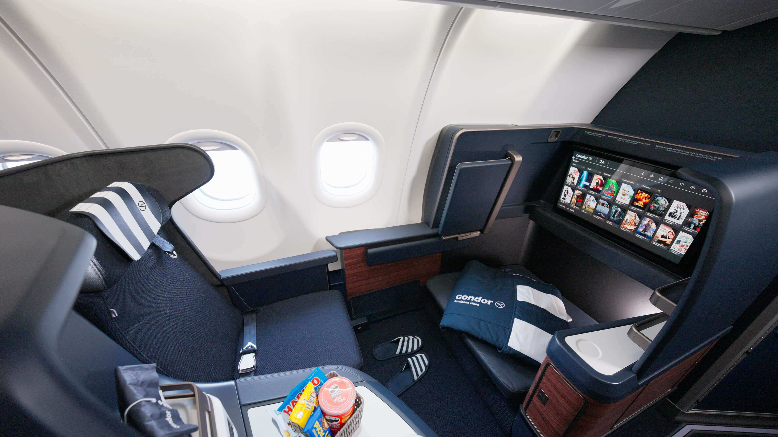

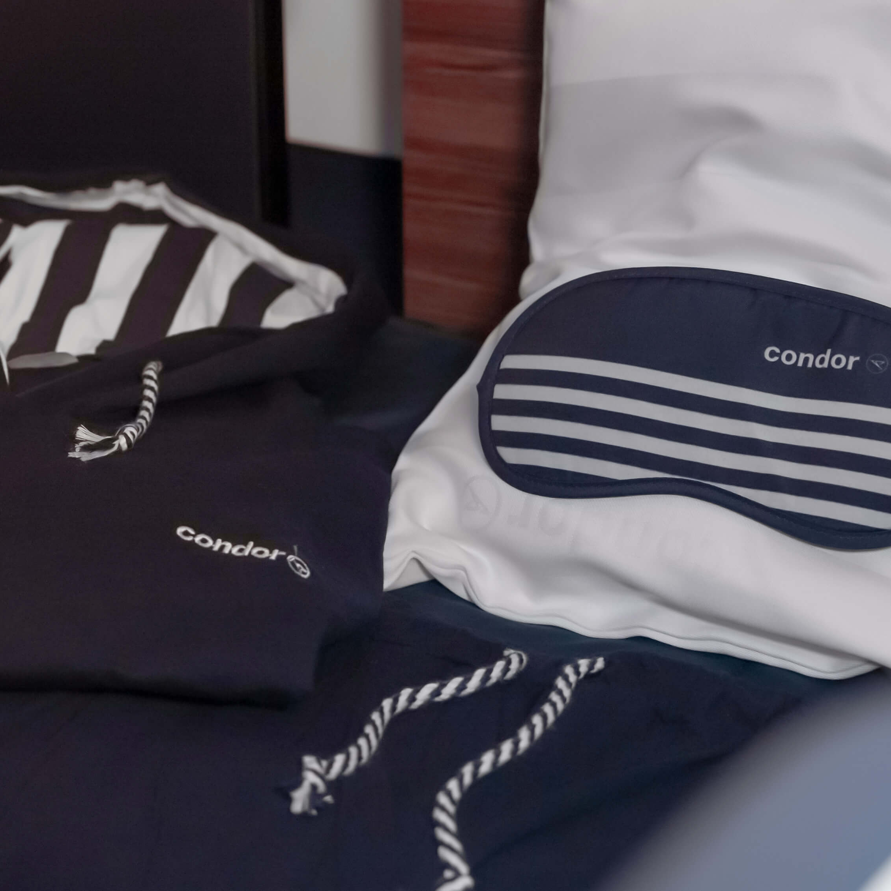
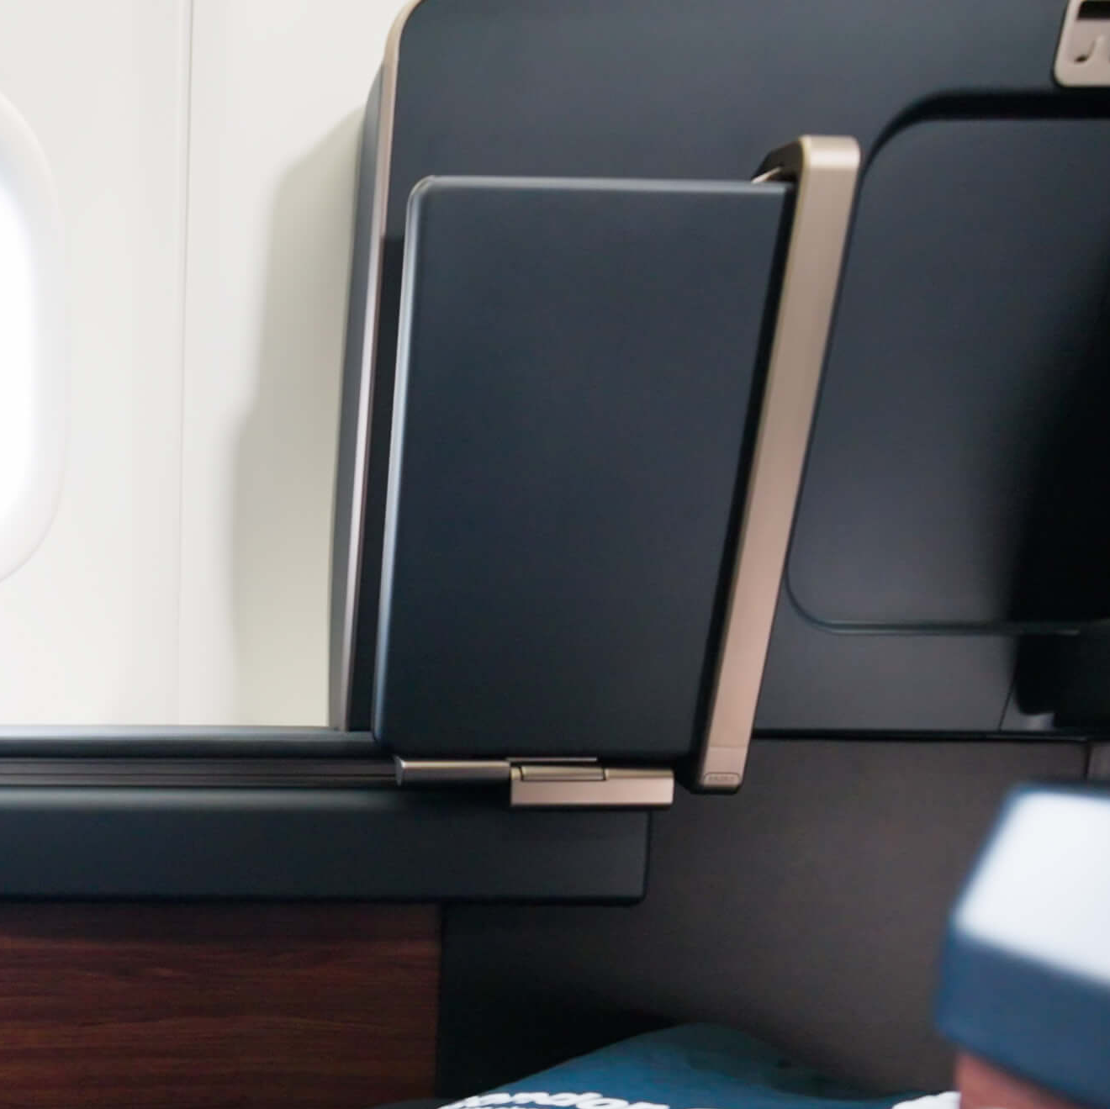
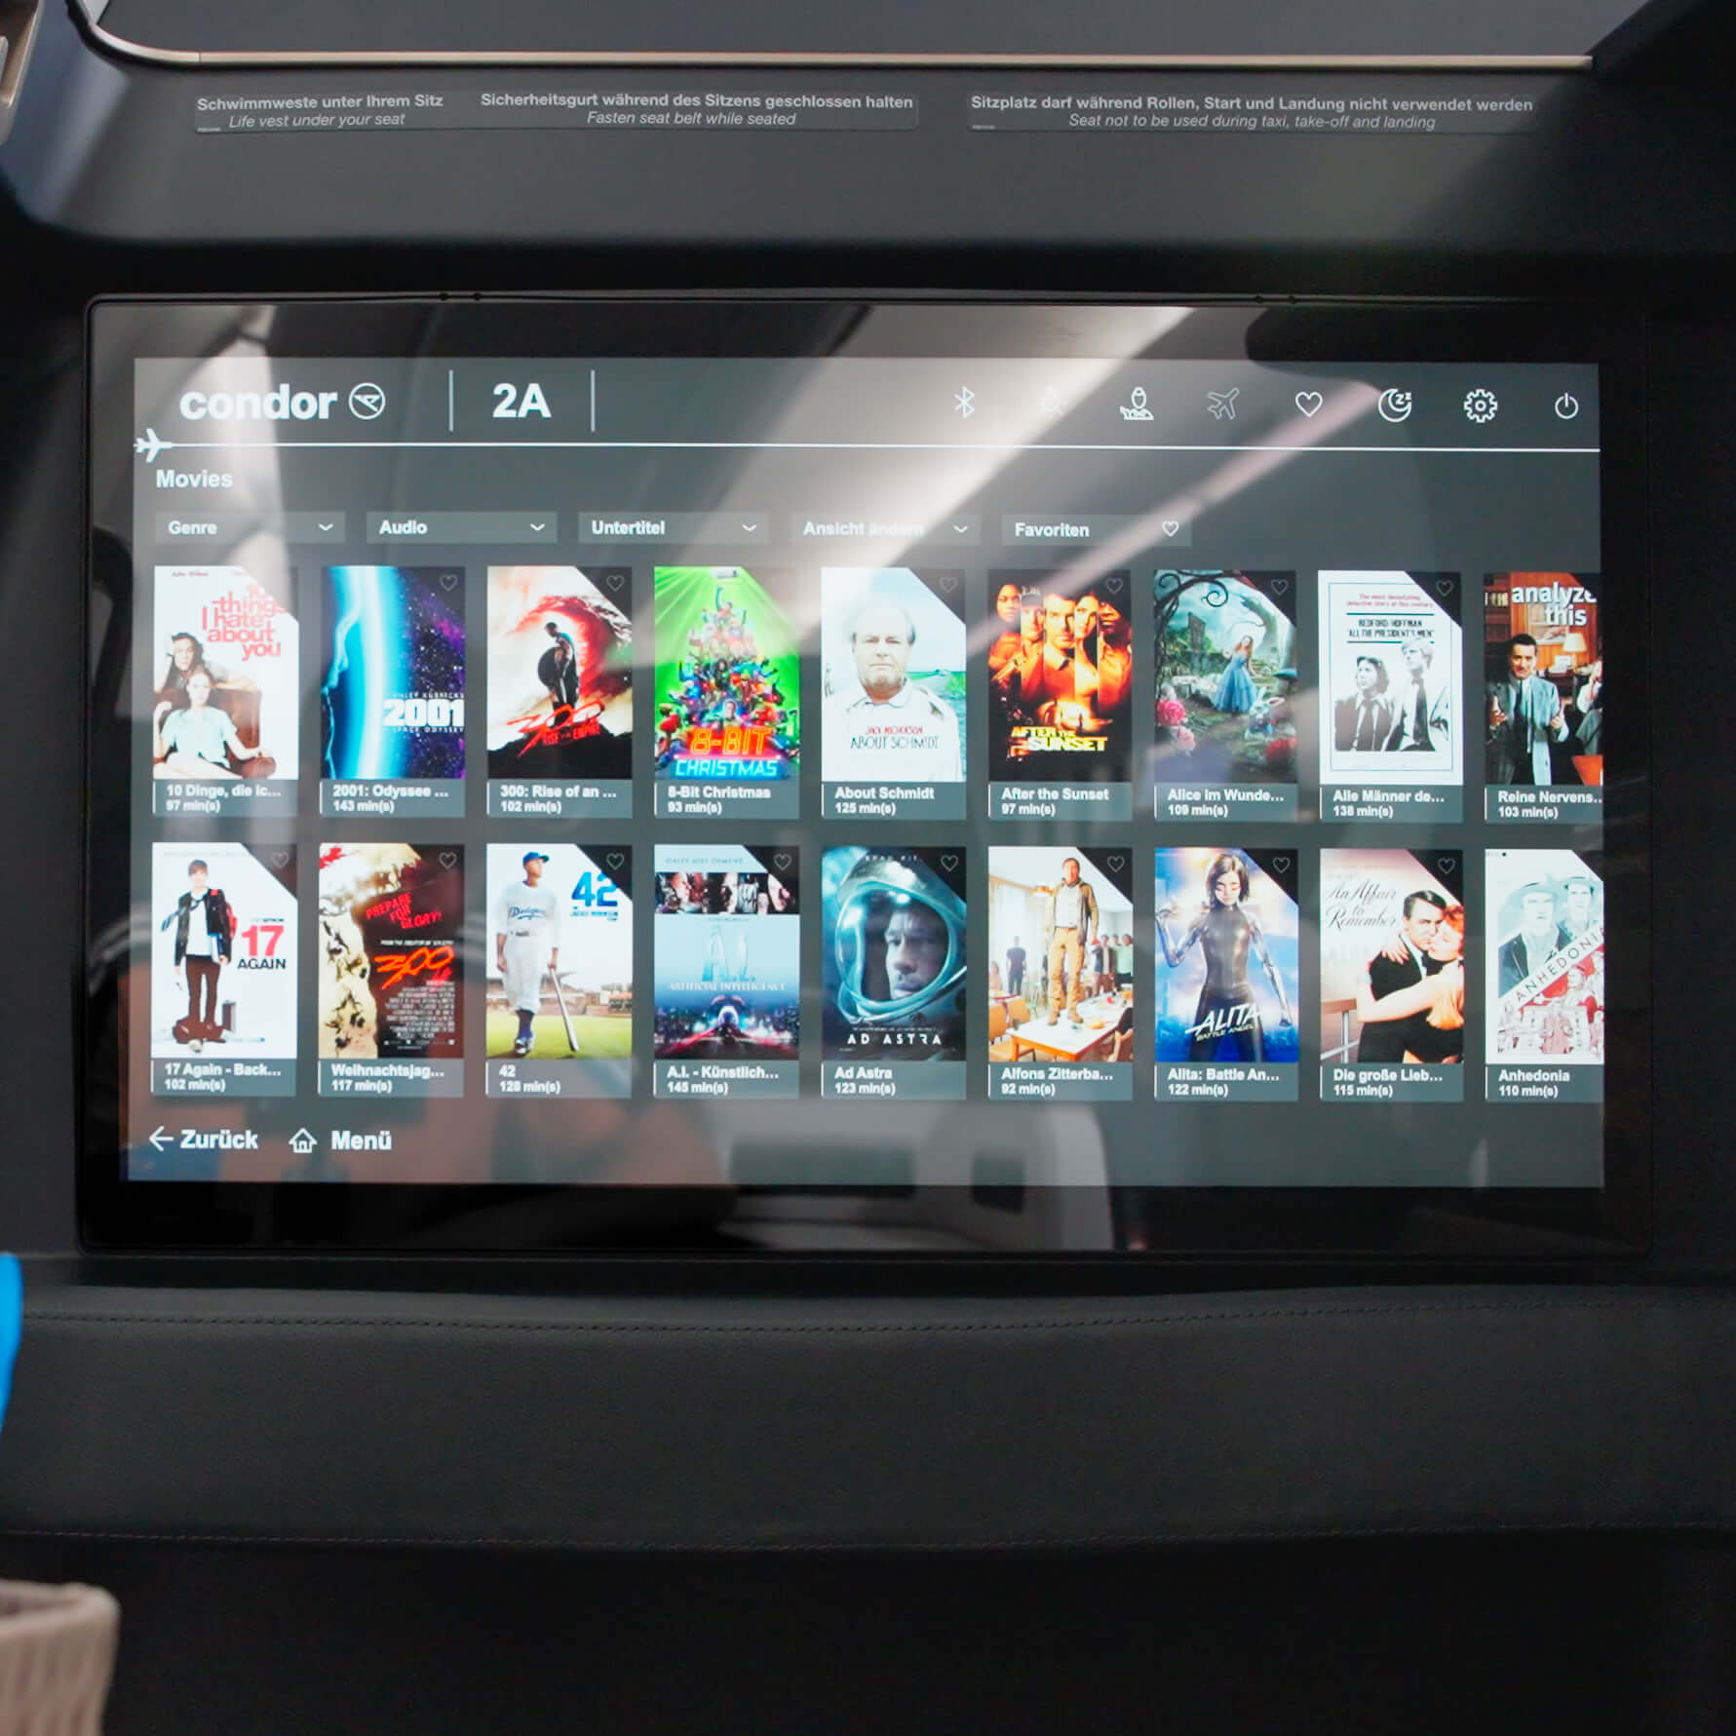
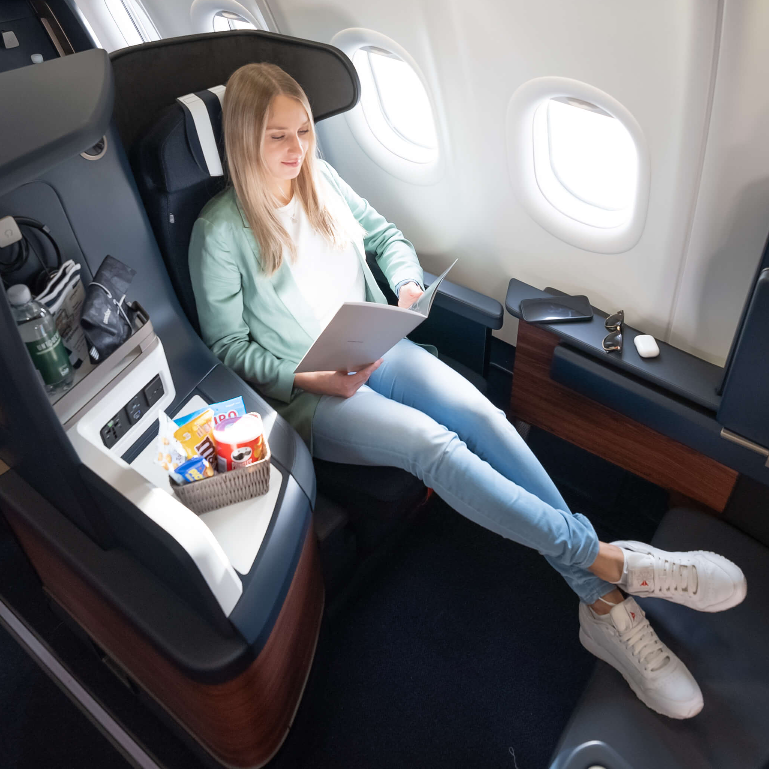
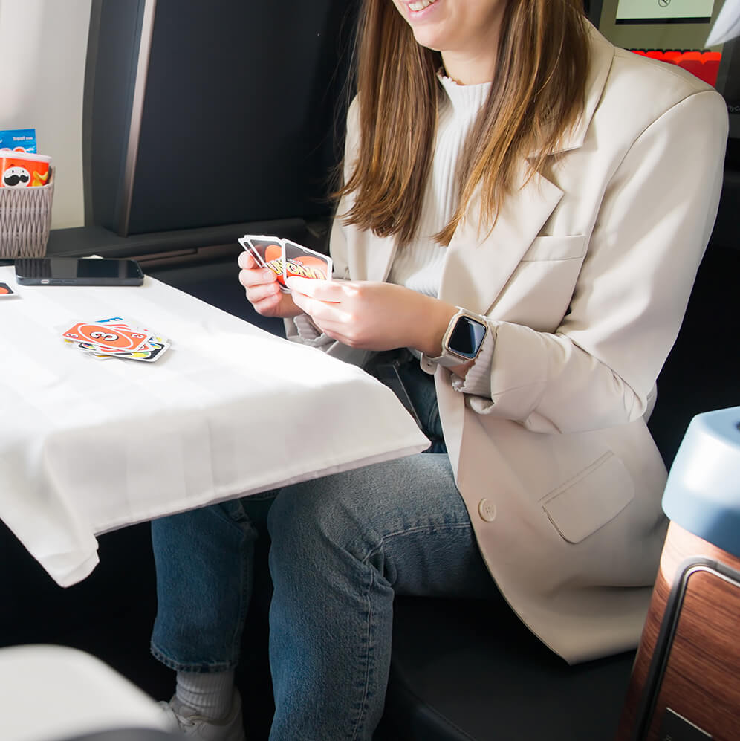
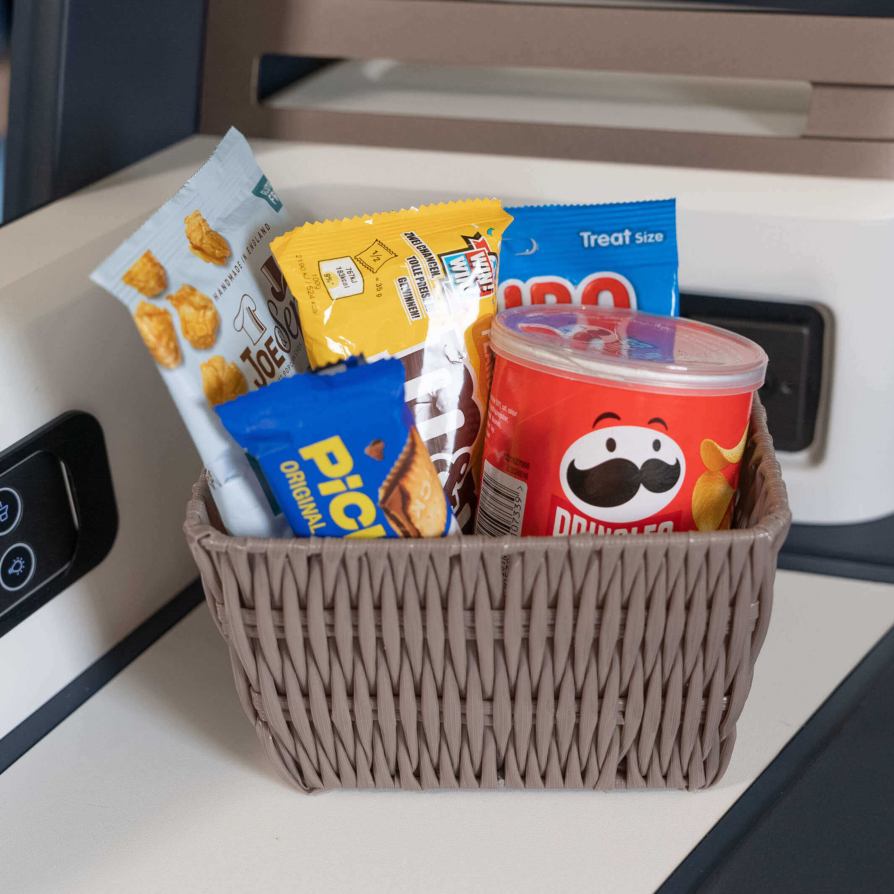
Prime
Seat
The Best Seat on the Plane
more comfort
more extras
more room
Comfortable pajamas included
Chat package
included
Larger bed and wider legroom
Even more space to stretch out
Cinema experience
Huge 24" monitor
with 4K picture quality
“Visitor” seat
With seatbelt
Snack basket included

Slide 13
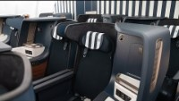
Our Fleet Airbus A330neo

Slide 14
Product: Lounge access in North America
ANC (Anchorage International Airport)
• Alaska Airlines Alaska Lounge: South Terminal
BWI (Baltimore/Washington Thurgood Marshall Airport)
• The Club BWI: Terminal D, after the security checkpoint
BOS (Logan Internationl)
•AF Located in Terminal E Inside Security.
LAS (McCarran International Airport)
• THE CLUB AT LAS: Terminal 3, past the security checkpoint
• The Club LAS: Concourse D (inside security)
JFK (John F. Kennedy International Airport)
• Lounge Horizon@T7: Upstairs after TSA Checkpoint
PHX (Phoenix Sky Harbor International Airport)
• Escape Lounge: Terminal 4, Gate B22
PDX (Portland International Airport)
• United Club Lounge: After the security control
SFO (San Francisco International Airport)
• China Airlines Lounge: Terminal 1, behind security, Level 4, near Gate A1
SEA (Seattle-Tacoma International Airport)
• Port of SEA Club International Lounge:
YYZ (Toronto Pearson International Airport)
• Plaza Premium Lounge: Terminal 3, Level 6, near Gate C32.
YYC (Calgary International Airport)
• Servisair Chinook Lounge: Departure Hall D
YEG (Edmonton International Airport)
• Plaza Premium Lounge: Near Gate 52
YVR (Vancouver International Airport)
• Plaza Premium Lounge
LAX
AF Lounge

Slide 15
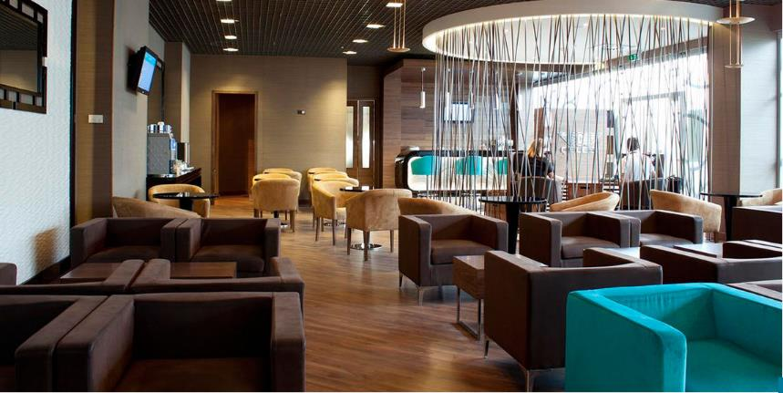
Lounge access in Germany
FRA
Lufthansa Business Lounge: Terminal 1, departure hall A, B (West & East), C
Luxx Lounge, Terminal 1, between departure hall B & C
MUC
Airport Lounge Europe & Airport Lounge World
HAM
Airport Lounge Airport Plaza (between T1 & T2)
DUS
Hugo Junkers Lounge, Terminal B
HAJ
Karl-Jatho Lounge, Terminal A-B

Slide 16



Sustainability
Part of our Mission
Our
Technology
Social
Responsibility
Integrated Sustainability
Long-Haul,
By mid-2024 up to:
20% less
CO2 emissions
Highest labor standards
for our employees.
Forgo super-short routes
that can be provided by other
modes of transportation.
60% less
noise pollution
#Equalopportunities
#Diversity
#Fairness
We support sustainable tourism initiatives to protect the environment and cultural heritage.
Short-Haul/Medium-Haul,
From 2024 up to:
20% less
CO2 emissions
50% less
noise pollution
We support
local communities.

Slide 17
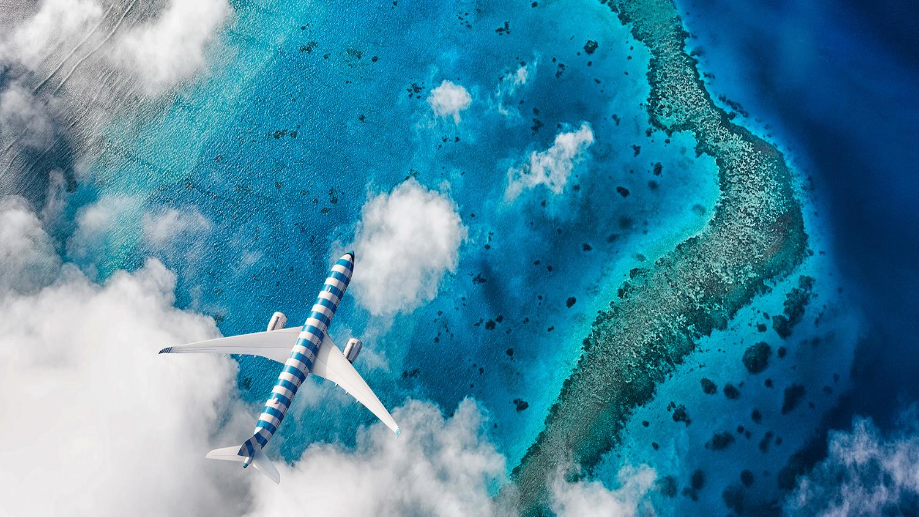
Our Flight Destinations
Get There with Condor
05

Slide 18
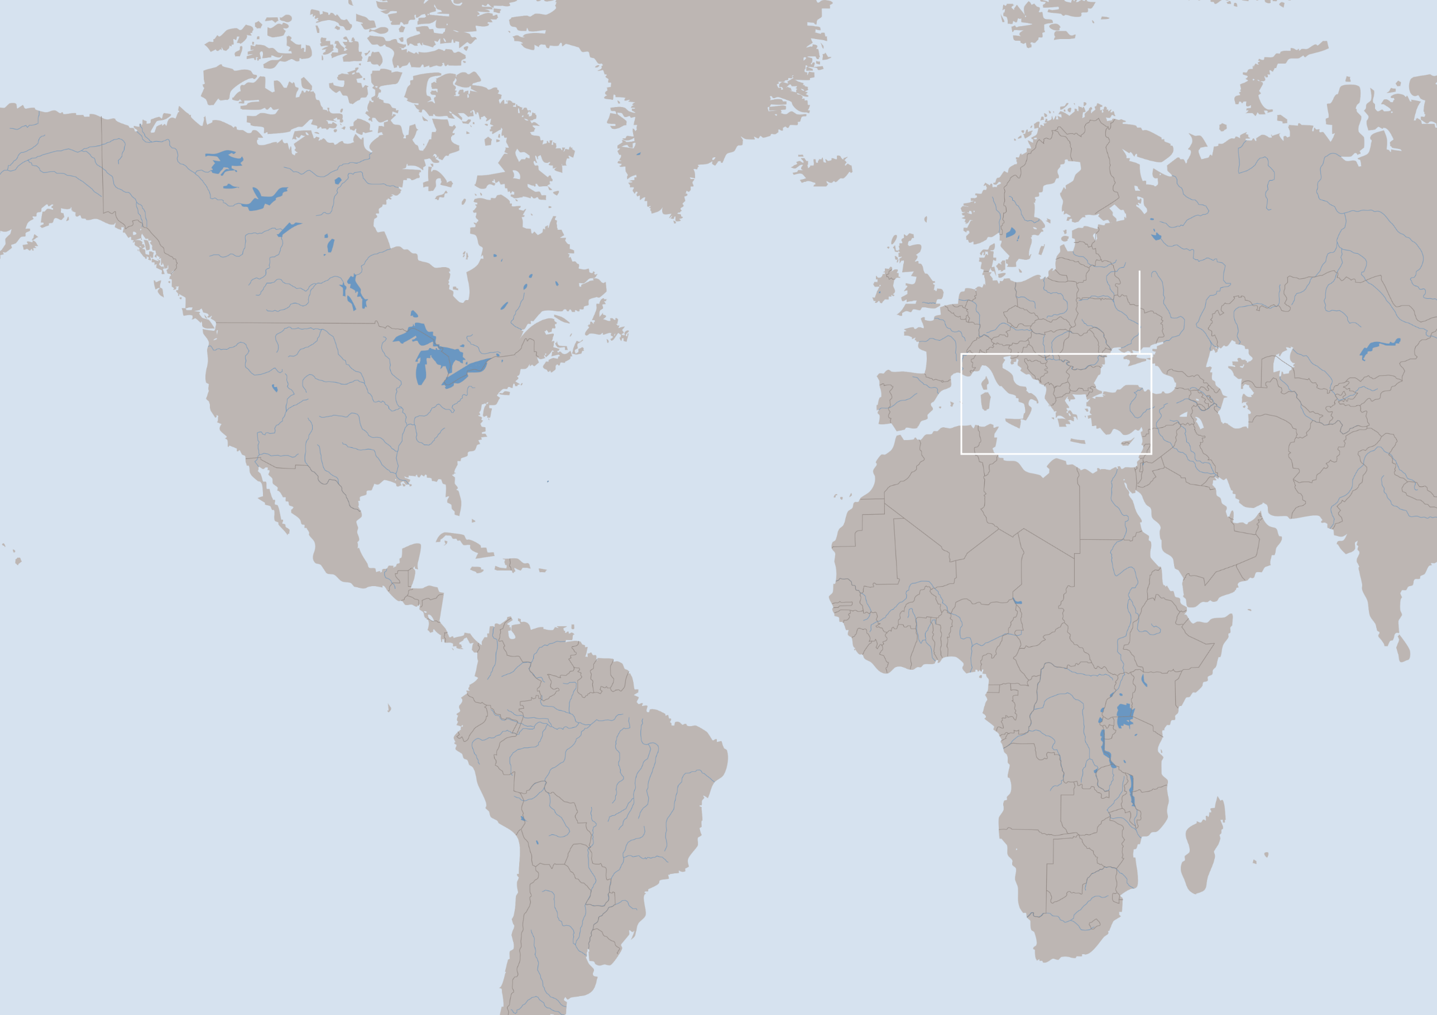
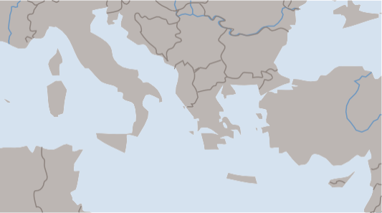
Gateways at a glance:
Top European destinations beyond FRA from North America
Florence
Brussels
Rome
Venice
Vienna
Nice
Hamburg
Prague
Budapest
Zagreb
Athens
Warsaw

Slide 19
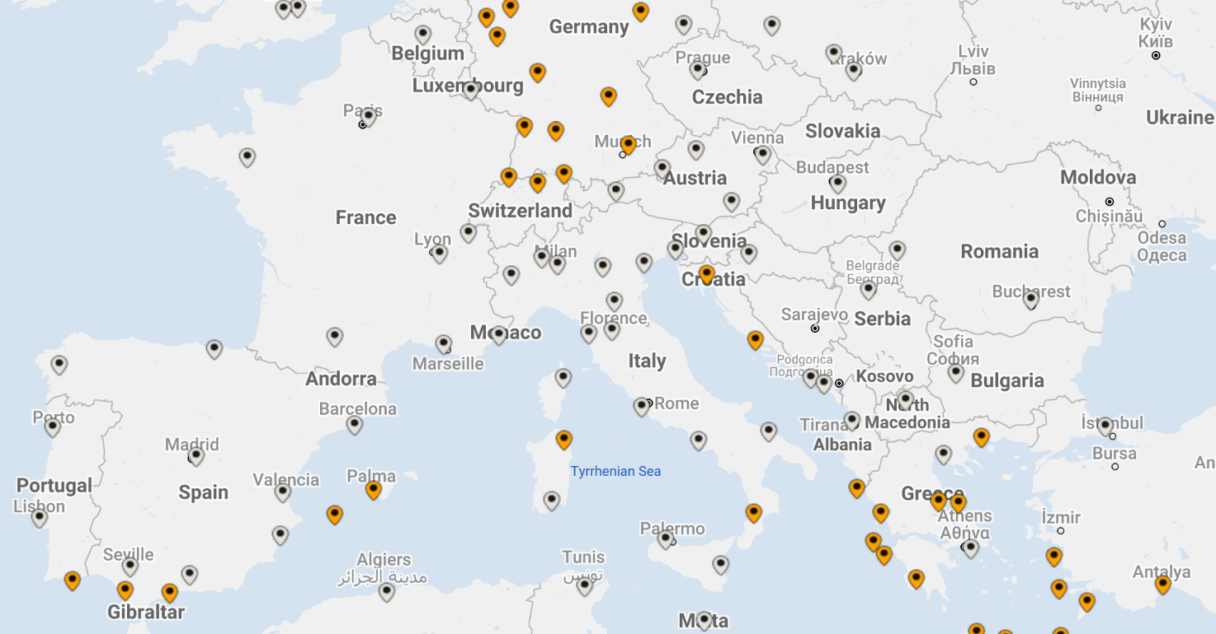
Fly beyond Frankfurt
Top examples:

Slide 20









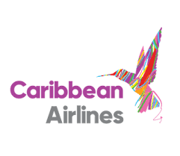













Our Interline Partners Worldwide/Partner Airlines

Slide 21
Pricing
Competitive Analysis – published prices pulled on February 2024

Slide 22
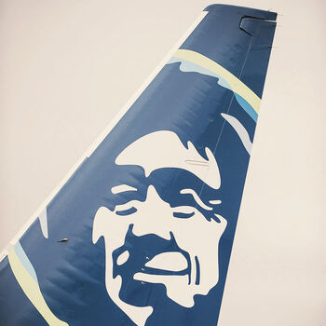
Loyalty program
Alaska Mileage Plan™
Earn miles with Alaska Mileage Plan™ whenever you fly with Condor or Alaska Airlines.
Earn Miles with Alaska Mileage Plan™
Earning miles was never that easy! As a member of the Alaska Mileage Plan™ you can earn miles on every Condor and Alaska Airlines flight.
Simply show your member card at check-in or provide your details during online check-in. The miles will be automatically credited to your account.

Slide 23

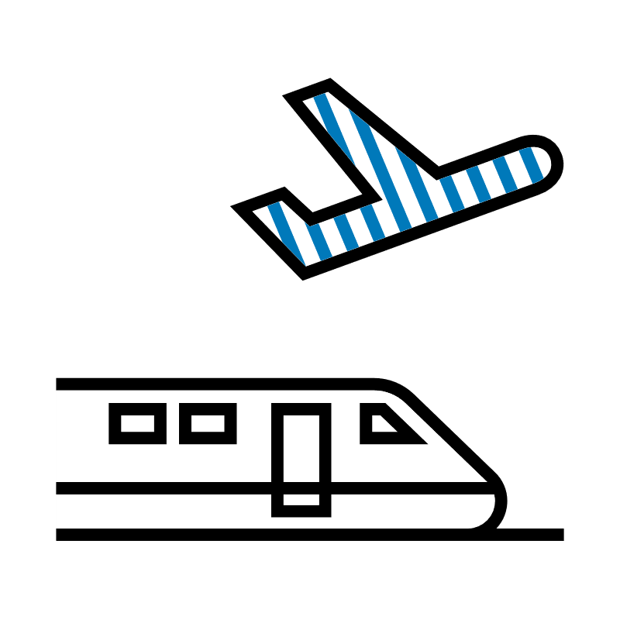

Affordable and Direct:
Get to the Airport
with Deutsche Bahn
Rail&Fly
Further
information
on the extranet
Bookable up to 3 hrs. before
departure.
Available for short, medium
and long-haul flights.
Entitles the holder to travel by train on the day of validity (departure date) +/- 1 day.

Slide 24
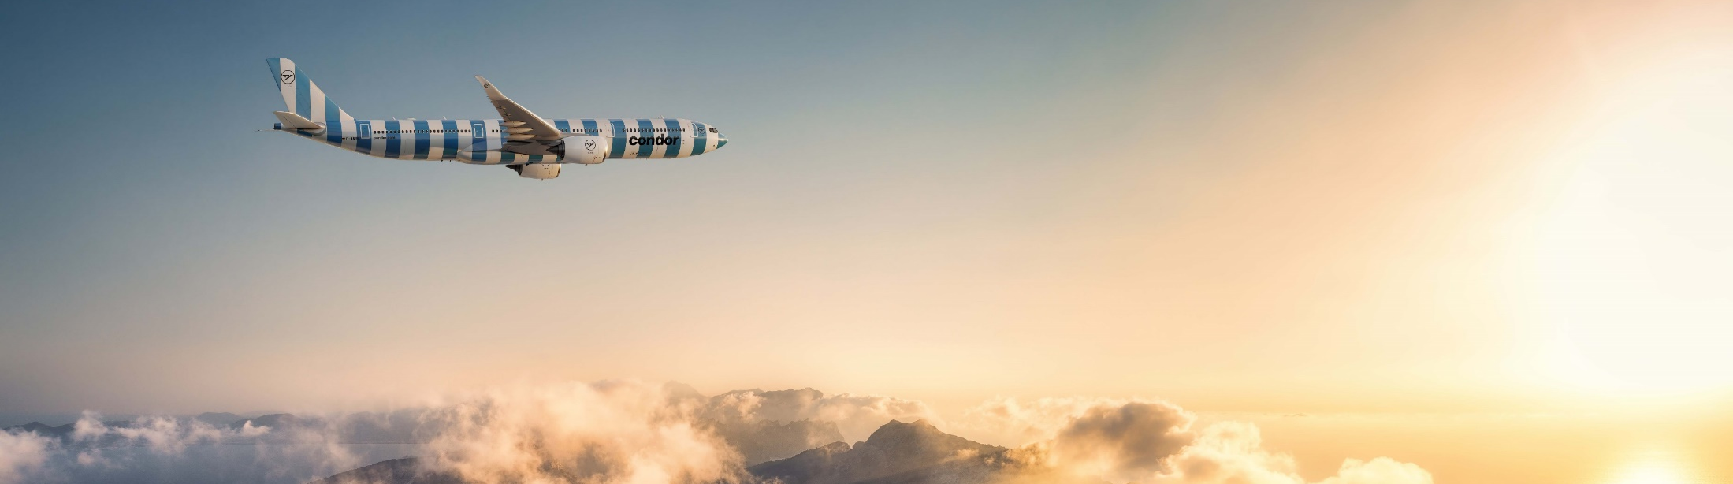
Travel agent support
USA: +I (800) 524-6975
Canada: +I (630) 467-8100
Groups: +1 (480) 443-5247
North America: gds-help@condor.com
Extranet: www.agent.condor.com

