Slide 1


Training Workshop

Slide 2
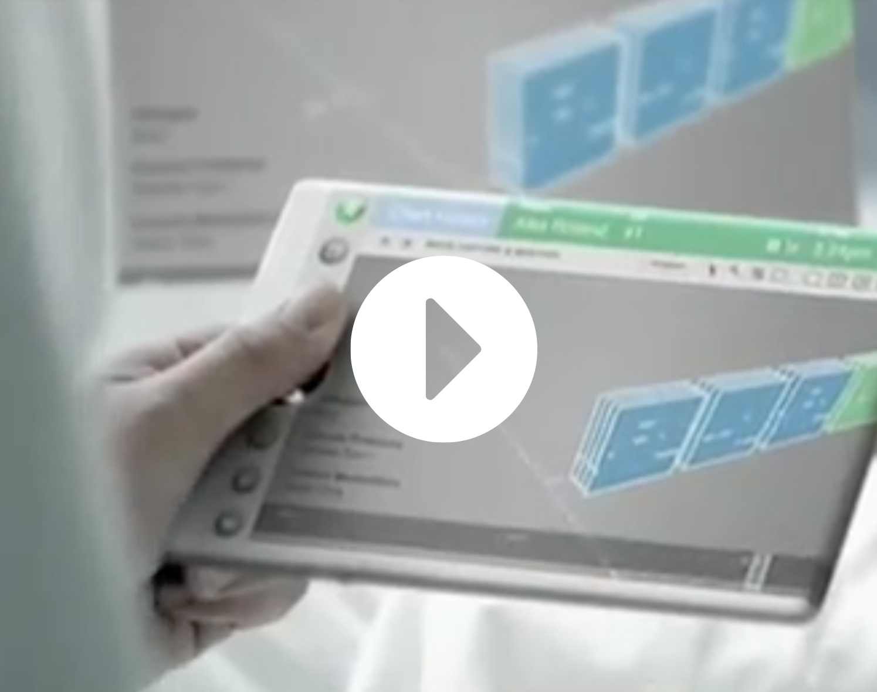

Slide 3
Understanding the Opportunity
SESSION 1

Slide 4
The healthcare sector is projected to create
45%, nearly half, of all new jobs between 2022 and 2032.¹
UNDERSTANDING THE OPPORTUNITY
17.6%
Percentage of the GDP related to healthcare spending in 2023²
1. US Bureau of Labor Statistics, 2. American Journal of Managed Care

Slide 5
Healthcare Occupational Growth
UNDERSTANDING THE OPPORTUNITY
14%
28%
Projected increase in healthcare occupations from 2018 to 2028.
Projected increase of medical and health services manager positions from 2022 to 2032.
US Bureau of Labor Statistics

Slide 6
$665.3B
expected healthcare market by 2028¹
UNDERSTANDING THE OPPORTUNITY
The US healthcare market is projected to experience significant growth in the coming years:
$
19.7
%
Projected health spending share of GDP by 2032 from 17.3% in 2022²
1. benchmarkintl.com/insights/2024-global-healthcare-medical-industry-report, 2. cms.gov/data-research/statistics-trends-and-reports/national-health-expenditure-data/nhe-fact-sheet

Slide 7




The total value of healthcare construction projects in Q3 2024 reached $646.9 billion.¹
UNDERSTANDING THE OPPORTUNITY
Acute Care Hospitals
Medical Office Buildings (MOBs)
Children’s Hospitals
34%
16%
26%
report planning a new or expanded hospital in the next three years.²
are planning MOB construction within the next three years.²
of survey respondents have plans for children’s hospital construction.²
1. globaldata.com/report/healthcare-construction-projects-market-analysis, 2. Health Facilities Management, 2023 Hospital Construction Survey

Slide 8

The healthcare furniture market is experiencing significant growth, with projections indicating:
UNDERSTANDING THE OPPORTUNITY
$
A market increase from
$9.8B in 2023 to
Some estimates suggest
the market could reach
Patient furniture leads applications, capturing over
$18.6B
IN 2033 AT A CAGR OF 6.6%¹
$34.16B
BY 2029²
46.7%
OF THE MARKET SHARE¹
1. market.us/report/healthcare-furniture-market, 2. mordorintelligence.com/industry-reports/medical-furniture-market

Slide 9
Long-Term Sales Potential
UNDERSTANDING THE OPPORTUNITY
An aging population will lead to an exponential increase in healthcare consumption.
100
80
60
AGE IN YEARS
40
20
0
2011
2016
2025
2050
YEAR

Slide 10
Technology Advancements
UNDERSTANDING THE OPPORTUNITY
86%
65%
of providers increased digital and IT budgets for 2024
of providers identified increasing efficiency as primary reason for IT investment
Guidehouse, 2024 Health System Digital & IT Investment Trends

Slide 11

Shaping The Future of Healthcare
UNDERSTANDING THE OPPORTUNITY
Increased Spending
Aging Population
The time is now for
JSI Health to challenge status quo and solve the unmet needs
in healthcare.
Huge Opportunity
Growing Workforce
Technology
Advancements

Slide 12
Planning For Success
SESSION 2

Slide 13
PLANNING FOR SUCCESS
Securing GPOs
Question
What is a GPO?

Slide 14



Group Purchasing Organization
PLANNING FOR SUCCESS
An entity that helps healthcare providers realize savings and efficiencies by aggregating purchasing volume and using that leverage to negotiate contracts/discounts with manufacturers, distributors, and other suppliers.
What is the value of the GPO to customers?
Access to competitive, aggregated pricing agreements across spend categories
Saves time and increases efficiencies while reducing overall total cost
Pre-negotiated (lowest price) contracts and compliance with bid requirements
Supplier rebates
Transparency into the contracted suppliers and their value proposition
Spend analytic and opportunity reports
Access to program, services, consulting, and solutions
Networking with other members and sharing of best practices
CUSTOMER
$ Purchases
product from...
$
Distributes a
portion of the
VENDOR
administrative fees to...
$ Pays administrative
fees to...
$
Uses a portion of the administrative fees to cover operating expenses and to finance other ventures
GPO
$
Uses a portion of administrative fees to fund additional services for customers

Slide 15
PLANNING FOR SUCCESS
Securing GPOs
Question
What percentage of hospital systems purchase through GPOs?

Slide 16

Health System GPOs
PLANNING FOR SUCCESS
97%
of hospital systems purchase through GPOs

Slide 17
PLANNING FOR SUCCESS
Healthcare Contracts
Question
What are JSI Health’s negotiated contracts?

Slide 18




JSI Health Established Contracts
PLANNING FOR SUCCESS
COMMERCIAL HEALTH
FED HEALTH
GPO
IDIQ (Indefinite Deliver Indefinite Quantity)
Cooperative
Indian Services Leverage GSA
Department of Defense Health Facilities

Slide 19
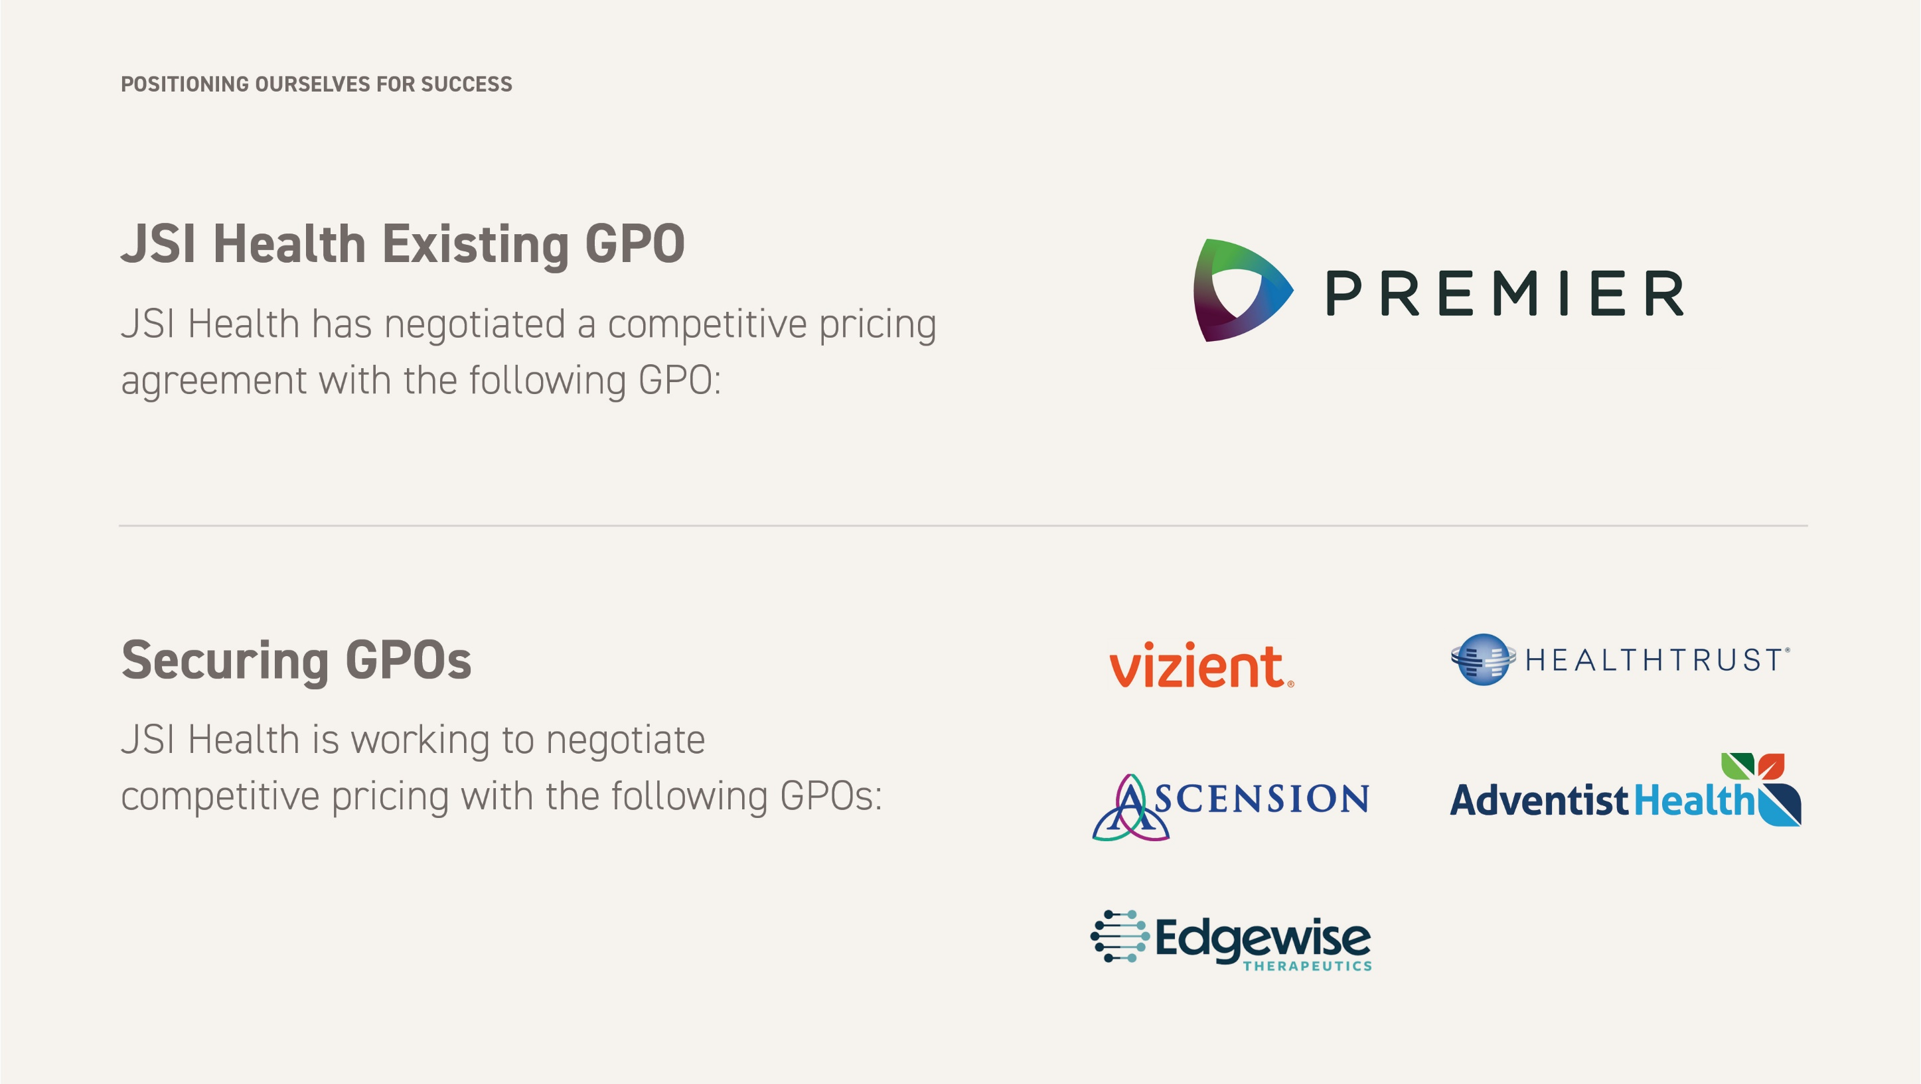






JSI Health Existing GPO
PLANNING FOR SUCCESS
JSI Health has negotiated a competitive pricing agreement with the following GPO:
Securing GPOs
JSI Health is working to negotiate competitive pricing with the following GPOs:

Slide 20

GPO Contract
PLANNING FOR SUCCESS
Contract: Premier Healthcare Alliance, L.P. | Contract #: PP-FA-2028 | Contract Abbreviation: PHCA | Contract Period: 1/1/2024 To 12/31/2026 (Eff. 3.25.25) | Applicable Price List: Zone 1 (1.6.2025)
 | END USER DISCOUNT | DEALER DISCOUNT | DEALER COMPENSATION | REP COMMISSION
TIER 1 TIER 2 TIER 3 | 56% = $1.00 to $499,999 list | 50/20/6.5 (62.6% Off) | 15% Commission of Net | 5% of Dealer Net
 | 57% = $500,000 to $750,000 list (or AHS -Academic Health System participation) | 50/20/7.5 (63.02% Off) | 14% Commission of Net | 5% of Dealer Net
 | 58% = $750,001 list plus | 50/20/8.7 (63.46% Off) | 13% Commission of Net | 5% of Dealer Net
Dealer Sales Incentive: 2% | Dealer Designer Incentive: 1%
Price Book:
Anthology 1.20.25

Slide 21
Premier Top 50 IDNs: Furniture & System Spend
PLANNING FOR SUCCESS
SYSTEM NAME | ANNUAL SALES VOLUME RANGE
Adventhealth | > $10,000,000
Advocate Health Supply Chain Alliance | > $10,000,000
Innovatix, LLC National Headquarters | > $10,000,000
Acurity FKA GNYHA Services, Inc. | > $10,000,000
Banner Health | $5,000,000 - $10,000,000
Baptist Healthcare System | $5,000,000 - $10,000,000
UHS Of Delaware, Inc. | $5,000,000 - $10,000,000
Alliant Holding, LLC | $5,000,000 - $10,000,000
CNECT | $3,000,000 - $5,000,000
OSF Healthcare System | $3,000,000 - $5,000,000
Healthpartners, Inc. | $3,000,000 - $5,000,000
Prisma Health | $3,000,000 - $5,000,000
Baptist Health South Florida | $3,000,000 - $5,000,000
West Virginia United Health System | $3,000,000 - $5,000,000
Harris County Hospital District | $3,000,000 - $5,000,000
Fairview Health Services | $3,000,000 - $5,000,000
Avera Health | $3,000,000 - $5,000,000
South Broward Hospital District | $3,000,000 - $5,000,000
Methodist Health System | $2,000,000 - $3,000,000
Premier, Inc. | $2,000,000 - $3,000,000
Bon Secours Mercy Health, Inc. | $2,000,000 - $3,000,000
UPMC Health System | $2,000,000 - $3,000,000
Champs Healthcare | $2,000,000 - $3,000,000
St Luke's University Health Network | $2,000,000 - $3,000,000
Texas Health Resources | $2,000,000 - $3,000,000
SYSTEM NAME | ANNUAL SALES VOLUME RANGE
Peacehealth | $2,000,000 - $3,000,000
Pandion Optimization Alliance | $2,000,000 - $3,000,000
Wakemed | $2,000,000 - $3,000,000
Woman's Hospital Foundation | $2,000,000 - $3,000,000
Acadia Management Company LLC | $2,000,000 - $3,000,000
H. Lee Moffitt Hospital Center | $2,000,000 - $3,000,000
The Moses H Cone Memorial Hospital - Parent | $2,000,000 - $3,000,000
Yankee Alliance | $2,000,000 - $3,000,000
Capstone Health Alliance | $1,000,000 - $2,000,000
Mclaren Health Care | $1,000,000 - $2,000,000
Henry Ford Health System | $1,000,000 - $2,000,000
University Hospitals Health System, Inc. | $1,000,000 - $2,000,000
Omnia Partners | $1,000,000 - $2,000,000
Health First Shared Services, Inc | $1,000,000 - $2,000,000
Unitypoint Health | $1,000,000 - $2,000,000
Health Resource Services | $1,000,000 - $2,000,000
University Health System | $1,000,000 - $2,000,000
Riverside Health System | $1,000,000 - $2,000,000
Tjuh System | $1,000,000 - $2,000,000
Saint Francis Hospital, Inc. | $1,000,000 - $2,000,000
Hospital Shared Services Association | $1,000,000 - $2,000,000
Nemours Foundation | $1,000,000 - $2,000,000
Honorhealth | $1,000,000 - $2,000,000
Norton Healthcare, Inc. | $1,000,000 - $2,000,000
Carilion Clinic | $1,000,000 - $2,000,000

Slide 22
JSI Health Workshop
Leveraging all aspects of a GPO contract. Successfully nurturing a large GPO opportunity.
PLANNING FOR SUCCESS
Facilities
Design
Construction
Personas

Slide 23
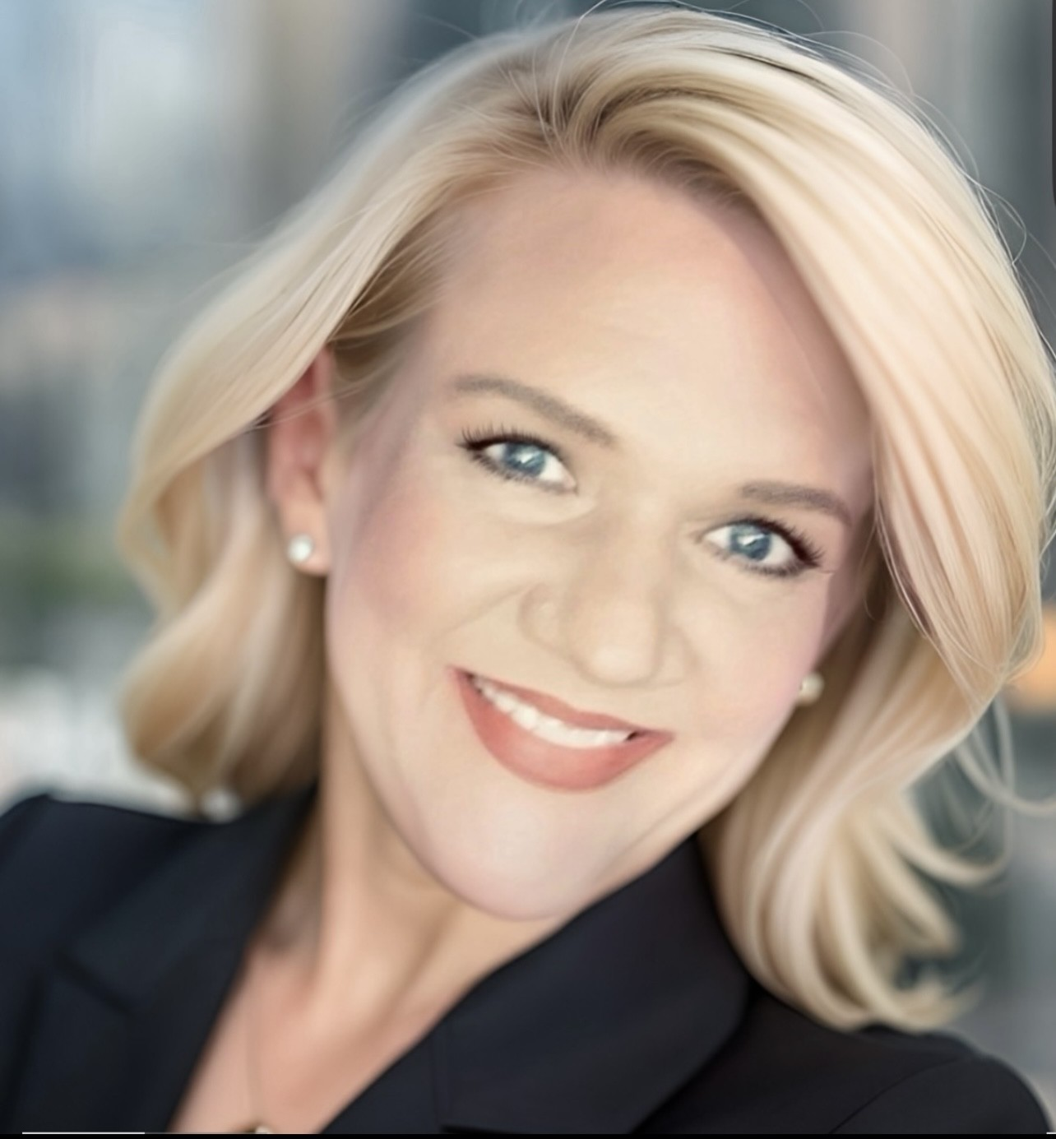




Premier Facilities, Construction, & EVS Engagement Team
PLANNING FOR SUCCESS
Micki Hammond
Director Central
micki_hammond@premierinc.com
704-361-0802
Corey Jackson
FC& E Team Manager
Director NE & Acurity
corey_jackson@premierinc.com
610-675-7601
Tim Elder
Director Mid-Atlantic/South
Timothy_Elder@premierinc.com
248-342-7245
Mark Olenski
Director UHS
mark_olenski@premierinc.com
215-962-0662
OPEN
Director West /
Southwest
Jason Ferri
Vice President - Portfolio Advisors
jason_ferri@premierinc.com
610-906-7337

Slide 24
Premier CoC Channel Partners Throughout the U.S.
PLANNING FOR SUCCESS
Banner Health (AZ)
IPC Group Purchasing (IL)
OSF (IL)
PeaceHealth (WA)
St. Luke’s (PA)
Sinai Health (IL)
BAILEY SESSA
Avera PACE (SD)
Advent Health (FL)
FPN (MN)
HPC (MN)
THR/OnHand (TX)
DAVID GOODEN
Health Enterprises Cooperative (IA)
Prairie Health Ventures (NE)
ShareSource (MD)
Savvik (MN)
UISS (NY)
Yankee Alliance (MA)
DREW IRELAND
ED
KURLEY
Beacon Purchasing (CA)
Omnia Partners (TN)
Team Four (MD)
KATIE HOFFMAN
Capstone (NC)
CHAMPS (OH)
HRS (WA)
Alliant (KY)
CNECT (CA)
HPS (GA)
Pandion (NY)
TROY CANEER

Slide 25
PLANNING FOR SUCCESS
Working Together To Secure GPOs: Advantus Example
Advantus Parent Organization Name | # of AHP Members | Region / Headquarters
Bon Secours Mercy Health | 1180 | Cincinnati, Ohio
Roper St. Francis Healthcare | 156 | Charleston, South Carolina
U.S. Physical Therapy, Inc. | 287 | Houston, Texas
Nationwide Children’s Hospital Toledo, LLC | 31 | Toledo, Ohio
Alliant Purchasing, LLC | 15 | Louisville, Kentucky
Compass Surgical Partners | 2 | Raleigh, North Carolina
Delta Health System | 2 | Greenville, Mississippi
Greater Dayton Area Hospital Association | 1 | Dayton, Ohio

Slide 26
PLANNING FOR SUCCESS
GPO Primary Affiliations
HEALTH SYSTEM | GPO AFFILIATION(S)
HCA Healthcare | Health Trust Performance Group (owned by HCA)
CommonSpirit Health | Premier Inc.
Ascension Health | The Resource Group (Ascension’s own GPO)
Providence St. Joseph Health | Vizient
Tenet Healthcare | Conducts in-house purchasing: collaborates with various GPOs for specific needs
Trinity Health | Health Trust Performance Group
University of Pittsburgh Medical Center | Conducts in-house purchasing collaborates with various GPOs for specific needs
AdventHealth | Conducts in-house purchasing collaborates with various GPOs for specific needs
Cleveland Clinic Health System | Conducts in-house purchasing collaborates with various GPOs for specific needs
Mayo Clinic Health System | Conducts in-house purchasing collaborates with various GPOs for specific needs
Mass General Brigham | Conducts in-house purchasing collaborates with various GPOs for specific needs
Intermountain Health | Vizient (following the sale of its Intalere GPO to Vizient in 2020)
Kaiser Permanente | Conducts in-house purchasing: collaborates with various GPOs for specific needs
Baylor Scott & White Health | Conducts in-house purchasing: collaborates with various GPOs for specific needs
Northwell Health | Conducts in-house purchasing: collaborates with various GPOs for specific needs
NYC Health + Hospitals | Conducts in-house purchasing: collaborates with various GPOs for specific needs
Community Health Systems | Conducts in-house purchasing: collaborates with various GPOs for specific needs
LifePoint Health | Conducts in-house purchasing: collaborates with various GPOs for specific needs
Henry Ford Health | Conducts in-house purchasing: collaborates with various GPOs for specific needs
Advocate Health | Advocate Health Supply Chain Alliance
Understanding and
Navigating GPOs
It’s important to note that while many health systems have primary GPO affiliations, they also engage with multiple GPOs or manage certain procurement functions internally to best meet their specific needs. Additionally, the landscape of GPO affiliations evolves due to mergers, acquisitions, and strategic
shifts within health systems.

Slide 27
Top 30 Vizient Health Systems
PLANNING FOR SUCCESS
RANK | COMPANY | SUM OF VOL.
1 | Kaiser Permanente | 63,776,446.17
2 | University of Texas System | 42,151,673.58
3 | St. Jude Children’s Research Hospital, Inc | 31,601,102.76
4 | UNA Purchasing | 28,028,443.85
5 | Baylor Scott & White Health | 19,935,866.69
6 | The Ohio State University Health System | 19,407,692.88
7 | Summit Health Management | 18,319,950.27
8 | Intermountain Health | 18,257,698.79
9 | PurNet, Inc. | 18,069,642.75
10 | Northside Hospital, Inc. | 18,044,402.56
RANK | COMPANY | SUM OF VOL.
11 | Houston Methodist | 18,040,734.55
12 | Children’s Hospital of Philadelphia | 17,065,497.65
13 | Mayo Clinic | 16,784,702.73
14 | Efficient Cost Containment Organization | 15,893,426.14
15 | Corewell Health | 15,267,135.11
16 | University of Colorado Health | 14,738,922.57
17 | Emory Healthcare | 14,207,202.71
18 | Indiana University Health | 13,413,305.01
19 | Ochsner Clinic Foundation | 13,152,876.17
20 | Providence | 12,803,627.42
RANK | COMPANY | SUM OF VOL.
21 | Texas Children’s Hospital | 12,101,339.52
22 | Regents of University of California | 11,376,794.19
23 | UNC Health Care Sytem | 11,244,060.05
24 | Memorial Sloan Kettering Cancer Center | 11,209,812.82
25 | Encompass Health Corporation | 10,757,673.35
26 | Memorial Hermann Health System | 10,342,009.30
27 | Cleveland Clinic | 10,021,387.44
28 | United Healthcare Services, Inc. | 9,749,765.90
29 | Sanford | 9,714,485.96
30 | SSM Healthcare | 9,637,169.04

Slide 28


State Municipality & Education
PLANNING FOR SUCCESS
JSI Health has a competitive pricing agreement with OMNIA Partners, a leading (1.2 Trillion) cooperative serving both public and private sectors. OMNIA leverages collective buying power to provide pre-negotiated supplier contracts, delivering cost savings through economies of scale. They specialize in procurement and supply chain management.
K-12 Education
Higher Education
Government
Non-Profit
Enterprise
Corporate

Slide 29

Cooperative
PLANNING FOR SUCCESS
Contract: OMNIA Partners | Contract #: R240107 | Contract Abbreviation: OMNIA | Contract Period: 12/17/2024 to 12/31/2027 (Eff: 2.3.2025) | Applicable Price List: Zone 1 (1.20.2025)
 | END USER DISCOUNT | DEALER DISCOUNT | DEALER COMPENSATION | REP COMMISSION
TIER 1 TIER 2 TIER 3 | 54% off list for Dock Delivery (direct shipment) | 50/20/2.5 (60.9%) | 15% Dock Delivery | 4.6% of Dealer Net
 | 53% off list for Inside Delivery (by servicing dealer) | 50/20/2.475 (61%) | 17% Inside Delivery | 4.6% of Dealer Net
 | 52% off list for Delivered & Installed | 50/20/1.6 (60.6%) | 18% Delivered & Installed | 4.6% of Dealer Net
Dealer Sales Incentive: 3% | Dealer Designer Incentive: 1%
Price Book:
Anthology 1.20.25
**Added services can be above what is listed above**

Slide 30
PLANNING FOR SUCCESS
Healthcare Contracts
Question
How is Federal Health different from a GPO?

Slide 31






Department of Veteran Affairs
PLANNING FOR SUCCESS
The VA is responsible for administering benefit programs for veterans, their families, and their survivors.
FEDERAL HEALTH
FEDERAL HEALTH

Slide 32
What is the VHA IDIQ?
PLANNING FOR SUCCESS
JSI participates with partners on the VA IDIQ Contract as an approved manufacturer.
IDIQ
Indefinite Quantity
of Services
Fixed
Time Period

Slide 33

The Opportunity
PLANNING FOR SUCCESS
The majority of business (+75%) with the VA is processed through the IDIQ Contract.
IDIQ SDVOSB Awardees:
JPL & Associates, LLC
SDV Office Systems, LLC
Veterans Office Design, LLC
Coronado Distribution, LLC
JohnsonDanforth, Inc.
Russell Group United, LLC
GovSolutions, Inc.
A. Pomerantz & Co.
Cuna Supply, LLC
$150M
*SDVOSB is a service-disabled veteran-owned small business that is 51% unconditionally owned and controlled by service-disabled veterans.
*Not aligned with JSI

Slide 34


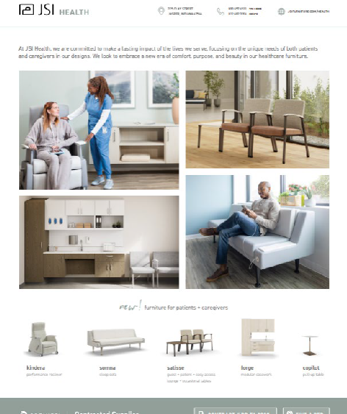
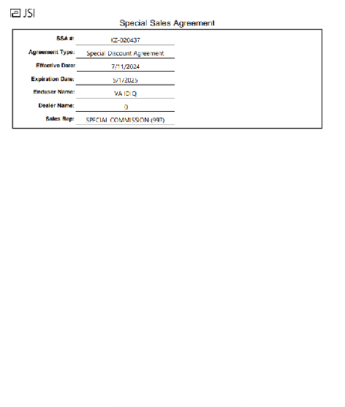
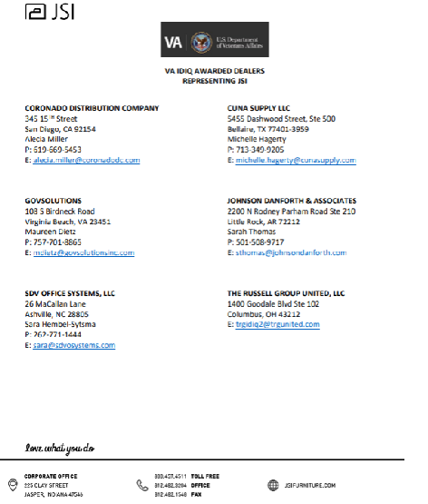
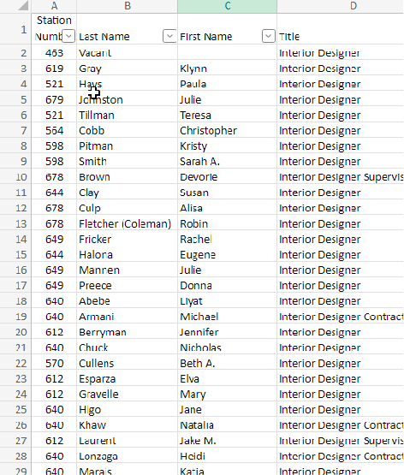
VA Tool Box
PLANNING FOR SUCCESS
Brochures with MTR Codes
Contract Support Info
Price Lists for MTR Series
Technical Support Documents
VA Designers List

Slide 35
Federal Health vs. GPO
PLANNING FOR SUCCESS
Federal Health agencies primarily use government contracts like GSA Schedules and the IDIQ Contract for furniture procurement. Unlike GPOs, which leverage the power of large buying volume to negotiate contractual discounts for their members.
80%
Nearly 80% of Federal Health furniture purchases occur through contracted suppliers or GSA Schedules, rather than buying directly from manufacturers.

Slide 36

Federal Health
PLANNING FOR SUCCESS
JSI Health has negotiated competitive pricing agreements with the following Federal Health organizations:

Slide 37

Federal Contract
PLANNING FOR SUCCESS
Contract: VA – IDIQ | Contract #: IDIQ SBVSOB Partner SSA# KZ-020437 | Contract Abbreviation: VAIDIQ | Contract Period: 11/1/2018 to 10/31/2025 with option period to 10/31/28.
END USER DISCOUNT | DEALER DISCOUNT | DEALER COMPENSATION | REP COMMISSION
62% | 50/10/26.5 | 13% payable to Contract Holder if no outside specifications or assistance by a local dealer OR 10% payable to the specifying dealer when validated by contract holder and SSA# KZ-020437 AND 3% payable to the purchasing contract holder | 4.74% (calculated on overall 62/13 and commission rate based on 64% sell) If the project was specified by a local dealer the rep commission will be split 70/30. 70% to specified territory and 30% to VA Contract holder territory.
No added incentives

Slide 38

GSA Contract
PLANNING FOR SUCCESS
Contract Number: GS-28F-0030U
Contract Period: June 24, 2013 - June 24, 2028
SINS: 33712, 33721, 339113H, and OLM
NAICS: 337214
FSC/PSC Code: 7110
DUNS #: 00-636-7767
SAMS Registration:
Jasper Seating Company, Inc. is registered
Cage Code #31881
Federal ID #35-0420370 UEI #DDJ2GKQM7M84
Discounts
Product Lines | List Price | Discount
All Product Lines* | $1.00 to $651,042 | 61.6%
Walden & Wellington | $1.00 to $652,912 | 61.71%
Product Lines | Net Price | Discount Quantity
Walden & Wellington | $300,000 to $350,000 | 0.5%
 | $350,001 to $400,000 | 1%
 | $400,001 to $450,000 | 1.5%

Slide 39
PLANNING FOR SUCCESS
Healthcare Product Solutions
Question
How do you currently position JSI Health’s product offering?

Slide 40
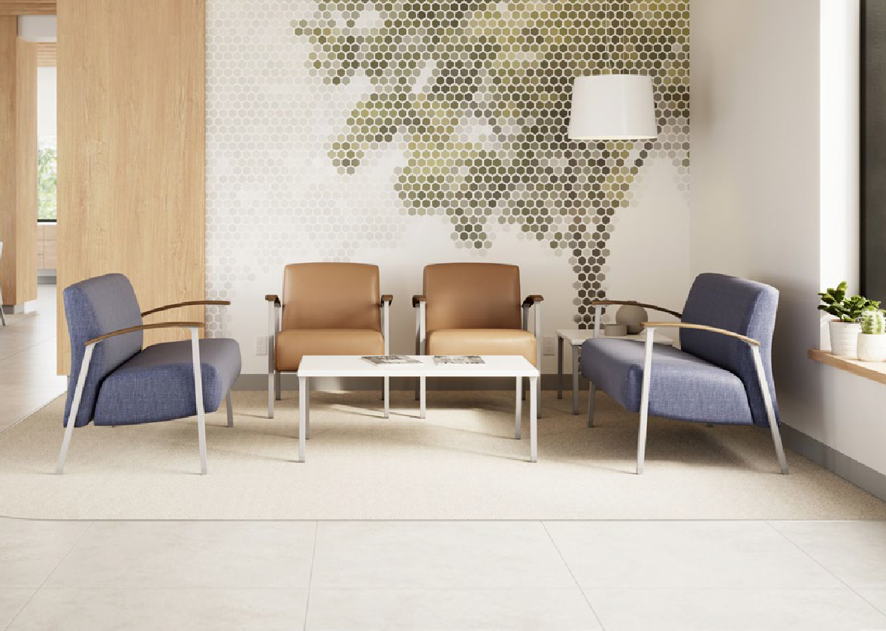

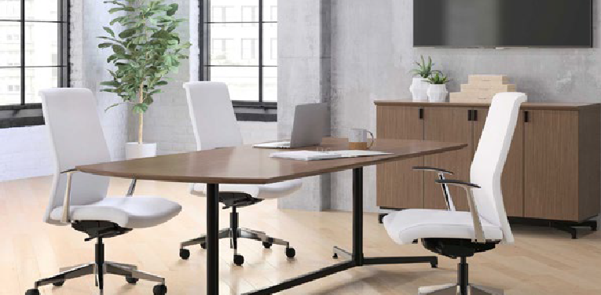
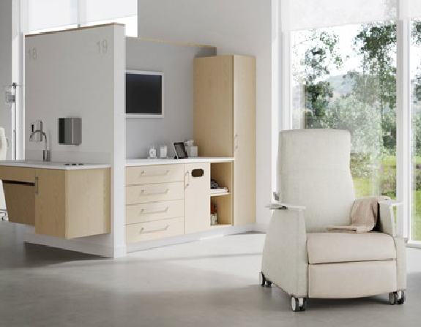
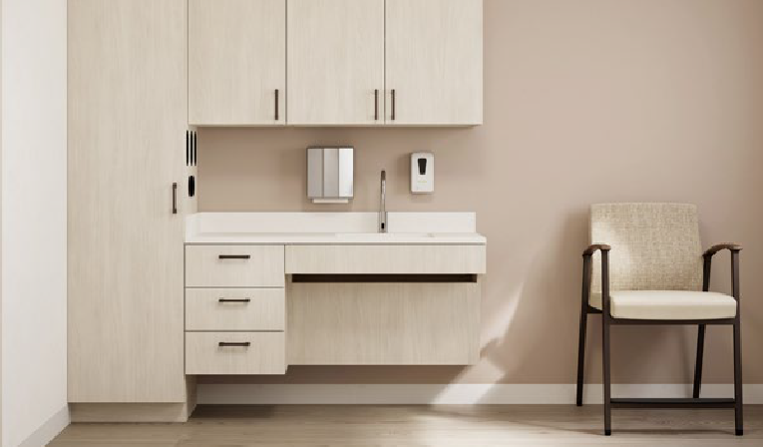
Research-Informed Design
PLANNING FOR SUCCESS
JSI integrates research, testing, and collaborative insights from patients, caregivers, and specifiers to develop innovative, purposeful solutions that address unique challenges and drive optimal outcomes.

Slide 41

Research-Informed Design
PLANNING FOR SUCCESS
Where We Started...
Collaborated with industry leader Mike Shields to develop human-centered products.
Engaged top A+D healthcare designers across key markets for input.
Conducted field research with industry experts in 10 regions.
Established design forums to collect valuable insights.
Performed field application research and testing.

Slide 42













PLANNING FOR SUCCESS
Holistic Integration
Designed to support every caregiver need and patient encounter, our furnishing solutions foster meaningful engagement and enhance care throughout an entire facility.
COMMUNITY SPACES
Lobby + Welcoming Cafe + Dining
PATIENT SPACES
Patient Room
Exam Room Treatment Area
CAREGIVER SPACES
Work Area
Private Office
Respite
Consultation
ADMINISTRATIVE SPACES
Workspace
Nourishment + Respite
Meeting
Learning

Slide 43
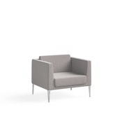
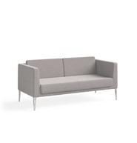
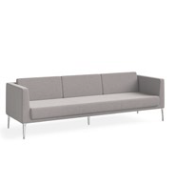




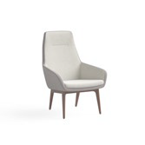
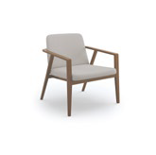
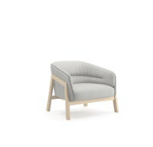
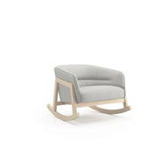
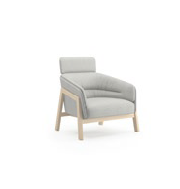
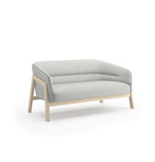
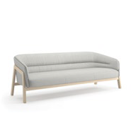
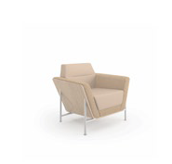
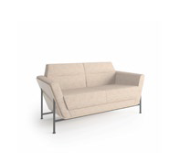
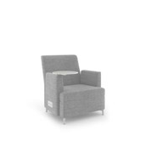






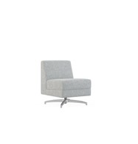
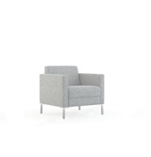
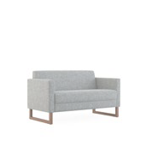
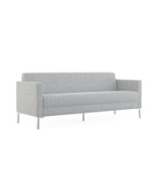
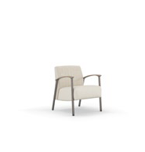
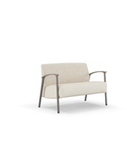
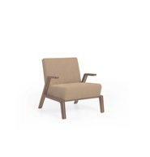
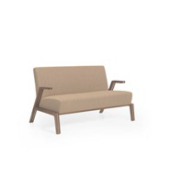
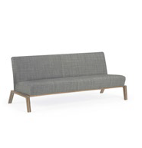
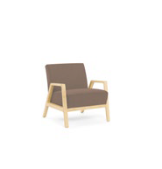
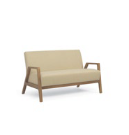
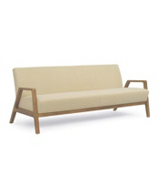

JSI Health Integrated Portfolio
PLANNING FOR SUCCESS
LOUNGE SEATING
Arwyn Lounge Chair
Arwyn Crossover Lounge Chair
Arwyn Loveseat
Arwyn Sofa
Cāav Lounge Chair
Cāav Loveseat
Cāav Sofa
Moto
Bourne Lounge
Indie Lounge Chair
Indie Lounge Rocker
Indie Lounge Chair
Indie Loveseat
Indie Sofa
BeSPACE Lounge Chair
BeSPACE Sofa
Ziva Lounge Chair
Ziva Sofa
Poet Lounge Chair
Poet Lounge Chair
Poet Sofa
Poet Sofa
Poet Sofa
Teekan Lounge Chair
Teekan Lounge Chair
Teekan Loveseat
Teekan Sofa
Satisse Lounge Chair
Satisse Sofa
Connect Lounge Chair
Finn Lounge Chair
Finn Loveseat
Finn Sofa
Finn Nu Lounge Chair
Finn Nu Loveseat
Finn Nu Sofa

Slide 44



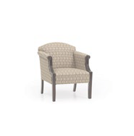
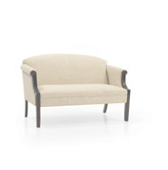

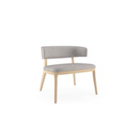


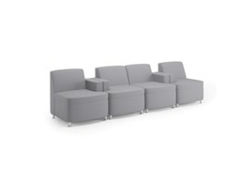

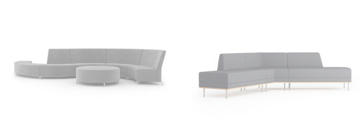
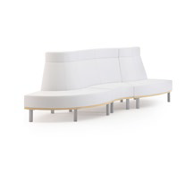
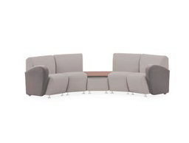


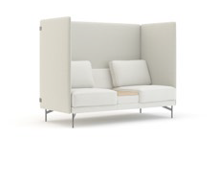
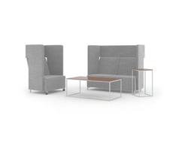
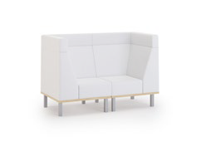
JSI Health Integrated Portfolio
PLANNING FOR SUCCESS
LOUNGE SEATING
Jude Lounge Chair | Encore Lounge Chair | Encore Loveseat | Encore Sofa | Harbor Lounge Chair | Harbor Loveseat | Harbor Sofa | Collective Motion Lounge
MODULAR LOUNGE Cāav Modular Lounge | Moto Modular Lounge |  | Poet Modular Lounge | Ziva Modular Lounge | BeSPACE Modular Lounge |  | Connect Modular Lounge | Encore Modular Lounge
PRIVACY LOUNGE
Cāav Privacy Lounge
Moto Privacy Lounge
Poet Privacy Lounge
Ziva Privacy Lounge
Connect Privacy Lounge

Slide 45
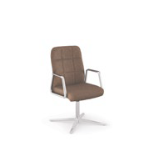
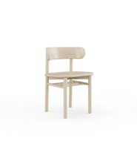
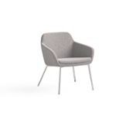
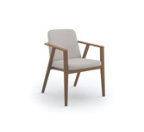






















JSI Health Integrated Portfolio
PLANNING FOR SUCCESS
GUEST SEATING
Arwyn Guest
Bourne Guest
Cosgrove Guest
Henley Guest
Knox Guest
Ramona Guest
Ria Guest
Gatsby Guest
Sosa Guest
Satisse Guest
Satisse 2-Seat Guest
Hoopz Stacking
Trinity Guest
Wink Guest
Jude Guest
Bryn Guest
Millie Guest
Avini Guest
Boston Guest
Collective Motion Guest
Harbor Guest
Madison Guest
Addison Guest
Americana Guest
Mackey Guest
Class Act Guest

Slide 46





















JSI Health Integrated Portfolio
PLANNING FOR SUCCESS
STOOLS
Ansen Stool
Bourne Stool
Byrn Stool
Hoopz Stool
Jude Stool
Kyla Stool
Mackey Stool
Avini Stool
Americana Stool
Wink Stool
Indie Stool
Knox Stool
Millie Stool
Addison Stool
BARIATRIC GUEST
TANDEM GUEST
EASY ACCESS + HIP
coming soon
Knox Bariatric
Satisse Bariatric
Gatsby Bariatric
Knox Tandem
Satisse Tandem
Gatsby Tandem
Knox
Satisse Easy Acess

Slide 47



























JSI Health Integrated Portfolio
PLANNING FOR SUCCESS
CONFERENCE + TASK
SIT-TO-STAND
Arwyn Conference
Cosgrove Conference
Proxy Conference
Garvey R5 Conference
Knox Conference
Newton Conference
Proxy Stool
Boston Conference
Madison Conference
Protocol Conference
Harbor Conference
Americana Conference
BENCHES + PODS + POUFS
Indie Bench
Native Bench
Oxley Bench
Poet Bench
Ziva Bench
Arwyn Bench
BeSPACE Bench
Finn Bench
Finn Nu Bench
Indie Pouf
Indie Pod
BeSPACE Pod
Collective Motion Pod
Totem Pod
Moto Bench

Slide 48



















JSI Health Integrated Portfolio
PLANNING FOR SUCCESS
HEALTHCARE-DESIGNED SEATING
Kindera Recliner
Somna Sleeper Sofa
Satisse Patient Chair
Satisse Easy Access
CASEGOODS + STORAGE + ARCHITECTURAL SOLUTIONS
Flux Casegoods
Vision Casegoods
Native Casegoods
Brogran Casegoods
Moto Casegoods
Wellington Casegoods
BeSPACE Casegoods
Walden Casegoods
Lok Casegoods
Bourne Casegoods
Connect Casegoods
Finale Casegoods
Flux Lockers
Forge Casegoods
Reef Casegoods

Slide 49
















JSI Health Integrated Portfolio
PLANNING FOR SUCCESS
ACCESSORIES + ANCILLARY
MEDIA WALLS
Indie Accessories
Lok Accessories
Native Boards
Native Accessories
Pillows
Cāav Accessories
Native Waste / Recyle
Native
Moto
HEIGHT-ADJUSTABLE TABLES
HOSPITALITY CARTS
Flux Private Offce Height-Adjustable
Native Height-Adjustable
Copilot Height-Adjustable
Vision Height-Adjustable
Lok Height-Adjustable
Brogan Height-Adjustable
Native
Finale Height-Adjustable

Slide 50






























JSI Health Integrated Portfolio
PLANNING FOR SUCCESS
OCCASIONAL TABLES
TRAINING TABLES
Moto Table
Nosh Table
Poet Table
Romy Table
Arwyn Table
Satisse Table
Knox Table
Lok Training Table
Trail Table
Ziva Table
Lincoln Tables
Connect Table
Encore Table
Finn Table
Finn Nu Table
Lok Lounge Table
Walden Table
Traditional Tables
Copilot Table
Indie Table
BeSPACE Table
Prost Table
CONFERENCE TABLES
Lok Conference Table
Flux Private Office Table
Native Table
Wellington Table
Vision Table
Finale Table
Anthology Tables
Brogan Table

Slide 51
PLANNING FOR SUCCESS
Custom Craftsmanship
Question
What percentage of healthcare projects require product customization?

Slide 52

Custom Craftsmanship
PLANNING FOR SUCCESS
NEARLY
80%
of all healthcare projects require some level of furniture customization.

Slide 53
Custom Craftsmanship
PLANNING FOR SUCCESS
The Value of Being a Maker
Brand Alignment
Healthcare organizations and A+D want to fully realize their brand vision and desired efficiencies.
Competitive Advantage
Most full-line competitors choose not to compete in this arena, opening the door for JSI Health.
Build A+D Relationship
Creates opportunities to highlight our manufacturing expertise, build trust, and deepen A+D connections.

Slide 54
POSITIONING OURSELVES FOR SUCCESS
Framework for Success
Question
How can JSI Health support your local sales efforts?

Slide 55








PLANNING FOR SUCCESS
Surround The Opportunity
Establish
Strategic Partners
Build
Institution Alliances
Develop
A+D Relationships
Grow
New Market Opportunities

Slide 56
JSI Health’s Commitment
PLANNING FOR SUCCESS
Building National Relationships
Strategic Health Accounts
Build relationships with National Healthcare organizations to drive valued on their desired efficiencies.
Relationships with Alliances
Build deeper relationships with current GPOs and foster new relationships with upcoming GPOs.
National A+D Relationships
Build relationships with key A+ Firms to highlight our expertise, build trust, and deepen A+D connections.

Slide 57
Top 25 Health Systems
PLANNING FOR SUCCESS
RANK | SYSTEM | REVENUE
1 | HCA Healthcare (Hospital Corporation of America) | $51,384,221,832
2 | CommonSpirit Health | $30,619,819,853
3 | Ascension Health | $22,299,893,095
4 | Kaiser Permanente | $22,109,572,373
5 | Trinity Health (CHE Trinity Health) | $21,373,343,612
6 | Advocate Health | $20,146,366,247
7 | University of California Health (UC Health-CA) | $19,321,094,207
8 | Providence St. Joseph Health (Providence) | $17,607,865,714
9 | Dignity Health | $14,967,486,129
10 | AdventHealth (FKA Adventist Health System) | $13,383,421,372
11 | Tenet Healthcare | $12,818,577,941
12 | Kaiser Permanente Northern California | $12,088,937,583
13 | Cleveland Clinic Health System | $11,712,463,759
RANK | SYSTEM | REVENUE
14 | Northwell Health (North Shore Long Island Jewish Health System) | $10,920,269,929
15 | Community Health Systems (CHS) | $10,660,441,725
16 | Universal Health Services | $10,428,923,269
17 | St. Lukes University Health Network | $10,354,167,683
18 | Mass General Brigham (Partners HealthCare) | $10,243,196,913
19 | NewYork-Presbyterian Healthcare System | $10,228,262,503
20 | University of Pittsburgh Medical Center (UPMC) | $10,137,426,933
21 | Banner Health | $10,054,203,618
22 | Stanford Medicine | $9,621,542,663
23 | Baylor Scott & White Health | $9,537,700,608
24 | Mayo Clinic | $9,377,911,804
25 | Kaiser Permanente Southern California | $9,279,357,000

Slide 58
JSI Health Existing GPO
PLANNING FOR SUCCESS
JSI Health’s Commitment
JSI Health has negotiated a competitive pricing agreement with the following GPO:
Securing GPOs
JSI Health is working to negotiate competitive pricing with the following GPOs:

Slide 59
Top 20 Healthcare A+D Firms
PLANNING FOR SUCCESS
RANK | COMPANY | 2023 HEATHCARE DESIGN REVENUE
1 | HKS | $286,388,671
2 | HDR | $268,100,000
3 | CannonDesign | $235,000,000
4 | Stantec | $219,100,647
5 | Perkins&Will | $194,697,852
6 | SmithGroup | $134,338,720
7 | HOK | $125,740,853
8 | Page | $117,548,000
9 | HGA | $115,539,448
10 | NBBJ | $87,000,000
RANK | COMPANY | 2023 HEATHCARE DESIGN REVENUE
11 | E4H Environments for Healthcare Architecture | $83,914,020
12 | ZGF | $75,495,862
13 | Ballinger | $70,110,508
14 | Gresham Smith | $69,664,000
15 | HMC Architects | $55,987,565
16 | LEO A DALY | $46,280,000
17 | Arcadis North America | $44,504,106
18 | Stengel Hill Architechure | $42,253,575
19 | Gensler | $36,958,878
20 | BSA LifeStructure | $32,033,746

Slide 60

Guide The Procurement Jouney
PLANNING FOR SUCCESS
Share Insights
Shape The Experience
Take Control Of The Sale

Slide 61





Framework for Success
PLANNING FOR SUCCESS
Internal (Specialist, Sales, Select Dealers)
External - Customer Buying Journey
Readiness
(Sales Alignment)
Field becomes educated on the market, and how to speak to customer needs and solutions.
Awareness (Share Insights)
Customer recognizes need / realizes they have a problem. Influencers become aware of JSI Health’s capability / expertise.
Consideration
(Shape The Experience)
Customers and influencers define problem and research options to solve it. They begin their preference building here.
Decision
(Take Control Of The Sale)
Customer establishes their preference and decides on a solution. Influencers make their recommendations.
Consultative Selling Healthcare Workshop Point of View
Why JSI Health Presentation
Healthcare Case Studies
Spaces & Applications Sales Tool
Customizable Solutions
Live Design Workshop
Application Thought Starters
HealthCast Webinar
Insight Video Series
Hero Market Roadshow
Healthcare Social Campaign
Sales Support Services
Sales Support Toolkit

Slide 62











JSI Health Toolset
PLANNING FOR SUCCESS
POV Positioning
Why JSI Health
Market Overview & Opportunities
Map Opportunities & Align Sales Strategy
ONBOARDING ^{Consultative Selling}
Bootcamp
Sales and Rep training workshop to support consultative selling strategy.
BIC Health Dealer Onboarding
Educate dealers on the JSI Health POV and design
planning insights.
Intro to Healthcare Spaces & Applications
Apply Our Knowledge
JSI Health Capabilities
Get Everyone On The Same Page
BIC Dealer Program Guide
Product ^{DEALER}
A&D Sales Presentation
JSI & Rep Groups
CEU & Event POV Sales SALES
Opportunities Presentation ^{TRAINING}
Identify Needs Create Consistent Experiences
^{Live Design Workshop} Specification ^{DESIGNER}
Take Charge Getting It Right Of The Sale
READINESS
Application Thought Starters
Get From A to B Faster
CONTINUOUS LEARNING
Video Series
Product & Sales Insights by Aneetha and Doug
BIC Program Awards & Recognition
HealthCast
Quartely Update & Insights With Reps
JSI Health POV
Training & Sales Support
JSI Health Branded Events
Insight Presentations & Workshops
LOGIN
PASSWORD
EXPLORE ➔
Healing Spaces Playbook
Dedicated JSI Health Channels
Hero Market Support
JSI Health Toolkit - May 2025

Slide 63
Positioning JSI Health
SESSION 3

Slide 64
POSITIONING JSI HEALTH
Market Position
Question
What does POV stand for?

Slide 65

Market Position
POSITIONING JSI HEALTH
POV stands for Point of View.
An effective POV is designed to clearly articulate how JSI Health uniquely adds value for our clients. It addresses their key concerns, defines how we can help,
and differentiates us in a competitive market.

Slide 66
POSITIONING JSI HEALTH
Market Position
Question
How does communicating JSI Health’s POV help your sales efforts?

Slide 67
Market Position
POSITIONING JSI HEALTH
A POV creates a framework for broader conversations that help shape our brand in the eyes of the customer.
It allows us to address the bigger issues that are impacting cleints and how we can solve for them beyond simply providing product.
It lets our clients know what we think and what we stand for.
Ultimately, it helps customers easily distinguish us from our competitors.

Slide 68
JSI Health Sales Narrative
POSITIONING JSI HEALTH
Nurturing Connection And Care
By embracing a future-focused approach, leveraging purposeful design, and prioritizing innovations that foster connected care, we inspire individuals to love where they thrive, love where they care, and love where they heal.

Slide 69
Turning Challenges Into Opportunities
POSITIONING JSI HEALTH
While there are significant issues impacting the healthcare experience, JSI Health’s holistic approach transforms these challenges into opportunities that enhance caregiver experiences and elevate patient comfort and connection.
Rigid Reactive
Resilient Predictive
Standardized Siloed Transactional Provider-Centered
Personalized Connected
Relational Human-Centered
FROM
TO

Slide 70

Sharing Our Story
POSITIONING JSI HEALTH
JSI Health POV

Slide 71
The Competitive Landscape
SESSION 4

Slide 72
THE COMPETITIVE LANDSCAPE
How We Compete
Question
Who are the full-line manufacturers that JSI Health competes against?

Slide 73



Full-Line Manufacturers
THE COMPETITIVE LANDSCAPE
KNOWN FOR
Strong Health Brand |  | • | • |  | • | •
Dedicated Salesforce Specializing in Healthcare | • | • | • | • | • | •
Dealer Network Aligned Distribution |  | • | • | • |  | • | •
Dedicated and/or Co-Shared Showrooms in Key Markets | • | • | • | • | • | • | •
Short Lead Times | • |  |  |  |  |  | •
Dedicated Customs Program | • |  |  |  |  | •
Cost Competitive | • |  |  |  | • | • | •
Dedicated Market Support | Reps | • | • | • | • | • | •
Clinicians on Staff |  |  | •
Strong Healthcare A+D Presence |  | • | • |  | •
Lab / Pharmacy | Discuss | • | • |  |  | Discuss
Holistic Product Offering | Integrated | • | • |  | • | •
Behavioral Health | Discuss | • | • |  | • | •

Slide 74
THE COMPETITIVE LANDSCAPE
How We Compete
Question
Who are a few of the specialty manufacturers that JSI Health competes against?

Slide 75








Specialty Manufacturers
THE COMPETITIVE LANDSCAPE
Innovative Design
Value
Driven
Premium Offering
Practical Functionality

Slide 76
Growing Your
Business
SESSION 5

Slide 77

Identifying Opportunities
GROWING YOUR BUSINESS
Healthcare Buildings
Acute Facilities
Hospitals
Retail + Mixed Use
+ Wellness
Retail Wellness Clinics Whole Body Care Holistic Care Therapies
Translational Sciences
Universities Translational Sciences Academic Medical
Medical Office Building/ Office Building
Clinics
Shared Services
Bio-Med /Pharmaceutical
Research Labs Offices
Community + Critical Access Hospitals
Rural Care (25 beds or less)
Senior Living + Hospice
Senior Care Facilities Hospitality
Federal + State Healthcare
Department of Defense Veteran Affairs
Specialty Centers
Children’s Hospitals Pediatric Centers Cancer Centers Skilled Nursing
County Health Facilities Behavioral Wellness
Ambulatory Care
Dialysis Clinics Surgical Centers
Outpatient Departments Primary Care Physician Office
Indian Health Services (IHS)
State Psychiatric Facilities Rural Health Clinics Public Hospitals & Clinics
Federally Qualified Health Centers Public Health Clinics &
Disease Control Centers
Behavioral Health
Office Lobby
Outpatient (some) Lockdown (not us)

Slide 78
Identifying Opportunities
Healthcare Spaces
GROWING YOUR BUSINESS
Psychiatric &
Behavioral Health
Cardiac Care Stepdown Unit Intensive Care Unit Oncology Hematology Rehabilitation
Orthopedics
Pediatrics
Women & Infant Health Units Neonatal Intensive Care Units Medical Surgery Units
Sub-Acute
Palliative Care Telemetry Gerontology
Inpatient Units

Slide 79
Identifying Opportunities
Healthcare Spaces
GROWING YOUR BUSINESS
Training Spaces
Community Meeting Spaces Pharmacy
Medical Equipment Supply Breakrooms & Staff Lounge
Caregiver Stations
Decentralized Workstations
Nourishment Centers
Open Community Rooms
for Visitors
Clinical Administration Offices
Inpatient Unit Support Spaces

Slide 80

Identifying Opportunities
Healthcare Spaces
GROWING YOUR BUSINESS
Rheumatology Treatment
Neurology Treatment Wound Care
Infusion Centers Outpatient Rehabilitation
Laser & Cosmetic Centers
Oncology & Hematology Radiation
Fertility Centers Endocrinology
Treatment Centers

Slide 81
Identifying Opportunities
Healthcare Spaces
GROWING YOUR BUSINESS
Patient Areas
Positron Emission Tomography (PET)
Computed Tomography (CT) Scan Mammography
Bone Density Radiology
Magnetic Resonance Imaging (MRI) NuclearMed
Ultrasound
Staff Areas
Clinical Staff
Physician Reading Reception / Intake
Diagnostic Imaging Areas

Slide 82
Identifying Opportunities
Healthcare Spaces
GROWING YOUR BUSINESS
Facilities/ Design Management
Medical Office
Employee Health Services Dietary Services
Material Management
Executive Suite
Director/ Managers Environmental Services
Workplace Environments Critical Spaces

Slide 83
Identifying Opportunities
Healthcare Spaces
GROWING YOUR BUSINESS
Hospital Retail Spaces
Nourishment Centers
Touchdown Spaces, Corridors, Walk Paths
Consult Spaces
Hospital Entrances / Lobby
Reception Areas Within Departments
Family Gathering Areas Reflection Rooms
Community-Wellbeing Conference Spaces
Community Spaces

Slide 84
GROWING YOUR BUSINESS
Speak the Language
Question
Where did the healthcare terms on-stage and
off-stage come from?

Slide 85






Speak the Language
GROWING YOUR BUSINESS

Slide 86
GROWING YOUR BUSINESS
Speak the Language
Question
How does on-stage /
off-stage translate to the healthcare environment?

Slide 87

Speak the Language
GROWING YOUR BUSINESS
On-Stage
Spaces primarily for patients or family members. These spaces include waiting rooms, exam rooms, labs, and other patient care areas.
Off-Stage
Spaces that are behind the scenes and for staff only. These include the care team pods or work stations, the internal corridors, caregiver break rooms, medical storage, and other secured staff-only areas.

Slide 88
GROWING YOUR BUSINESS
Insights Affecting Change
Question
In commercial sales, how does understanding market trends help you engage with clients?

Slide 89

GROWING YOUR BUSINESS
DRIVER 1
Adaptable, Efficient Spaces
The inability to quickly reconfigure spaces to meet diverse healthcare needs can disrupt workflow, while inefficient design further impacts patient care.
25%
of US healthcare spending ($935 Billion) is lost annually due to inefficiencies.
Journal of the American Medical Association, October 2021
Designing Fluid vs. Fixed Spaces

Slide 90
GROWING YOUR BUSINESS
DRIVER 2
Comfort & Connection
Many healthcare environments
lack furniture that balances patient comfort while supporting family
and friends, which can hinder recovery and healing processes.
47%
Patients who are unsatisfied with the ergonomic features and aesthetic design of healthcare furniture.
pesjournal.net, Hospital Furniture: Expectations of Patients Toward Furniture in Healthcare Setting, October 2020
Balancing We vs. Me Comfort

Slide 91
GROWING YOUR BUSINESS
DRIVER 3
Human-Centered Care
A lack of inclusive design can lead
to disparities in patient experiences, failing to accommodate the diverse
needs of all patients.
28%
of U.S. adults live with a disability highlighting the need for inclusive healthcare design.
Centers for Disease Control and Prevention, 2024
Supporting Holistic Connected Care

Slide 92
GROWING YOUR BUSINESS
Business Priorities
Question
Would it help to have tools to script your engagement process?

Slide 93
Step 1: Identify Business Priorities
GROWING YOUR BUSINESS
What are the top 3 goals you are trying to achieve?
How can we better understand your pain points?
How do we relieve your pain points?
Do you have standards you want to maintain?
Budget: Capital or Operational?
What operational areas do you affect?
Tell me what has and hasn’t worked in the past.
What features are critical for patient care, comfort, and safety and staff health and safety?
What are your post-care procedures for the room?

Slide 94
Step 2: Understand Space Needs
GROWING YOUR BUSINESS
Patient Room Thought Starters
(Internal Use Only)
Understanding the Space
General Questions
Human-Centered
Process-Focused
Place-Focused
Q. What accommodations do you want the patient to access?
Q. How many caregivers are typical in the space?
Q. What is the biggest obstacle to providing patient care with the existing room layout?
Q. How has care changed for your practice in the past 3 to 5 years?
Q.
How much privacy is needed or necessary?
Q. How do patients access their information?
Q. How does technology integrate into your practice currently?
Q. What spaces within the room tend to go unused or untouched?
Q.
Are communication boards standard to patient rooms?
Q. How can families stay connected/ communicate with caregivers and all service providers?
Q. What is your overall vision for this environment?
Q. What is working in the space now?
Q.
Is there adequate seating for visitors?
Q. Is there a bigger vision or goals in sight to consider?
Q. What amenities do you want to provide for patients and families?
Q. What is your protocol for visiting hours?
Q. What controls do you want patient and families to have?
Q. Do you have any standards in place like a patient recliner standard in all rooms?
Q. Is the room layout intuitive and include direction to visitor zone?
Q. Does the layout provide adequate clinician space?

Slide 95
Step 2: Understand Space Needs
GROWING YOUR BUSINESS
Exam Room Thought Starters
(Internal Use Only)
Understanding the Space
General Questions
Human-Centered
Process-Focused
Place-Focused
Q. Why is this project happening now?
Q. What are you hoping to do differently?
Q. Describe the patient populations that you treat (age, mobility, etc.)
Q. Can you walk me through the process that a clinician goes through in the current space during an exam?
Q. How has care changed for your practice in the past 3-5 years?
Who is typically in the exam room?
  during an exam
  during a consultation
Q. How does technology integrate into your practice currently?
Q. What spaces within the room tend to go unused or untouched?
Q. What is a clinician bringing into the space with them?
Examples:
What platform are you using?
(e.g., iPads, laptops, computer on wheels). How do you see that changing in the future? Is
there a consistent layout of the exam rooms? Do they look and function the same?
Q. What accommodations need to
be made for the patient population?
Q. What is working in the space now? What is not working?
Q. What activities are happening in the space?
Q. What would clinicians say works best? What needs improvement?
Q. What tasks does a clinician complete in the exam room?
Q. What does a clinician do outside of the exam room?

Slide 96
Step 2: Understand Space Needs
GROWING YOUR BUSINESS
Caregiver Station Thought Starters
(Internal Use Only)
Understanding the Space
General Questions
Human-Centered
Q. Who makes up your care team?
Process-Focused
Q. Is this space staffed 24/7?
Q. Where does documentation occur?
Place-Focused
Q. Have you considered how layout changes would improve efficiency? Tell me more about that.
Q. What are the top 3 important characteristics of this space?
Q. How many caregivers use this space?
Q.
What changes are you considering for the future and why?
Q. How does supply & pharmaceutical work management operate with the stations?
Q. Care for the caregiver is so important. How do you see this incorporated in this project?
Q. What level of input have, or will
the caregivers offer for this project?
Q. How do technology systems integrate in existing layout?
Q. Is peer to peer collaboration and visibility important?
Q. Does the station have a receptionist/ unit coordinator?
Q. What are your goals for this project and are they part of a bigger vision?
Q. Do all stations function the same or are they all centralized?
Q. How important is privacy?
Q. Does anyone else interact with the staff or use of these stations?
Q. What are the drivers of the schedule and budget for this project?
Q. Is noise control a concern?

Slide 97

GROWING YOUR BUSINESS
Step 3: Clarify Driving Factors
Patient Room Considerations
Impact on Patient Rooms
Decrease operational costs
Improve quality of care
Enhance the patient experience
Inspire loyalty in a competitive market
Standardization ensures a consistent patient experience and saves time and money by reducing time to market.
Well-designed environments support safer care, stronger communication, greater family engagement, and more efficient workflows.
1
Effective Patient Room Design
Impact on Patient, Family, & Caregivers
1
A modular system offers flexibility with components that can be quickly assembled, adjusted, repaired, or updated as standards evolve over time.
Smart space planning includes ample room to move patients, clutter-reducing storage, and guest-friendly seating—creating a more efficient, comfortable environment.
Research shows that integrating family areas into patient rooms supports quicker recovery, lowers stress, strengthens communication, and boosts overall satisfaction.
3
2
2
3

Slide 98

GROWING YOUR BUSINESS
Step 3: Clarify Driving Factors
Exam Room Considerations
Impact on Exam Rooms
Maximize utilization
Support technology to enhance
patient satisfaction
Foster a collaborative and inclusive patient experience
Inspire loyalty in a competitive market
Thoughtful design and layout foster
patient engagement and improve
access to information.
Adaptable, efficient exam rooms enhance process efficiencies and create supportive and productive environments.
1
Effective Exam Room Design
Impact on Patient, Family, & Caregivers
2
3
1
A thoughtfully designed space supports technology and mobility to enhance communication and engagement and support a range of functions.
Define clear treatment zones that guide flow for patients, families, and care teams, while considering ADA and bariatric accessibility needs.
With over 70% of exam room visits not requiring an exam table, reimagine spaces to become more inviting, comfortable, and collaborative.
2
3

Slide 99



GROWING YOUR BUSINESS
Step 3: Clarify Driving Factors
Caregiver Station Considerations
Impact on Caregiver Stations
Enhance employee well-being
Improve operations
Fostert collaboration
Support varying work styles
Insight into multidisciplinary teaming
and workflows informs the design of spaces
that are flexible, scalable, and
appropriately sized.
Incorporating technology, ergonomic principles, and strategic layout helps minimize steps, stress, and fatigue—enhancing caregiver well-being and
quality of care.
1
Centralized
Effective Caregiver Station Design
Impact on Patient, Family, & Caregivers
2
3
1
Modular components offer flexibility to assemble, reconfigure, repair,
and update easily as needs evolve over time.
Design for privacy and confidentiality while ensuring nurses can maintain visual connection with patients and collaborate easily with peers
Multi-functional workstations support ergonomic comfort, adapt to various tasks, and integrate technology to enhance efficiency and quality of care.
2
3
2
1
Deentralized
Workstation

Slide 100
GROWING YOUR BUSINESS
Identify Furniture Priorities
Question
What are a few furniture priorities you need to consider when engaging with a prospect?

Slide 101
Identify Furniture Priorities
GROWING YOUR BUSINESS
Items to Consider
Level of Acuity
Understanding the level of acuity for patients informs us on what environments they should be in and the specialty that surrounds it.
Specialty
It is important to understand the specific design considerations and be able to identify what adaptable solutions will accommodate the setting.
Privacy
Understanding how to abide by specific HIPPA laws is crucial.
Engagement
Like commercial settings, collaboration drives the communication needed to provide the right outcome.
Safety
Understanding how to reduce medical errors is critical in the overall satisfaction and patient experience.
Amenities
Creating environments that comfort and embrace the user promotes healing and the overall satisfaction.
Inclusivity
Always keep in mind that having and providing access is critical.
Infection Control
The policies, procedures, and design strategies used to prevent the spread of infections among patients, staff, and visitors, including antimicrobial surfaces, to minimize contamination risks.

Slide 102
Healthcare Spaces & Applications
SESSION 6

Slide 103
HEALTHCARE SPACES & APPLICATIONS
Spaces Where We Thrive
Question
What application settings does JSI Health support?

Slide 104















Spaces Where We Thrive
HEALTHCARE SPACES & APPLICATIONS
Patient Rooms
Exam Rooms
Treatment Areas
Lobby + Waiting
Nurses Stations
Nourishment + Respite
Consultation
Workspace
Cafe + Dining
Community Environments
Private Office
Breakroom
Meeting
Learning
Conference

Slide 105

Engaging With Clients
HEALTHCARE SPACES & APPLICATIONS
Let’s take a look at a tool JSI Health created to guide you through all the spaces where JSI Health thrives.

Slide 106
Working
Seamlessly Together
SESSION 7

Slide 107
WORKING SEAMLESSLY TOGETHER
Growing Presence
Question
Are you aware of the relationships we are nurturing in your market?

Slide 108
LEVEL Chicago
WORKING SEAMLESSLY TOGETHER
Dealer Alignment
Top Healthcare Systems
Key A+D Relationships
BOS
Continua (II)
Forward Space Henricksen
Office Revolutions
Advocate Aurora Endeavor Health Loyola Med Lurie Children’s
Northwestern Med UIC
University of Chicago Med
VA (Jesse Brown)
Cannon Design ESA
Gensler Gresham Smith HDR
HKS HOK
Perkins&Will
SmithGroup Stantec
Goals:
JSI GOAL:
$XXXX
JSI HEALTH GOAL:
$XXXX
PACE:
$XXXX
CURRENT SALES:
$XXXX

Slide 109
LEVEL Wisconsin
WORKING SEAMLESSLY TOGETHER
Dealer Alignment
Top Healthcare Systems
Key A+D Relationships
BOS
Creative Business Interiors Interior Investments Forward Space
Henricksen
Advocate Aurora
Aspirius
Froedert
SSM Health
University of Wisconsin
Health
VA
DSGW
Erdman EUA
Flad Architects Groth Design HGA
Goals:
JSI GOAL:
$XXXX
JSI HEALTH GOAL:
$XXXX
PACE:
$XXXX
CURRENT SALES:
$XXXX

Slide 110

WORKING SEAMLESSLY TOGETHER
Supporting Our Partners

Slide 111

WORKING SEAMLESSLY TOGETHER
Building A+D Relationships

Slide 112

WORKING SEAMLESSLY TOGETHER
Who To Talk With
Design and Construction/Designer
Architect/Construction Manager
CFO/COO/CNO
Director of Facility/Facility Manager
Senior Project Manager/Project Manager
Procurement/Purchasing
Director of Environmental Services
Chief Engineering/Director of Engineering
Director of Nursing/Nursing Staff
Real Estate
Medical Planner
Materials Manager
Equipment Planner

Slide 113
JSI Health Project Engagement
WORKING SEAMLESSLY TOGETHER
Health Opportunity
Direct Engagement
Product Support
Customer Support
Design Specification
Bids & Pricing
Contracts
Product and General Support
Aneetha McLellan
Design | Spec Team
Customer Service | Spec Team
Kathy Vonderheide
A+D Relationships & Strategic Health Accounts
Aneetha McLellan
Strategic Planning
Huddle Workshops
Presentation Development
Funding Support
Pricing Discounts
Mock-Up Management
A+D Relationships & Strategic Health Accounts
Audrey Meyer
Product Feedback
Competitive Positioning
Customized Sales Tools + Technical Support
Case Studies

Slide 114
Top 20 Healthcare A+D Firms
WORKING SEAMLESSLY TOGETHER
RANK | COMPANY | 2023 HEATHCARE DESIGN REVENUE
1 | HKS | $286,388,671
2 | HDR | $268,100,000
3 | CannonDesign | $235,000,000
4 | Stantec | $219,100,647
5 | Perkins&Will | $194,697,852
6 | SmithGroup | $134,338,720
7 | HOK | $125,740,853
8 | Page | $117,548,000
9 | HGA | $115,539,448
10 | NBBJ | $87,000,000
RANK | COMPANY | 2023 HEATHCARE DESIGN REVENUE
11 | E4H Environments for Healthcare Architecture | $83,914,020
12 | ZGF | $75,495,862
13 | Ballinger | $70,110,508
14 | Gresham Smith | $69,664,000
15 | HMC Architects | $55,987,565
16 | LEO A DALY | $46,280,000
17 | Arcadis North America | $44,504,106
18 | Stengel Hill Architechure | $42,253,575
19 | Gensler | $36,958,878
20 | BSA LifeStructure | $32,033,746

Slide 115
Top 30 Vizient Health Systems
WORKING SEAMLESSLY TOGETHER
RANK | COMPANY | SUM OF VOL.
1 | Kaiser Permanente | 63,776,446.17
2 | University of Texas System | 42,151,673.58
3 | St. Jude Children’s Research Hospital, Inc | 31,601,102.76
4 | UNA Purchasing | 28,028,443.85
5 | Baylor Scott & White Health | 19,935,866.69
6 | The Ohio State University Health System | 19,407,692.88
7 | Summit Health Management | 18,319,950.27
8 | Intermountain Health | 18,257,698.79
9 | PurNet, Inc. | 18,069,642.75
10 | Northside Hospital, Inc. | 18,044,402.56
RANK | COMPANY | SUM OF VOL.
11 | Houston Methodist | 18,040,734.55
12 | Children’s Hospital of Philadelphia | 17,065,497.65
13 | Mayo Clinic | 16,784,702.73
14 | Efficient Cost Containment Organization | 15,893,426.14
15 | Corewell Health | 15,267,135.11
16 | University of Colorado Health | 14,738,922.57
17 | Emory Healthcare | 14,207,202.71
18 | Indiana University Health | 13,413,305.01
19 | Ochsner Clinic Foundation | 13,152,876.17
20 | Providence | 12,803,627.42
RANK | COMPANY | SUM OF VOL.
21 | Texas Children’s Hospital | 12,101,339.52
22 | Regents of University of California | 11,376,794.19
23 | UNC Health Care Sytem | 11,244,060.05
24 | Memorial Sloan Kettering Cancer Center | 11,209,812.82
25 | Encompass Health Corporation | 10,757,673.35
26 | Memorial Hermann Health System | 10,342,009.30
27 | Cleveland Clinic | 10,021,387.44
28 | United Healthcare Services, Inc. | 9,749,765.90
29 | Sanford | 9,714,485.96
30 | SSM Healthcare | 9,637,169.04

Slide 116
Sales Mapping
WORKING SEAMLESSLY TOGETHER
Sales Process Mapping Worksheet
Sales Process Mapping Worksheet
Sales Process Mapping Worksheet
Account Discovery:
Prospecting:
Project Opportunity:
Account Name: | GPO:
Sales Rep:
Rep Owner: | Action Items: | Date:
JSI Owner:
Dealer Owner:
What prework does the team need assistance with?: (example: research and gaining of knowledge before call):
Project Name:
A&D: | Project Description: | Est. Install Date:
Known Business Partners working on project (example Flooring, fabric, contractors, lighting manufacture reps):
Distribution:
Client Relationship Map:
Potential Project Size (SF & $): | Possible Product Solutions: | Co/Creation presentation:
Competitors on project: Manufactures/Dealers
Organization Overview:
Additional Considerations:
Role: (descision maker?) | Name, Title, Email: | Personal Wins / Concerns: | Friend/Foe:
Understanding the customer needs (challenges, opportunities, roadblocks):
Sales call discovery: (first call to client, setting up first appointment, goal of meeting)
Team Resources: What additional resources or expertise is needed
Rep Owner: | Action Items: | Date:
JSI Owner:
Dealer Owner:
What prework does the team need assistance with?: (example: know audience before call, understand what hot topics would be to secure an appointment.)
Mockup/demos: | Responsible for Mockup:
Site visits, customer recommendations with related projects, testimonials:
Competitors and current purchasing habits:
What do you believe is the main reason this customer would buy from us?:
Rep: | JSI: | Dealer:
What does the approval process look like?
Additional Considerations:
Existing JSI Projects:
Presenting Solutions: (face to face first meeting)
Past BIDS win/lose ratio:
Rep Owner: | Action Items: | Date:
JSI Owner:
Dealer Owner:
What prework does the team need assistance with?: (Remember to listen first, but have talking points ready if asked questions by client.)
What does the long term pricing Strategy need to look like:
JSI Identified Pain / Gains (product failures, leadtime, services, new performance criteria):
Additional Considerations:
A&D firms that work with Healthcare Account:
Additional Considerations:

Slide 117







Supporting Every Stage Of The Customer Journey
WORKING SEAMLESSLY TOGETHER
Customer Experience
Spec Services
Order Services
812.482.3204
customerservice@jaspergroup.us.com
812.482.3204
specs@jaspergroup.us.com
812.482.3204
orders@jaspergroup.us.com
Mock-Up Program
Order Placement
812.482.3204
orders@jaspergroup.us.com
812.482.3204
orders@jaspergroup.us.com
Custom Orders
Sustainability Documents
Submit through portal
View Online

Slide 118


