Slide 1
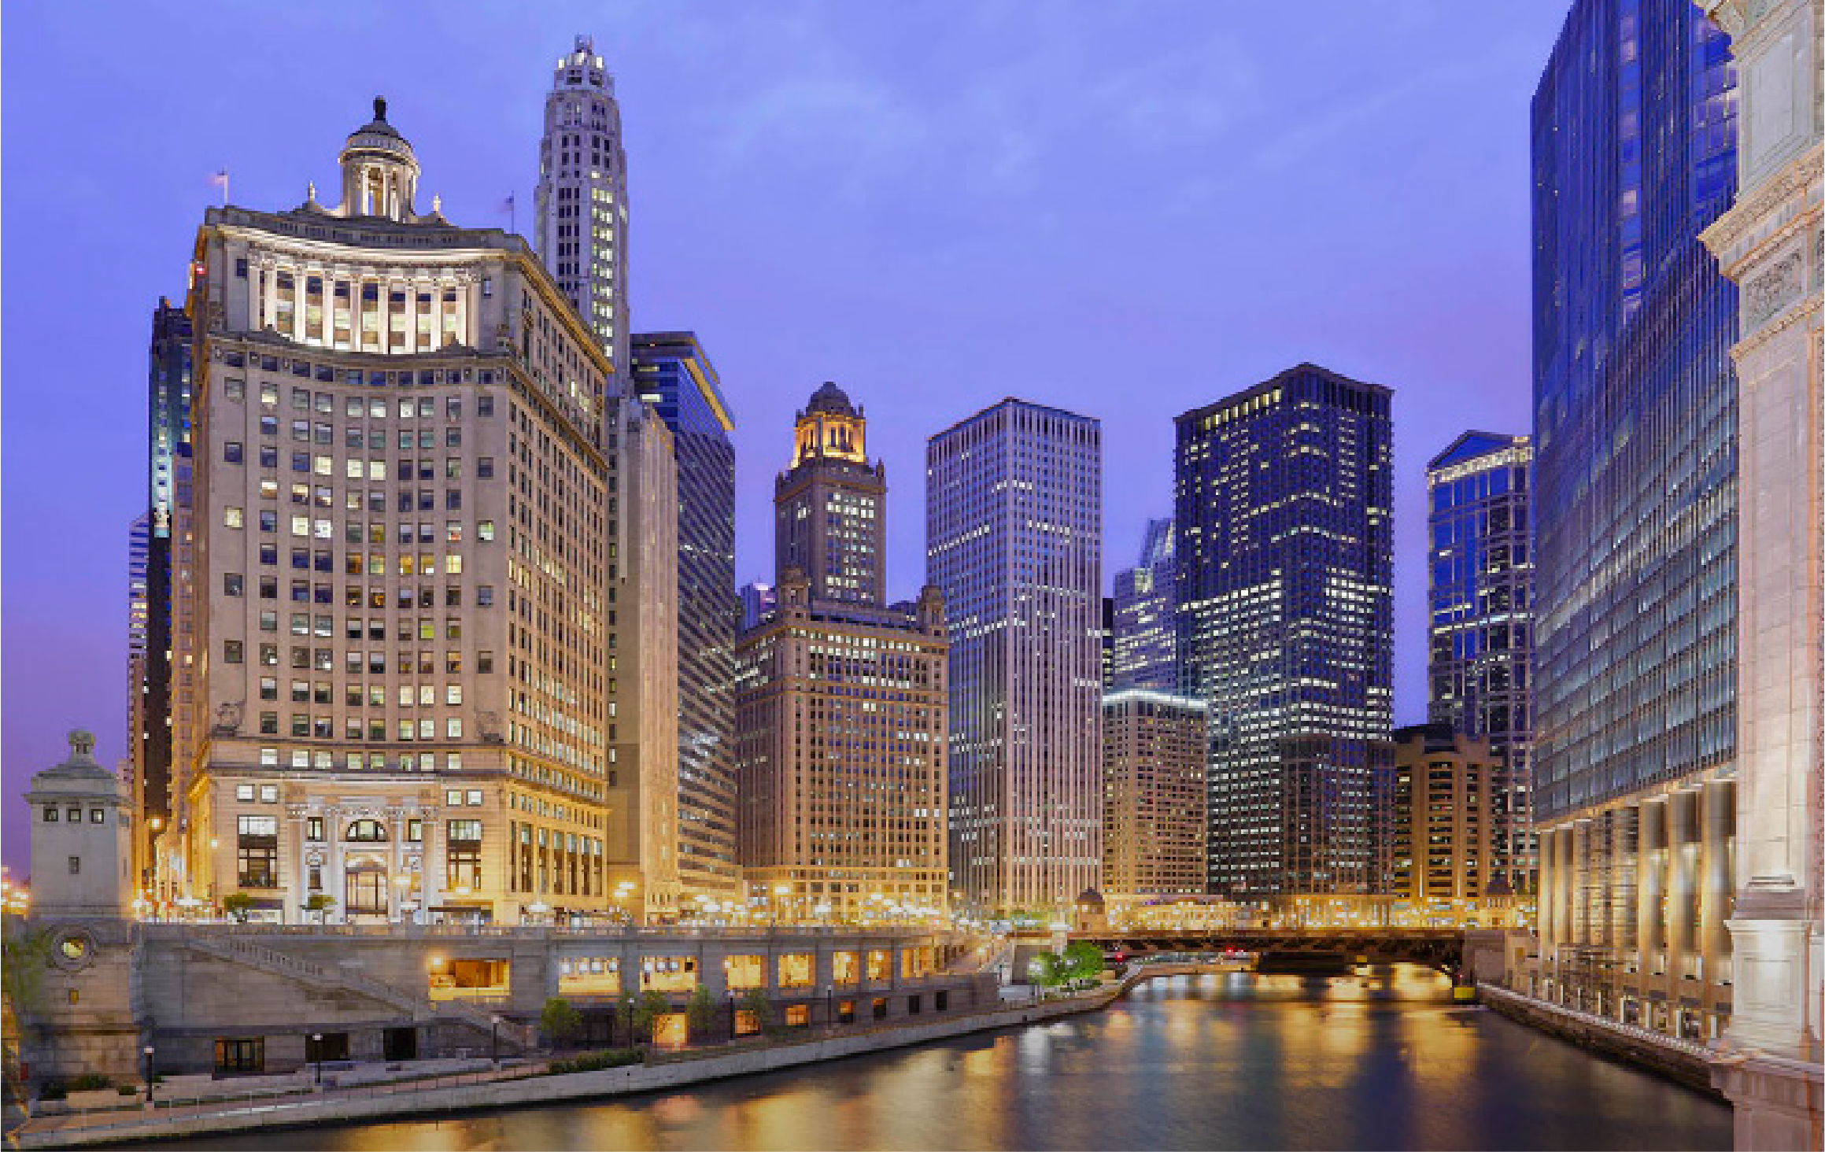
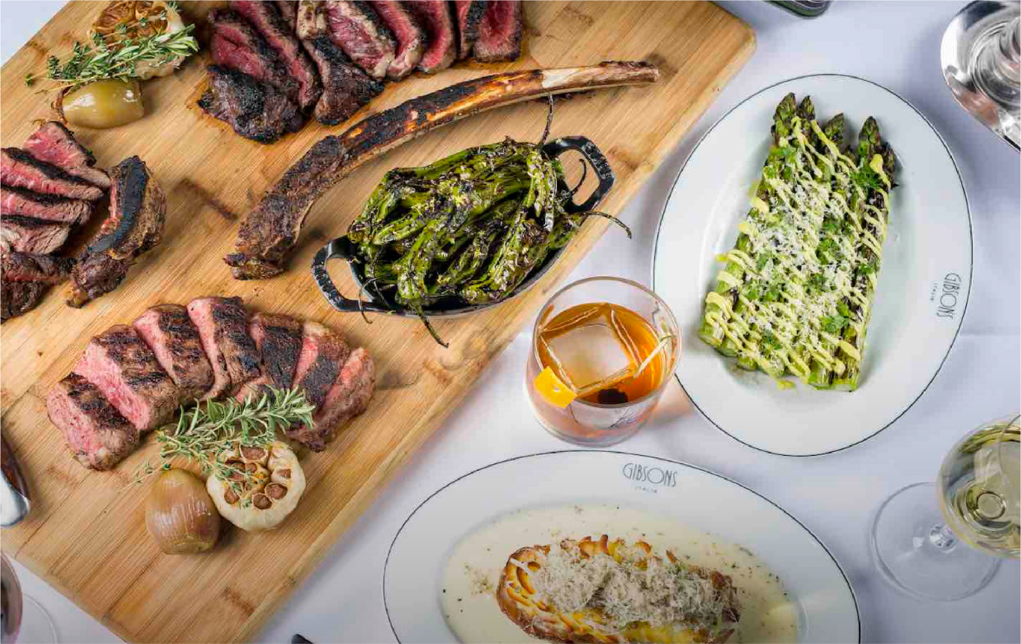
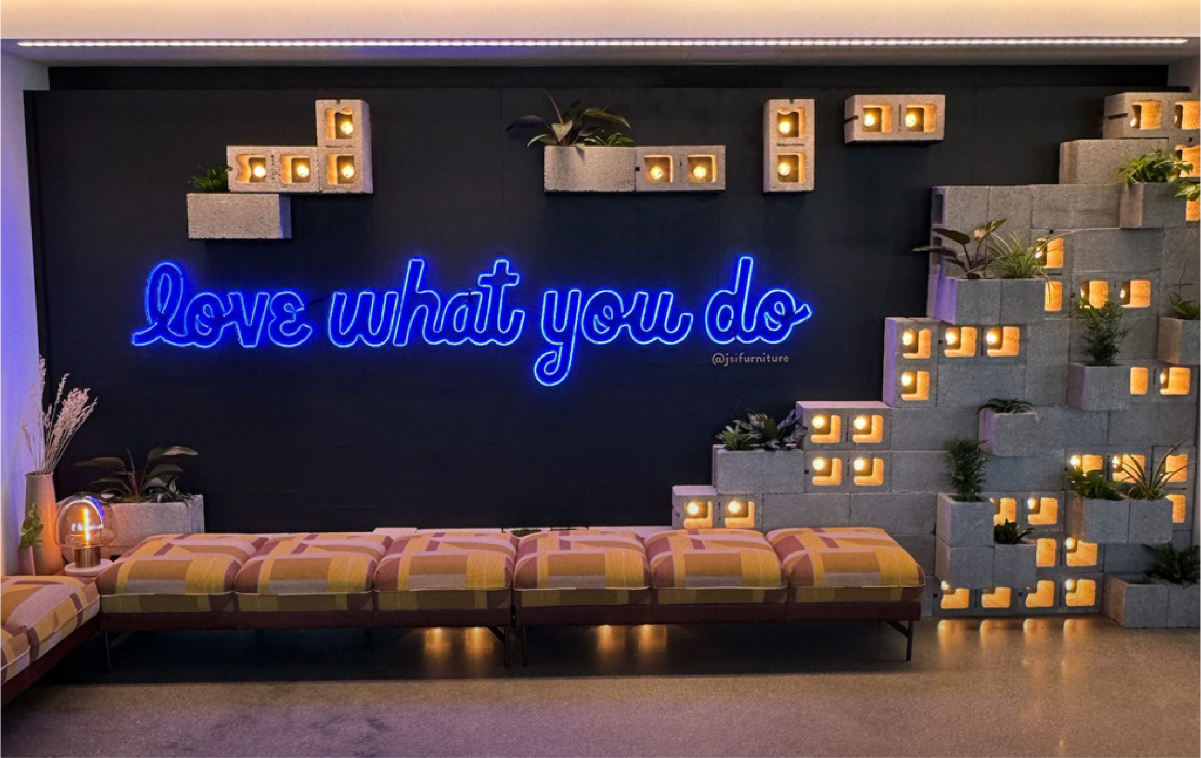
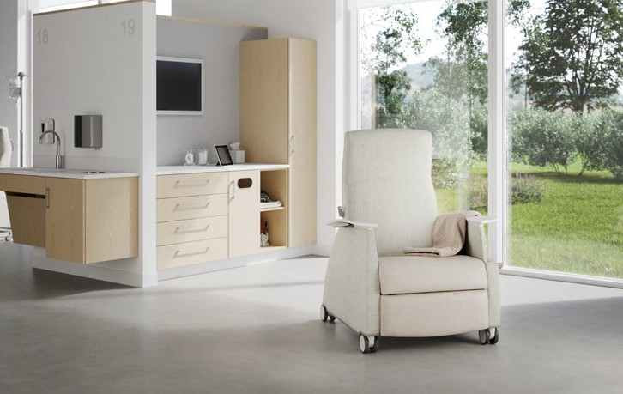
In partnership with Incline Contract
ANEETHA MCLELLAN
JSI Health
GARY HURD
RASHELL RENEAU
RACHAEL BENNETT
President
AMANDA CAIN
Sales
RYAN SEES
Sales
HORTENCIA RUIVIVAR
Sales
ALICIA COLE
Design
ERIC RENNIE
Design
Incline Contract CommonSpirit
MONDAY
MARCH 24
Arrival & Dinner
DRESS:
Business Casual Dinner
VIEW HOTEL WEBSITE
VIEW RESTAURANT WEBSITE
4:30 PM
Airport Transportation
Black car service from Midway
6:45 PM
Dinner at Gibson’s Italia
Depart 6:15pm for Dinner
5:00 PM
Hotel Check-In
Londonhouse Chicago for 2 night stay
TUESDAY
MARCH 25
JSI Health Experience
DRESS:
Smart Casual
Business Casual Dinner
VIEW SHOWROOM
8:30 AM
Depart for JSI Showroom
Black car service from hotel to JSI Fulton Market Showroom
1:15 - 4:00 PM
Showroom Tour & Health Workshop
8:45 AM
Showroom Breakfast
4:00 PM
Depart for Hotel
10:00 - 11:30 AM
The JSI Health Brand Experience
Who we are and Why JSI Health
4:45 PM
Londonhouse Outdoor Terrace Drinks
Hosted by JSI Health (weather permitting)
12:00 - 1:00 PM
Showroom Lunch
6:30 PM
Dinner with Fellowes
The Oakville Grill and Cellar See Fellowes agenda for details

