Slide 1


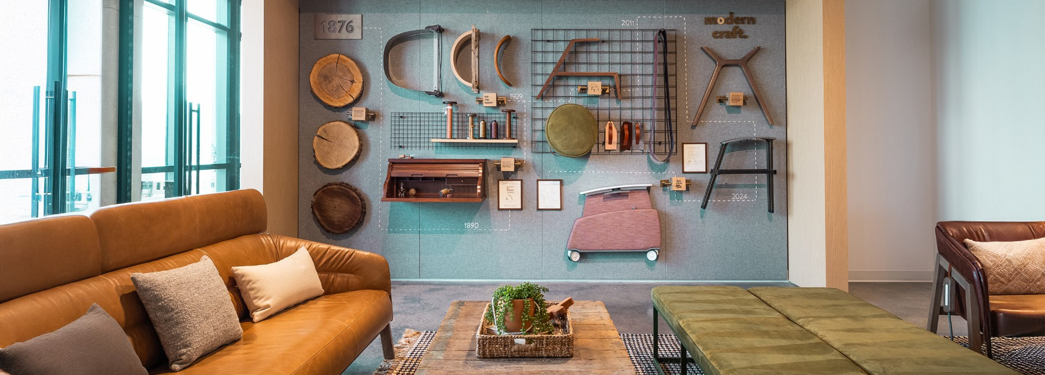
We enjoyed getting to know you and look
forward to continuing the conversation.
— Aneetha McLellan

Slide 2
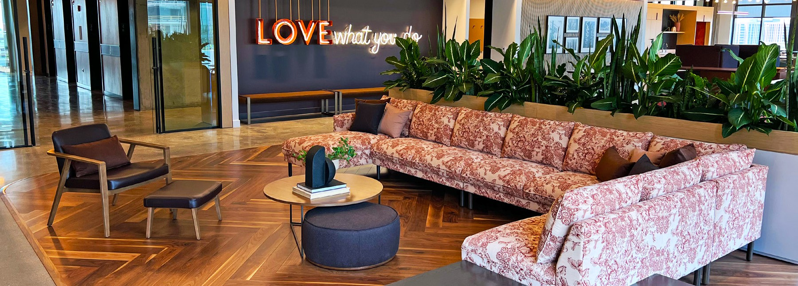
We enjoyed getting to know you and look
forward to continuing the conversation.
— Aneetha McLellan

Slide 3
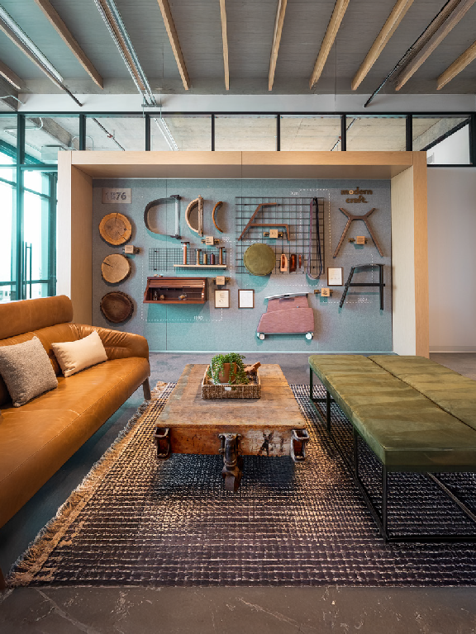
We enjoyed getting to know you and look forward to continuing the conversation.
— Aneetha McLellan

Slide 4
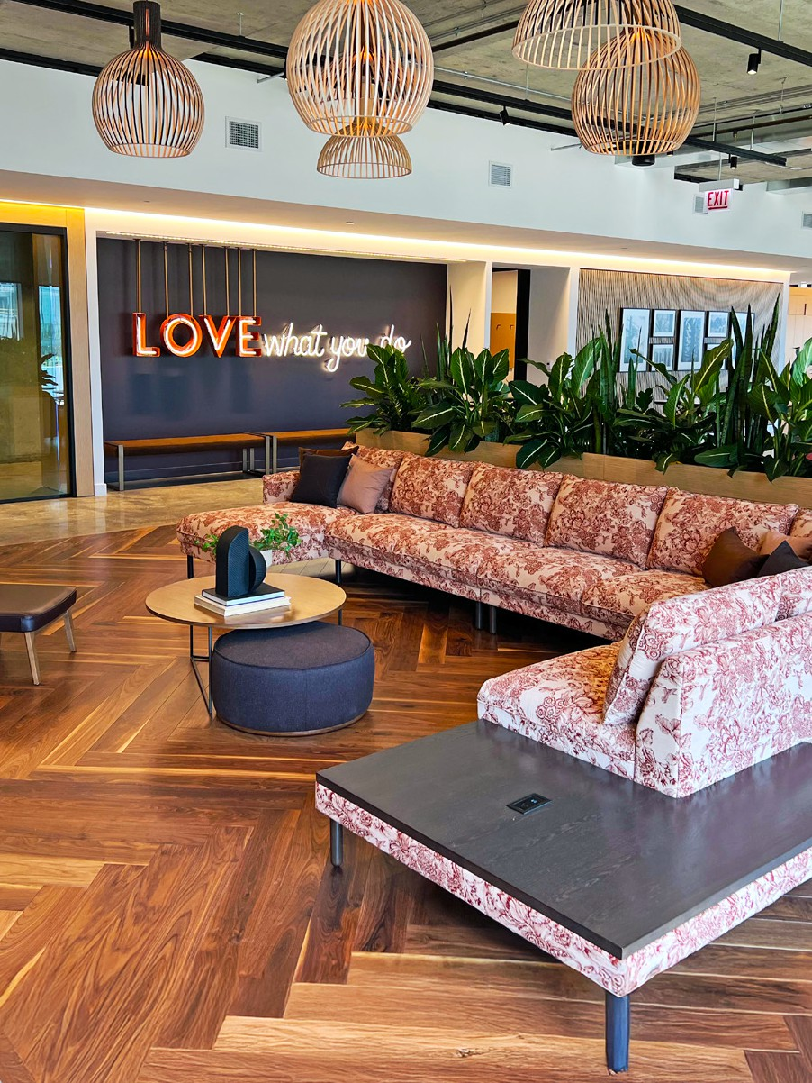
We enjoyed getting to know you and look forward to continuing the conversation.
— Aneetha McLellan

Slide 5

We enjoyed getting to know you and look forward to continuing the conversation.
— Aneetha McLellan

Slide 6
We enjoyed getting to know you and look forward to continuing the conversation.
— Aneetha McLellan

