Slide 1

NURTURING CONNECTION AND CARE

Slide 2
Turning Challenges Into Opportunities
Rigid Reactive
Resilient Predictive
While there are significant issues impacting the healthcare experience, JSI’s holistic approach transforms these challenges into opportunities that enhance caregiver experiences and elevate patient comfort and connection.
Standardized Siloed Transactional Provider-Centered
Personalized Connected
Relational Human-Centered
FROM
TO

Slide 3

Adaptable, Efficient Spaces
DRIVER 1
The inability to quickly reconfigure spaces to meet diverse healthcare needs can disrupt workflow, while inefficient
design further impacts patient care.
25%
Designing Fluid Versus Fixed Spaces
of US healthcare spending ($935 Billion) is lost annually due to inefficiencies.
Journal of the American Medical Association, October 2021

Slide 4
Comfort & Connection
DRIVER 2
Many healthcare environments lack furniture that balances patient comfort while supporting family and friends, which can hinder recovery and healing processes.
47%
Patients who are unsatisfied with the ergonomic features and aesthetic design of healthcare furniture.
Balancing We Versus Me Comfort
pesjournal.net, Hospital Furniture: Expectations of Patients Toward Furniture in Healthcare Setting, October 2020

Slide 5
DRIVER 3
Human-Centered Care
A lack of inclusive design can lead to disparities in patient experiences, failing to accommodate the diverse needs of all patients.
28%
of U.S. adults live with a disability highlighting the need for inclusive healthcare design.
Supporting Holistic Connected Care
Centers for Disease Control and Prevention, 2024

Slide 6
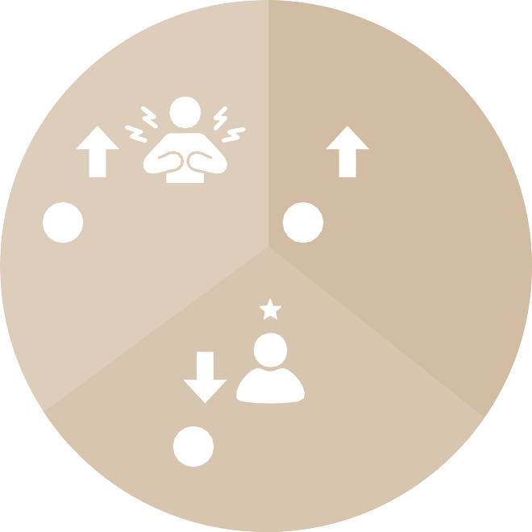
IMPACT
Inefficient Connection & Care
These factors compromise an organization’s ability to optimize facility performance, enhance the patient experience, and nurture a sense of belonging.
$
Organizational Cost
1
Inefficient Facilities
2
Unintuitive Design
3
Fragmented Care
1
Employee Burnout
2
+
+
=
3
Patient Experience

Slide 7

How JSI Health Can Help
By embracing a forward-thinking approach, supporting comfort through purposeful design, and fostering inclusivity with connected care, JSI Health inspires caregivers to love where they care and patients to love where they heal.
1
2
3
Future-focused
Purposeful Design
Connected Care

Slide 8


Future-Focused
Flexible Planning Approach
We maximize outcomes by integrating our industry and product expertise with your understanding of patient and caregiver needs to create adaptable spaces that empower everyone.

Slide 9

Agile Solutions
FUTURE-FOCUSED
Our thoughtfully designed portfolio of products prioritizes flexibility, making it easier for facilities to respond to everyday demands and unexpected challenges.
Ready For Today
Adaptable for Tomorrow

Slide 10
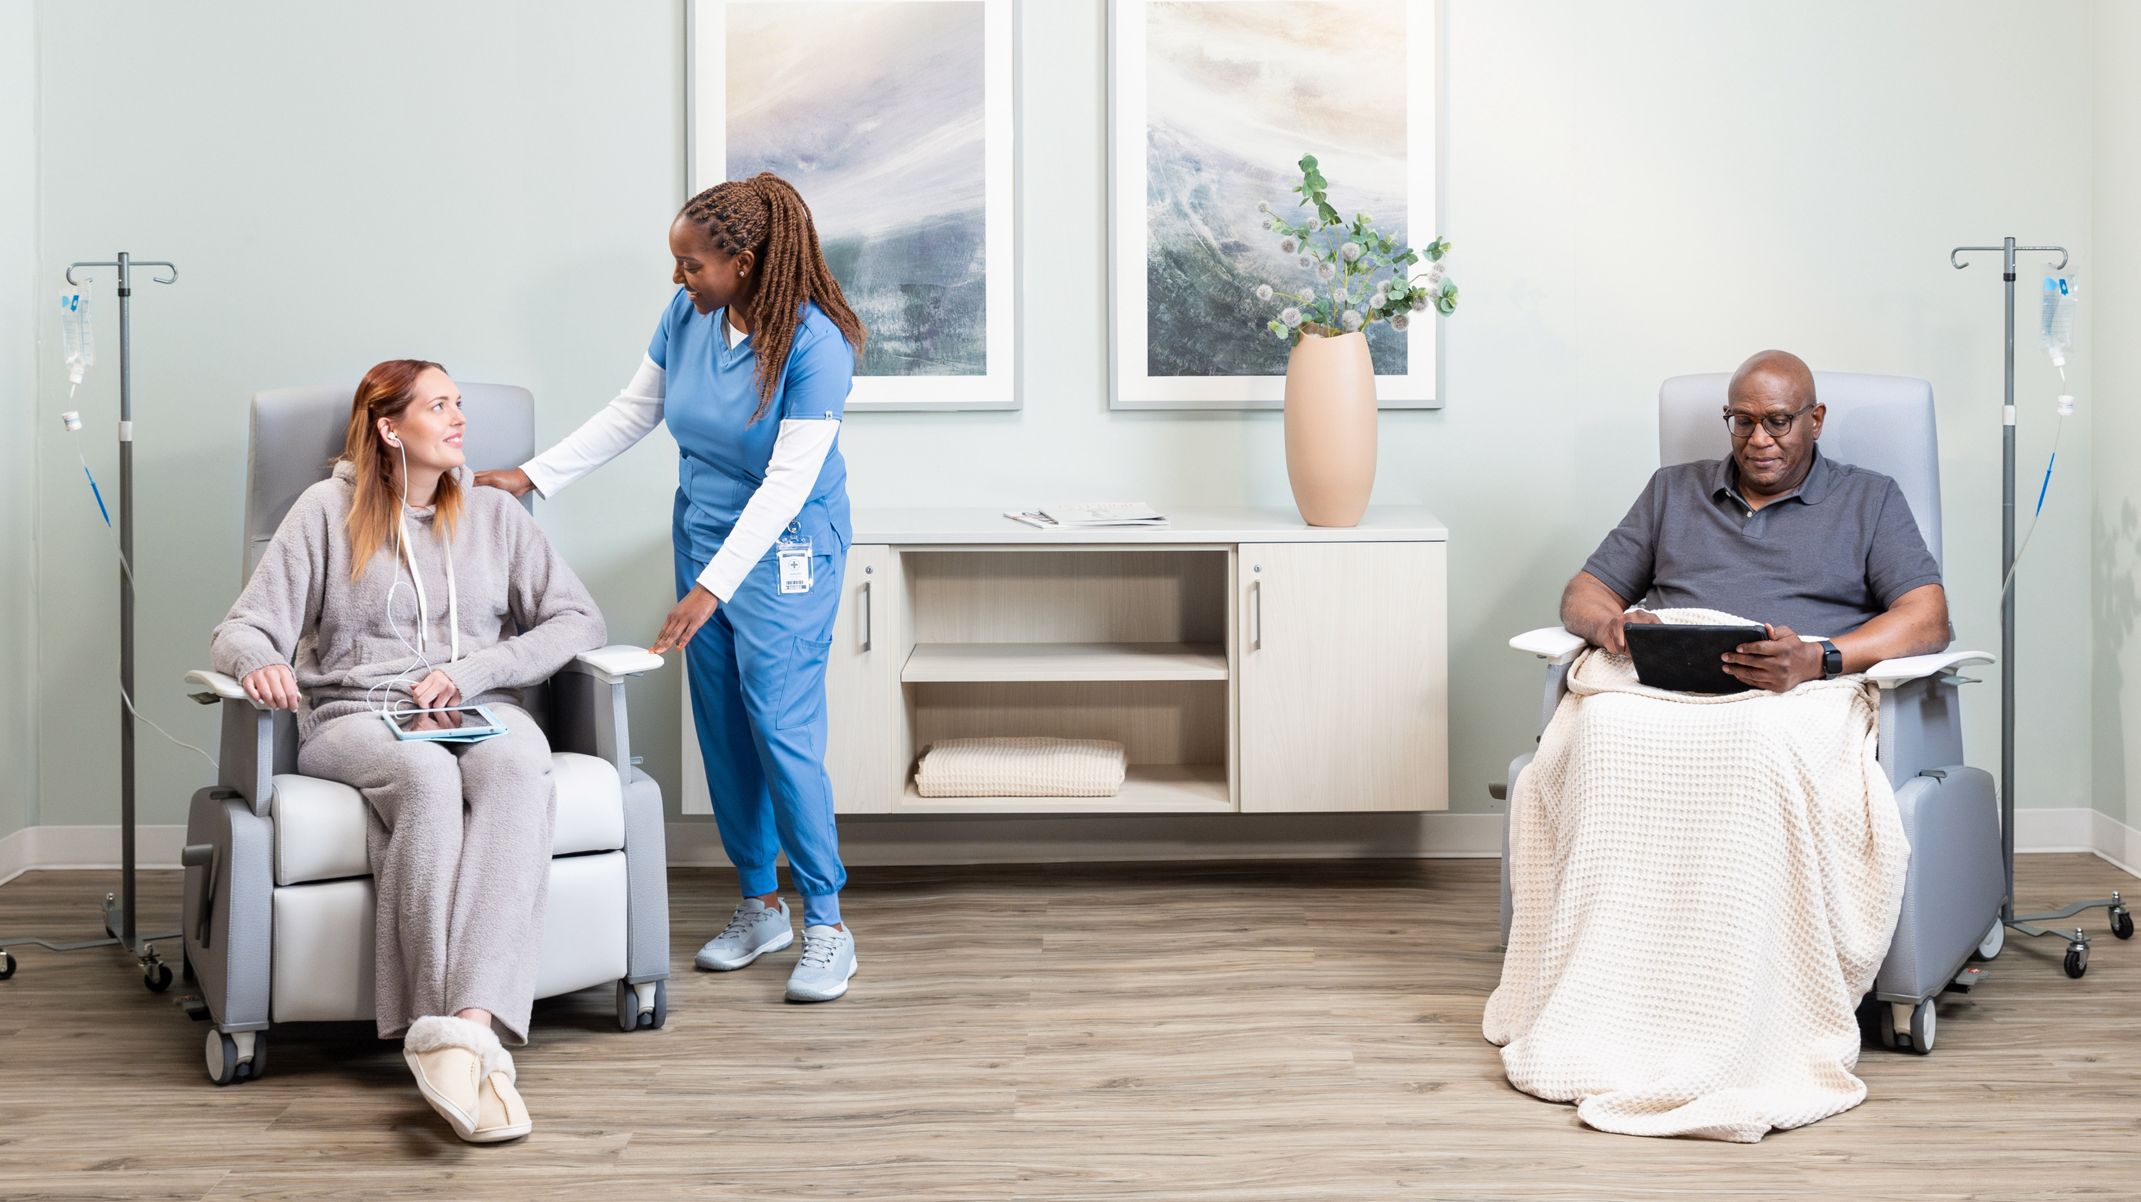
Purposeful Design
Human-Centered Solutions
We leverage our design innovation, healthcare expertise, and bespoke capabilities to enhance comfort for patients and caregivers and maximize your return on investment.

Slide 11
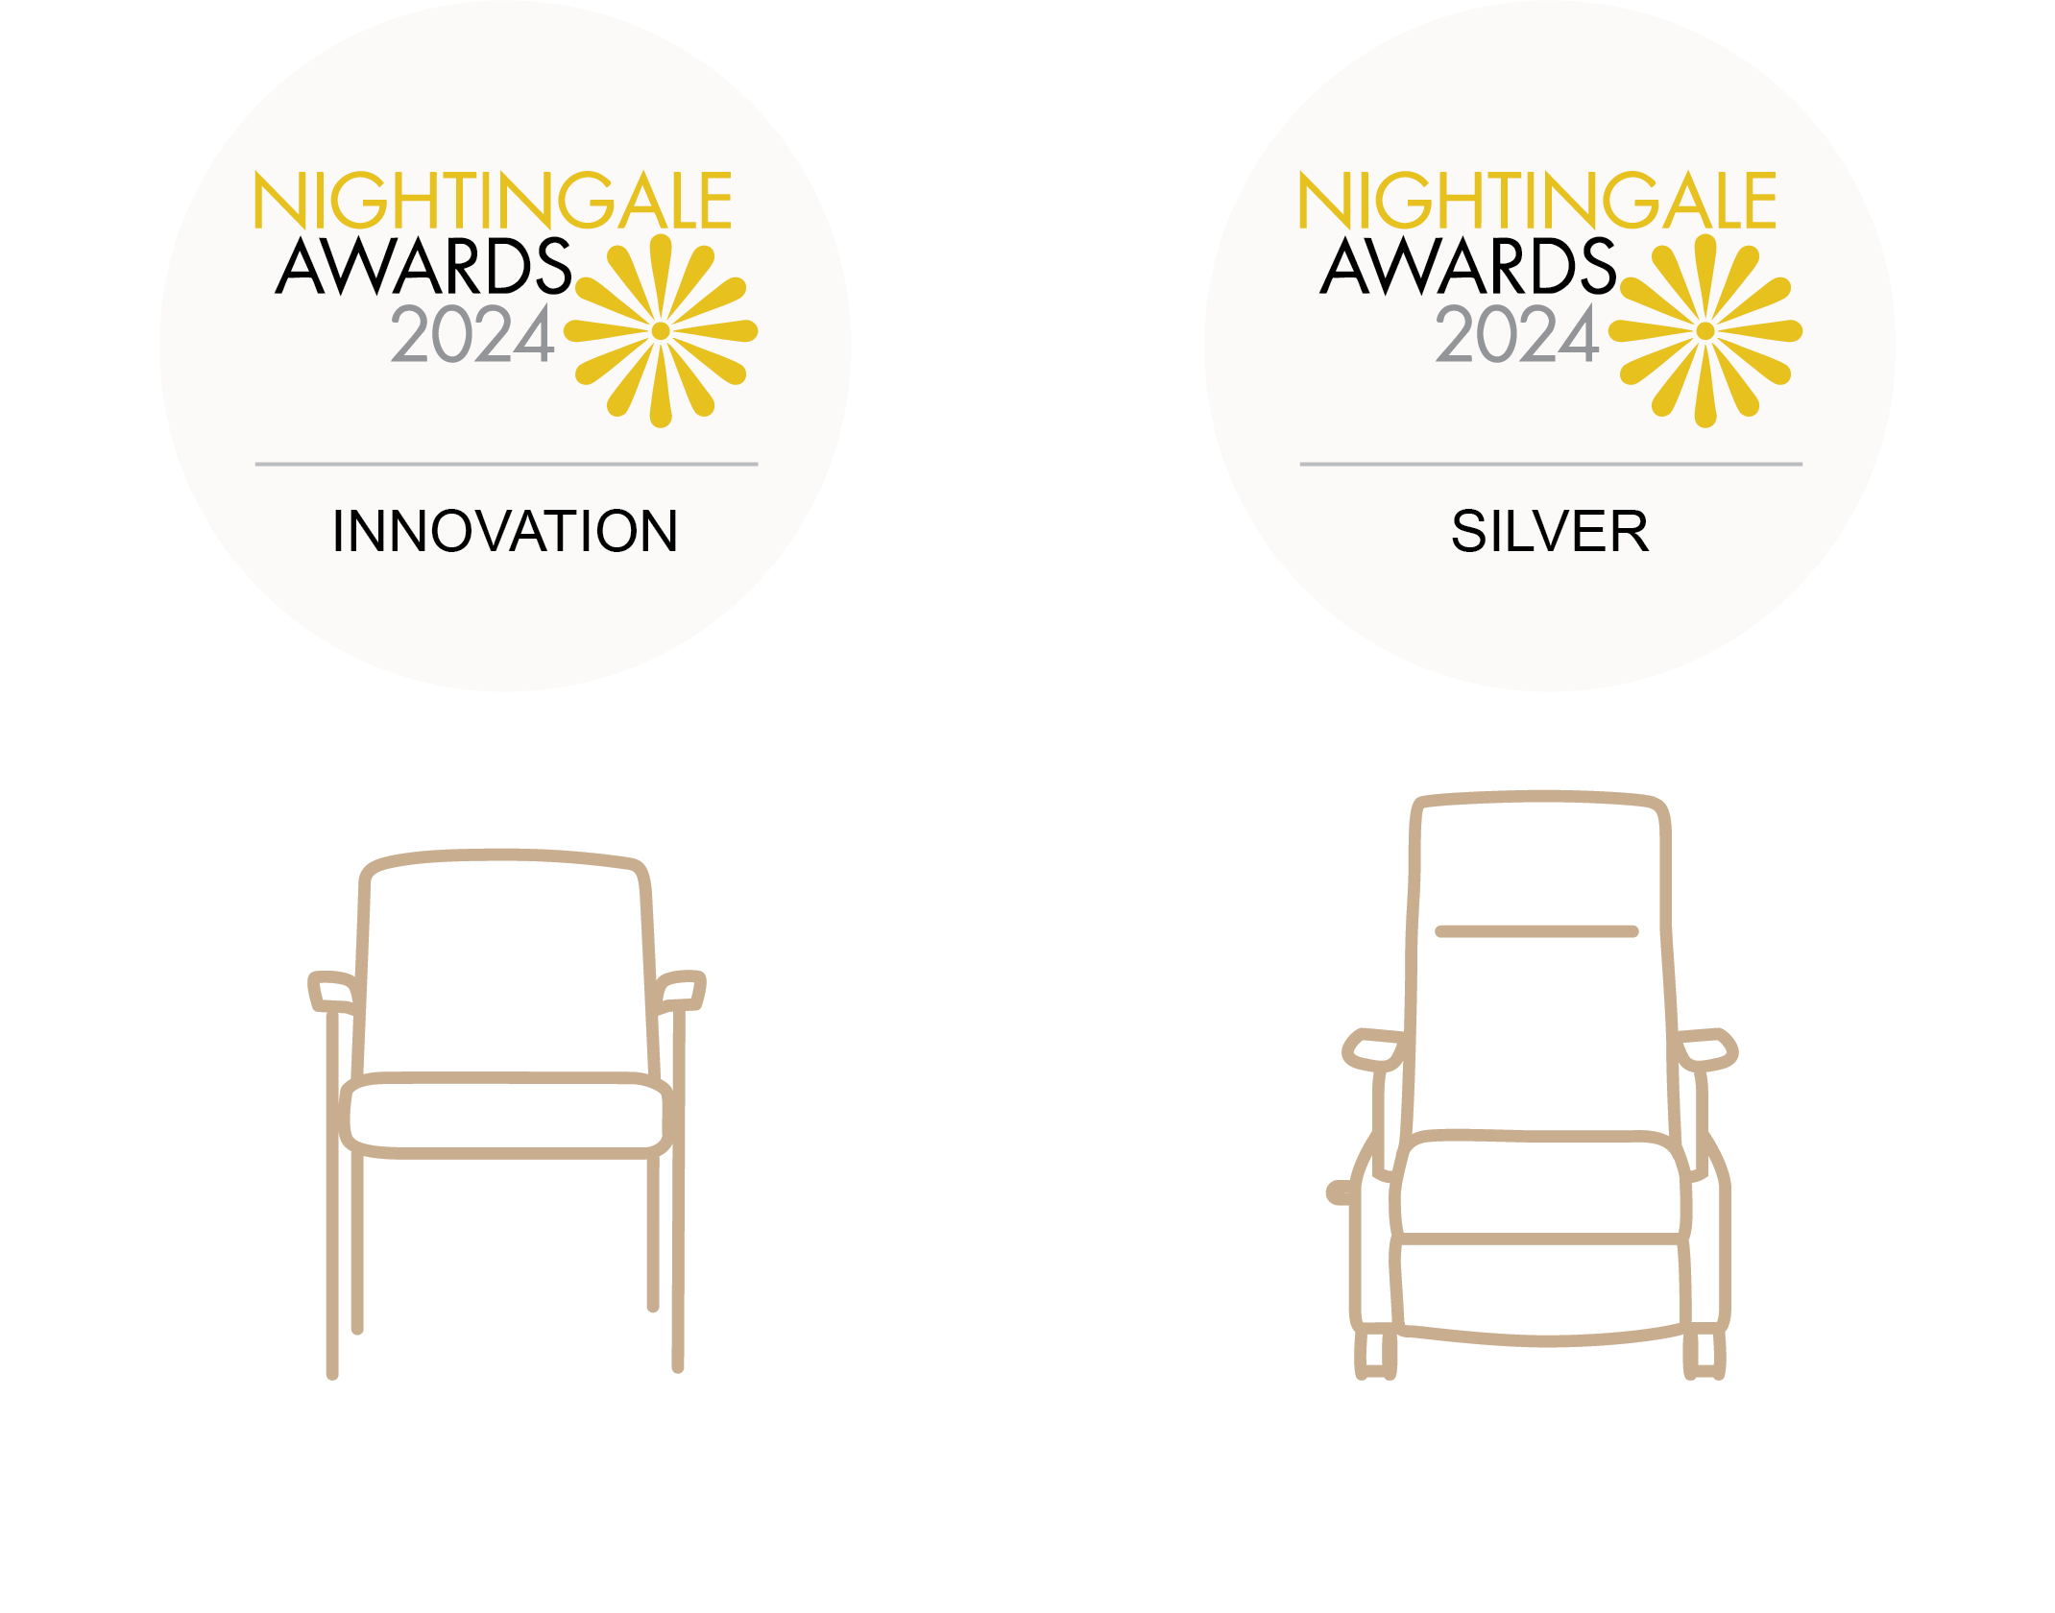
Innovating Since 1876
PURPOSEFUL DESIGN
From earning the first furniture patent in 1890 to driving innovation with today’s Nightingale Awards, we have a long legacy of shaping the future of design with human-centered solutions that balance comfort and functionality.
Satisse
Kindera

Slide 12
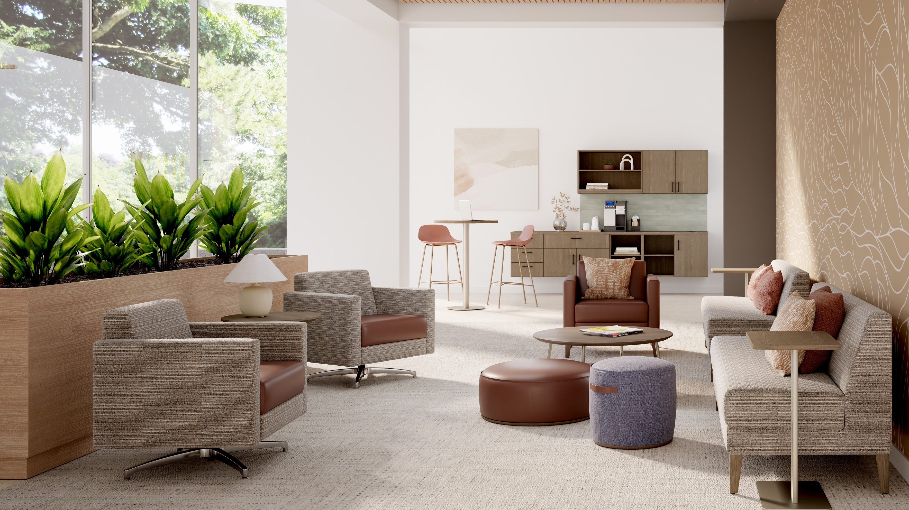
Connected Care
Designing Meaningful Connections
Informed by your design vision, we create calming, inclusive environments that foster connection and belonging—all brought to life in a nurturing way only our products can.

Slide 13













CONNECTED CARE
COMMUNITY SPACES
Lobby + Welcoming Cafe + Dining
Holistic Integration
Designed to support every caregiver need and patient encounter, our furnishing solutions foster meaningful engagement and enhance care throughout an entire facility.
PATIENT SPACES
Patient Room
Exam Room Treatment Area
CAREGIVER SPACES
Work Area
Private Office
Respite
Consultation
ADMINISTRATIVE SPACES
Workspace
Nourishment + Respite
Meeting
Learning

Slide 14

Nurturing Connection & Care
By embracing a forward-thinking approach, leveraging purposeful design, and prioritizing innovations that foster connected care, we inspire individuals to love where they thrive, love where they care, and love where they heal.

