Slide 1

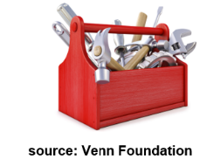
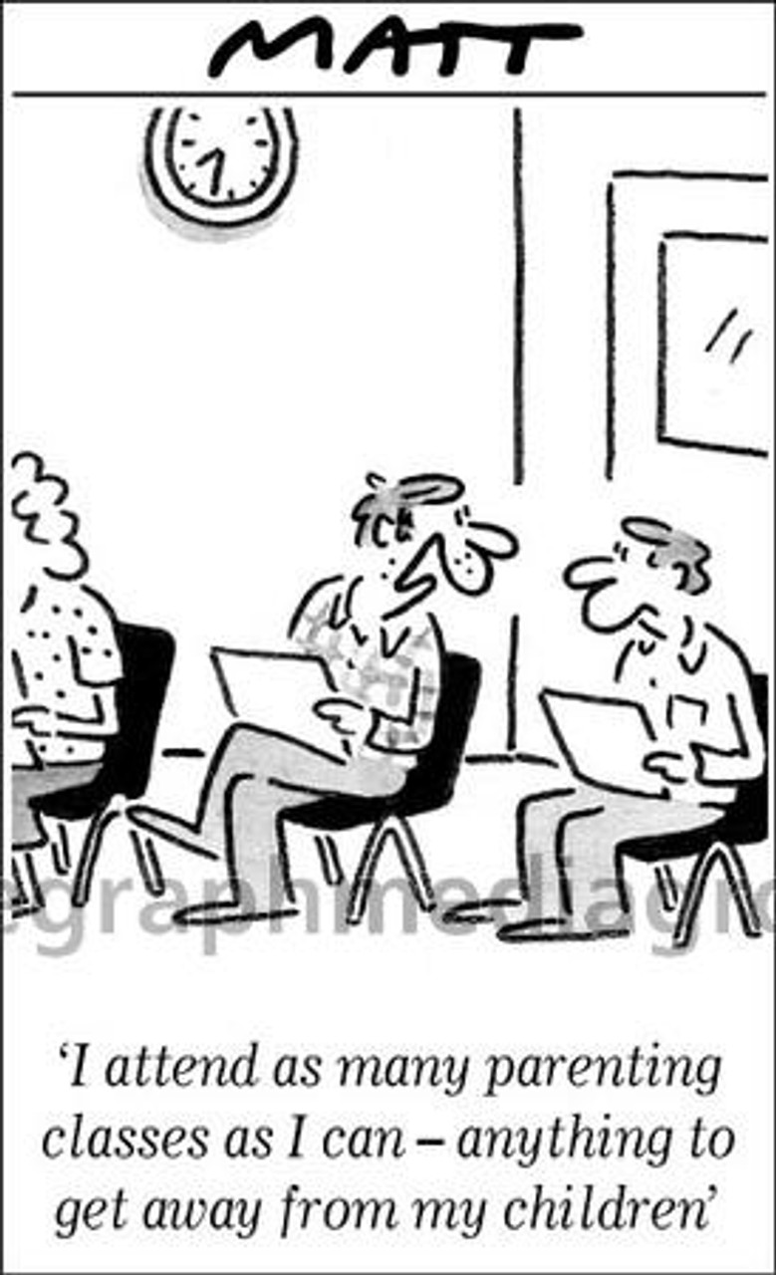
Helping Parents Become a Cannabis Prevention Resource in the Home (3.0)
Cannabis Prevention Toolkit: Parent Materials
Presenter: ___________________________
Date: _________
Location: ____________________________
Source: Smart Approaches to Marijuana Minnesota & The Minnesota Prevention Alliance, © July, 2024
Notes:
1
Presenter: Insert details about you, the date and the location.
Background: This is estimated to be a 60-90-minute presentation. See the accompanying Facilitator's Manual for information on the development of this resource and presentation tips.
Acknowledgements to several prevention specialists and parents who provided content and input to this resource.

Slide 2
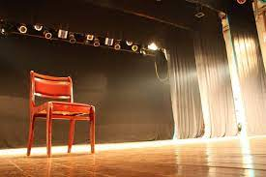
Setting the Stage
Parents: Please introduce yourself
Something about me
Housekeeping matters
Notes:
Introductory topics.

Slide 3

Today’s Objectives
After attending this event, you should be able to:
1. Appreciate that legalized cannabis products are quite different than generations ago.
2. Understand how cannabis can affect the brain and have a negative effect on the teenage developing brain.
3. Summarize the harmful effects of cannabis on a teenager’s mental health, learning, social life, and driving skills.
4. List ways to strengthen your parenting skills.
Notes:
Summarize the objectives of the event.

Slide 4

“What brings you here?”
"What is your burning question about cannabis and teenagers?”
Notes:
Seek a group discussion

Slide 5
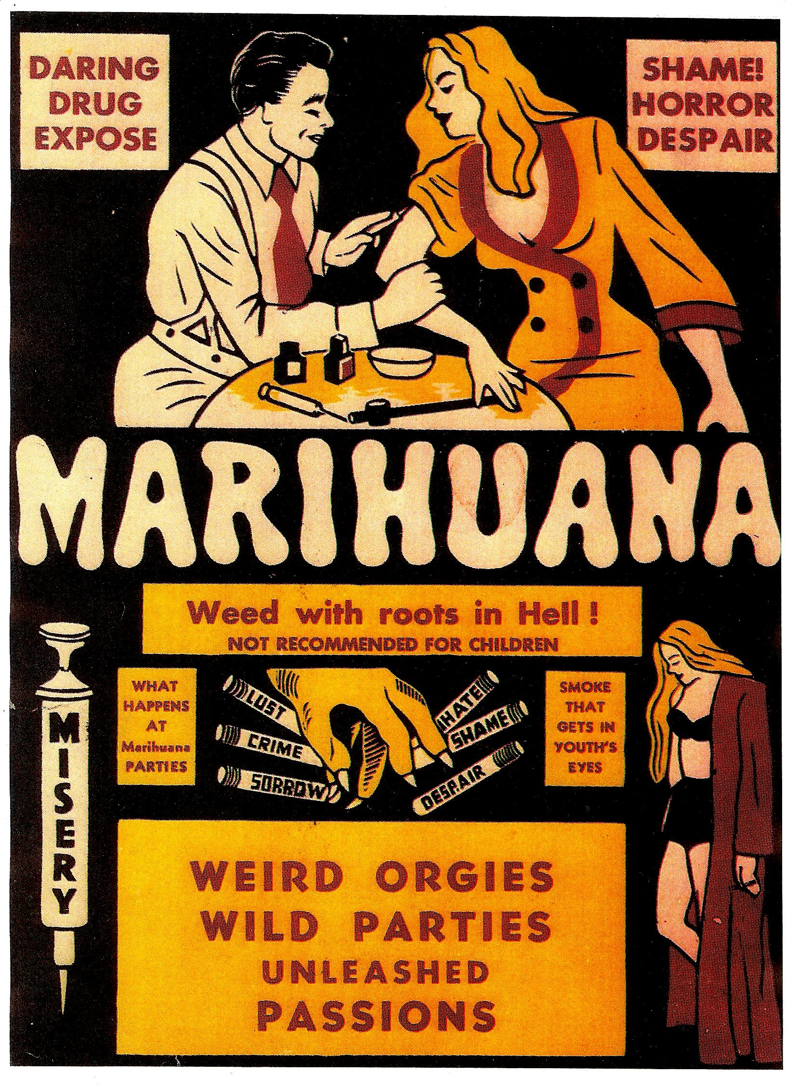

“In what ways have you have observed there are different attitudes today about cannabis compared to years past?”
Notes:
Themes that you may heard:
Cannabis use is becoming normalized. It is safer than alcohol. It’s medicine.
The liberalization of cannabis laws and perceptions are challenging traditional cannabis markets, opinions, and its place in culture.
As of December 2023, legalization approved for commercial adult use and medical in 24 states + Wash DC. Medical only in 19 states (some limited to CBD). Fully illegal in only 4 states.

Slide 6

Recent Minnesota Cannabis Legislation (adult use)
1. 2023: edibles from legal hemp
2. 2024: growing limited number of plants; use on private property
3. 2025: retail sales expected
4. 2026 (Fall): school prevention required
Notes:
Overview of key dates of MN legalization.

Slide 7
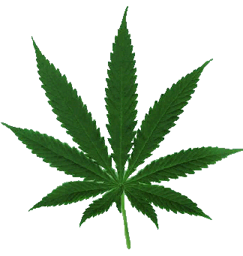
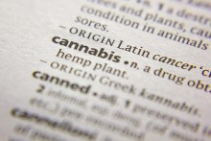
It Has Many Names
Common names: THC, cannabis, Delta-9, Delta-8, marijuana, weed, pot, dab, wax, edibles
They all can refer to what gets a person high
source: Nicole Janas
Notes:
The term cannabis is the preference term used throughout this resource given that in the U.S., it’s the plant’s scientific name and it generally refers to all products from the cannabis plant (either sativa or indica).
Cannabis generally refers to the parts of the plant that contain Delta-9, its main intoxicant. Often when “THC” is used, the reference is to Delta-9.
Marijuana is less preferred term these days. In the early 1900’s many newspapers and politicians started calling it “marijuana,” the Spanish word for the plant. People were warned about the madness driven by “marijuana” — particularly Mexican immigrants. See this website for more on this issue.
https://www.npr.org/sections/codeswitch/2013/07/14/201981025/the-mysterious-history-of-marijuana

Slide 8
What is Cannabis?
Contains over 500 chemical compounds, approximately 100 cannabinoids
All the cannabinoids in the cannabis plant remain a Schedule I substance under federal law and are illegal at the federal level
  CBD is an exception depending on its source from hemp and state law
source: https://learnaboutsam.org
Notes:
There are numerous cannabinoid compounds in the cannabis plant.
CBD: its schedule status may depend on whether its extracted from legal hemp (<0.3% THC), and some states have banned it.

Slide 9
The Cannabis Plant is Complex
The most “important ones”:
  Delta-9 (“THC”): the primary intoxicant
  Delta-8: about half as potent as Delta-9
  CBD: non-intoxicant
source: https://learnaboutsam.org
Notes:
delta-9-tetrahydrocannabinol (“THC”)
delta-8-tetrahydrocannabinol
cannabidiol (CBD)
Many use the term “THC” when referring to Delta-9.
CBD: its schedule status may depend on whether its extracted from legal hemp (<0.3% THC), and some states have banned it.

Slide 10
More on Delta-9 and Delta-8
Delta-9: “Not what your grandparents used”
  1960’s/70’s: average potency of street weed about 3-5%
  nowadays: average potency of street weed about 15-20%; concentrates up to 90%
Delta-8: “Diet Weed”
  its less euphoria and fewer side effects preferred by some
  FDA: “Delta-8 THC has serious health effects” that are similar to Delta-9
  production from CBD, which is abundant in hemp

Slide 11
What is Hemp?
Hemp plant looks similar to the cannabis pant
FDA: Hemp is no longer an illegal product when it contains less than 0.3 percent THC by dry weight
The federal Farm Bill may be revised to address the “hemp loophole” that is enabling the production of Delta-8 and other cannabinoids
source: https://learnaboutsam.org
Notes:
Hemp loophole: The Farm Bill of 2018 failed to specify that it’s illegal for all cannabinoids, such as Delta-8, to be manufactured from the hemp plant.

Slide 12
The Cannabis Plant is Complex
Is cannabis medicine?
  FDA has approved some cannabis products for medicinal purposes
  Minnesota, like many states, has approved cannabis for a host of disorders and ailments
  More later on this topic
Notes:
Review these points.

Slide 13
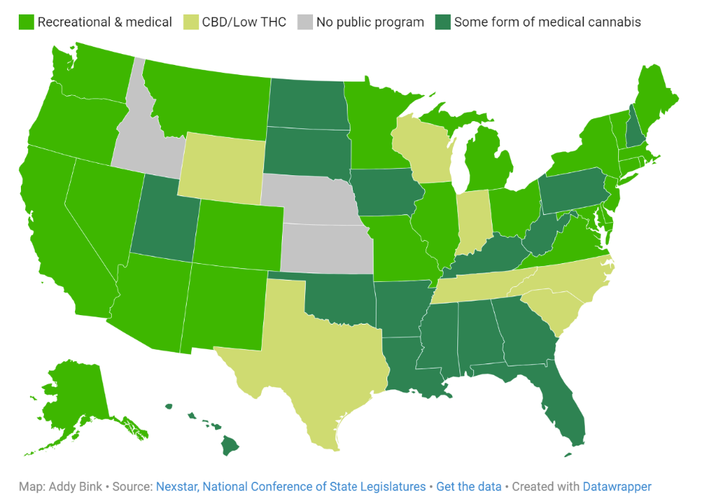
Many States Where It’s Legal
    As of 2024, legalization approved for...
      Commercial adult use and medical use in 24 states + Wash DC
      Medical only in 23 states (some limited to CBD)
    Fully illegal in only 3 states (Idaho, Kansas and Nebrska)
Notes:
Bring this issue into the discussion: The changing landscape of attitudes about cannabis has significantly shifted toward permissiveness.

Slide 14

Quiz: Separating Fact from Fiction
To continue our discussion, we will look at a few quiz items and use them to dig deeper into key issues about cannabis and health and safety.
Notes:
Each quiz item is to be offered to the group to answer silently. The answer slide always follows.
You may want to use the e-voting option offered by https://www.menti.com/. This feature allows participants to respond to each question with their cell phone and the breakdown of answers are displayed on the screen.
A group discussion about the correct answer is advisable. For example: “What surprised you about the correct answer?”

Slide 15
Quiz: Separating Fact from Fiction
Typical THC potency levels of “street weed” in the 60’s and 70’s was about 3%. What is the typical THC potency levels of street weed nowadays?
  same, about 3%
  about 10%
  about 15%
Notes:
Ask parents to take a moment to consider this question. The next slide shows the answers.

Slide 16
Correct Answer
Typical THC potency levels of “street weed” in the 60’s and 70’s was about 3%. What is the typical THC potency levels of street weed nowadays?
  same, about 3%
  about 10%
  about 15%
source: https://www.mjfactcheck.org/potency
Notes:
The next slide has more on this topic.

Slide 17
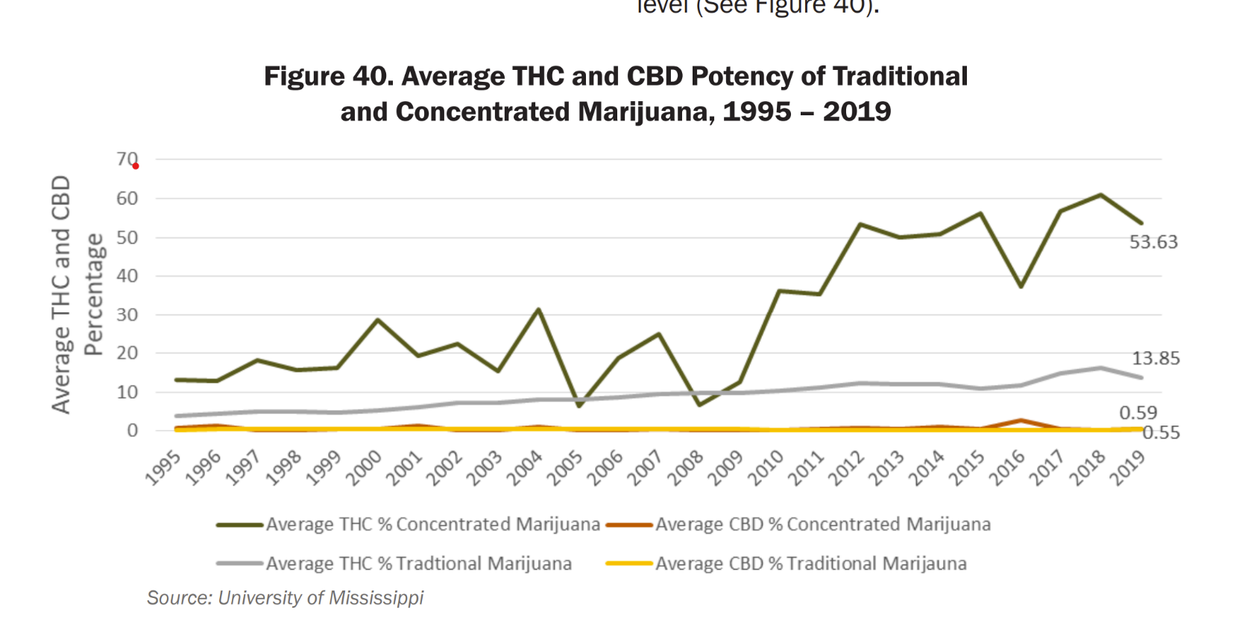
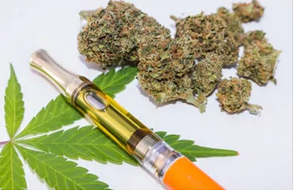
Modern Cannabis
up to 90% THC potency in retail stores
street weed
Notes:
Concentrates at retail stores can be as high as 90% THC potency.

Slide 18
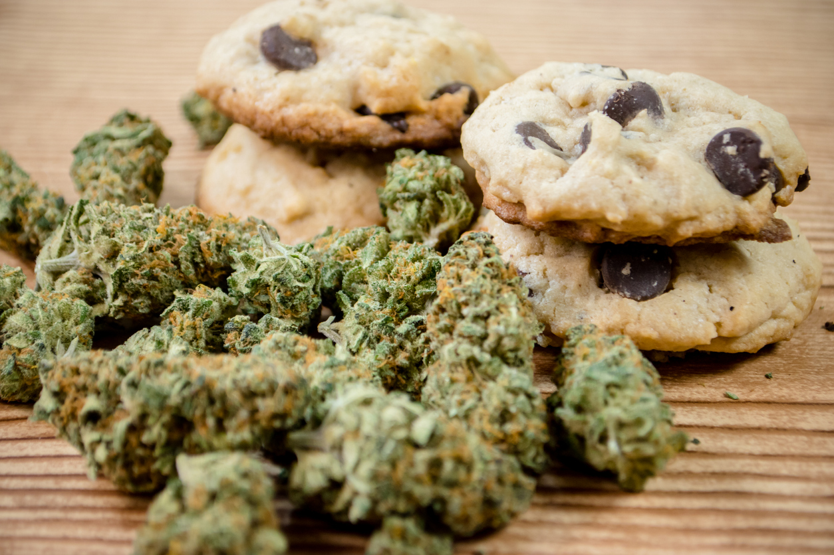
Quiz: Separating Fact from Fiction
Which is true about the likely intoxicating effects of edibles?
  later onset, longer effect
  rapid onset, short effect
  there are no intoxicating effects of edibles
Notes:
Ask parents to take a moment to consider this question. The next slide shows the answers.

Slide 19
Correct Answer
Which is true about the likely intoxicating effects of edibles?
  later onset, longer effect
  rapid onset, short effect
  there are no intoxicating effects of edibles
source: https://www.ncbi.nlm.nih.gov/pmc/articles/PMC5260817/
Notes:
Seek discussion. What surprises you about the answer?
The next two slides have more on this issue of edibles and their effects.

Slide 20
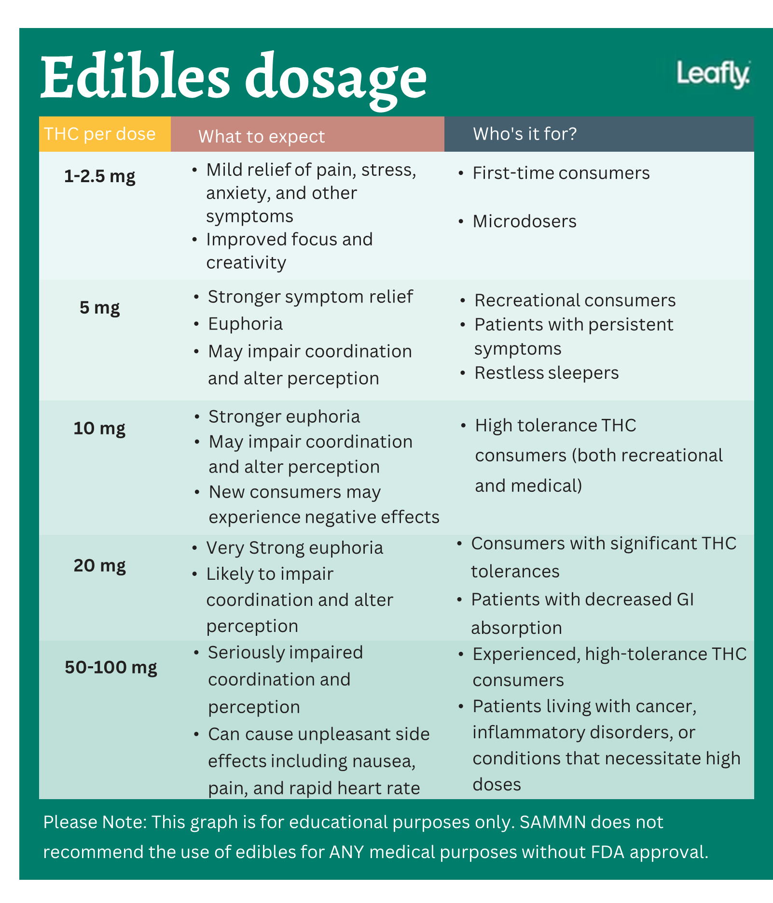
Edibles
Later onset of effect; can take up up to an hour
Longer-lasting effect; can be for several hours
source: https://www.leafly.com
Notes:
5 mg row is marked because in Minnesota, each edible serving can have 5 mg of THC. For a naïve user, there can be a significant intoxicating effect at this dosage level.
Another issue with edibles: It is harder to find the right dose because it takes longer for the body to absorb the THC. This can result in a person using more than they intended and maybe having a negative or even scary experience.

Slide 21
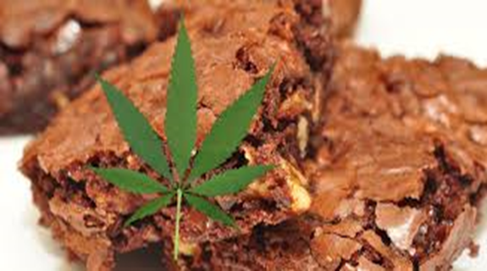
Questions for the Group
Why is an edible potentially dangerous to a person’s driving ability?
Why are emergency room visits skyrocketing in states after edibles are legalized?
Notes:
1. Answer: Later onset and longer interval of intoxicating effects can contribute to a person falsely believing they are a safe driver.
2, Answer: Due to people, including children, ingesting edibles and suffering from acute overdose intoxication.

Slide 22
Quiz: Separating Fact from Fiction
Frequent cannabis use (e.g., weekly or daily) can be harmful to the adolescent developing brain.
True
False
Notes:
Ask parents to take a moment to consider this question. The next slide shows the answers.

Slide 23
Research Says
Frequent cannabis use (e.g., weekly or daily) can be harmful to the adolescent developing brain.
True
False
sources: www.nationalacademies.org/cannabishealtheffects; Volkow et al., 2016, doi:10.1001/jamapsychiatry.2015.3278
Notes:
Engage parents in a discussion. What surprises you?

Slide 24
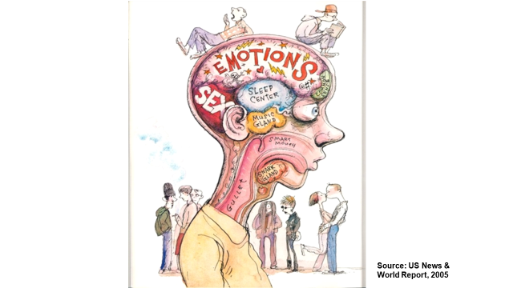
Why is this issue so important for adolescents?
Because the teen brain is still developing. It continues through adolescence, until approx. age 25.
Exposure to THC can disrupt brain development.
source: Volkow et al., 2016, doi:10.1001/jamapsychiatry.2015.3278

Slide 25
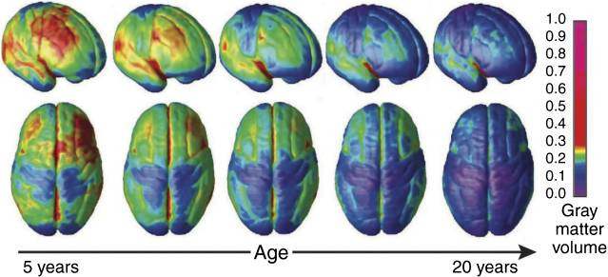
Changes in Brain Structure
source: Tau & Peterson, 2009
Notes:
This image shows how the brain continues to change between the ages of 5 and 20. The blue indicates the areas of the brain that have fully developed; while the green indicates areas that are still developing. In a young child, notice how much of the brain is green; even 15-year-olds have quite a bit of green, which tells us that many parts of their brain are still maturing (Konrad, and Uhlhaas, 2013).
While the brain is fully grown shortly after birth, brain development and maturation continues to occur. However, it does not occur evenly throughout our life course or evenly within the brain itself. There are specific periods of time where more development is happening compared to other time periods. Adolescents is one of the points in time where the most dynamic changes in the brain occur.
Photo citation: Tau, G. Z. & Peterson, B. S. (2009) Normal development of brain cells. Neuropsychopharmacology, 35(1), 147-168. doi:10.1038/npp.2009.115
From Tau et al (2009):
“Gray matter maturation across development. Right lateral and top views of the brain showing the dynamic sequence of temporal changes in gray matter volume over the cortical surface. The images represent modeled data from 52 anatomical MRI scans from 13 individuals 4–21 years of age, each scanned four times at approximately 2-year intervals. Color scale represents gray matter units of volume. Reproduced with permission from Gogtay et al (2004) (Copyright 2004) National Academy of Sciences, USA.”

Slide 26
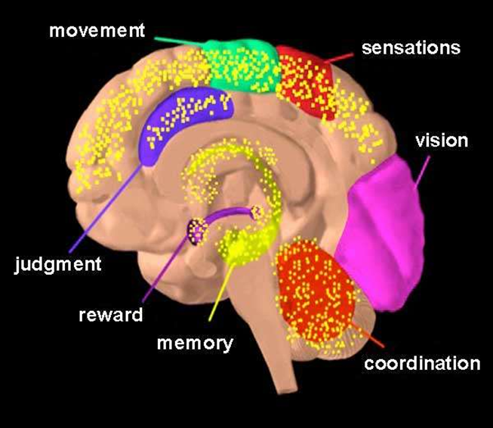
Brain Cannabinoid Receptor Sites
Multiple Regions of the Brain are Rich with “Endocannabinoid” Receptors
(THC-Like Chemicals Produced Naturally by the -Brain)
source: National Institute
on Drug Abuse
Notes:
Endogenous (produced by the brain) cannabinoid, THC-like, chemicals can be found in multiple regions of the brain (yellow areas).
These chemicals modulate neuron/brain activity in multiple parts of the brain.
When a person uses cannabis, all of these regions of the brain, and the functions linked to these regions, are affected.

Slide 27
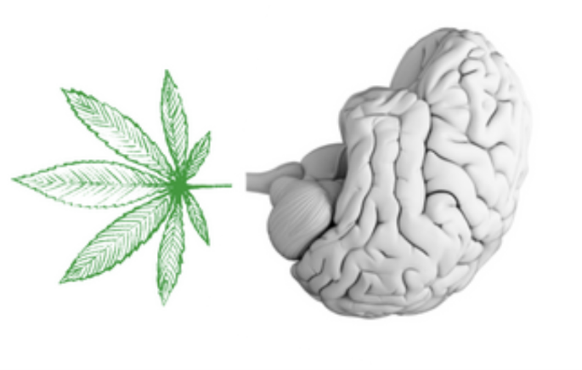
What Happens When the Developing Brain is Exposed to THC
The natural THC-like endocannabinoid network helps brain cells communicate properly
When the teen uses THC, the brain’s cell activity is overwhelmed, like “turning up the volume dial” all over the brain
source: Recovery Research Institute
source: Hurd et al., 2023
Notes:
For the developing brain, the natural THC-like endocannabinoid network of neurons in the brain helps to establish healthy connections between nerve cells, so that these cells can communicate properly.
When THC enters the body through cannabis use, it binds to this network of neurons and overwhelms and disrupts the teen brain’s task of cell communication.

Slide 28

What Happens When the Developing Brain is Exposed to THC
“Turning up the volume dial” of cell activity due to THC exposure causes disruptions in….
  controlling emotions
  coping with stress
  memory and learning
  making sound decisions
image courtesy of Marta Di Forti, Ph.D.
source: Hurd et al., 2023
Notes:
Specific disruptions include……

Slide 29
Quiz: Separating Fact from Fiction
        increases risk for addiction to cannabis
        disrupt brain development
        impair learning ability
        lead to a fatal overdose
4. Which May Occur When a Teenager Uses THC (Delta-9)?
Notes:
Ask parents to take a moment to consider this question. The next slide shows the answers.

Slide 30

Research Says
Here is what research says may occur when a teenager uses THC (Delta-9).
        increases risk for addiction to cannabis
        disrupt brain development
        impair learning ability
        lead to a fatal overdose
sources: Copeland et al,, 2022; Meier et al., 2012; 2022; Volkow et al., 2014, 2016, 2021
Notes:
Engage parents in a discussion. What surprises you?
Provide context that the high potency THC products are creating these risks in ways different compared to prior years when low potency was the norm.
Regarding #3: A developing brain that is exposed to THC can contribute to deficits in memory, concentration, and attention, as well as negative effects with thinking and problem solving.
Regarding #4: But there is a documented case of an infant that fatally died from an overdose on THC.

Slide 31
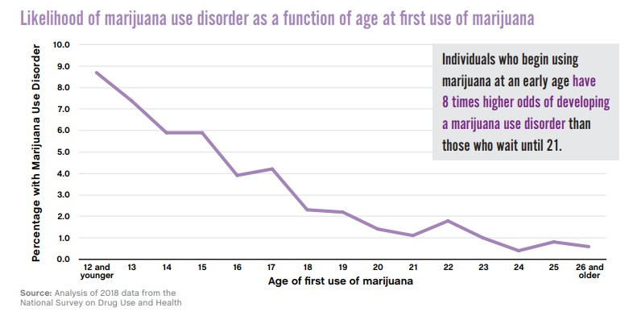
Focus on Addiction:
Age of Onset of Cannabis Use and Risk for a Cannabis Use Disorder
Percentage with Cannabis Use Disorder
Age of first use of cannabis
Notes:
The risk to develop an addiction to cannabis is often downplayed. But users of THC can develop a Cannabis Use Disorder.
Factoid: when cannabis use begins during adolescence, the likelihood of developing a cannabis use disorder can be elevated by 8 times compared to waiting an using age 21 or older.
Another factoid: For every year a teenager delays cannabis use, the risk of developing a Cannabis Use Disorder drops by about 10%.
Another factoid: given the current strains of cannabis, it is estimated that at least three in every ten users will become addicted.

Slide 32
Quiz: Separating Fact from Fiction
A research study followed a sample of young people in the U.S. from adolescence into adulthood. Among those that used cannabis frequently from adolescence and continued into adulthood, which of these adult outcomes did the researchers observe were more likely compared to those who did not use cannabis?
  less satisfied social life
  poorer physical health
  less wealth
  more criminal involvement
Notes:
Ask parents to take a moment to consider this question. The next slide shows the answers.

Slide 33
Research Says
A research study followed a sample of young people in the U.S. from adolescence into adulthood. Among those that used cannabis frequently from adolescence and continued into adulthood, which of these adult outcomes did the researchers observe were more likely compared to those who did not use cannabis?
  less satisfied social life
  poorer physical health
  less wealth
  more criminal involvement
source: Copeland et al,, 2022, https://doi.org/10.1016/j.jaac.2021.07.824
Notes:
Engage parents in a discussion. What surprises you?
Results based on the 25-year Great Smoky Mountains Study that has been following 1,420 participants since childhood.
At the adult assessment, those who had started cannabis use during adolescence and continued regular use as an adult reported these negative outcomes.

Slide 34
Quiz: Separating Fact from Fiction
Which statement is true about the link between use of THC (Delta-9) by a teenager and risk for mental illness?
  little or no link
  use of THC may increase risks for several mental disorders
  there is a link, but use of THC improves mental health
Notes:
Ask parents to take a moment to consider this question. The next slide shows the answers.

Slide 35
Research Says
Which statement is true about the link between use of THC (Delta-9) by a teenager and risk for mental illness?
  little or no link
  use of THC may increase risks for several mental disorders
  there is a link, but use of THC improves mental health
sources: www.nationalacademies.org/cannabishealtheffects; Volkow et al., 2014, DOI: 10.1056/NEJMra1402309
Notes:
Engage parents in a discussion. What surprises you?
More details: Converging data suggest that the highest risk is for psychosis and depression. Mixed data regarding anxiety disorders.
Does THC improve mental health? Users typically report that acute, short-term effects can be a relaxant. These acute effects are offset for some in that cannabis use can contribute to a worsening of emotional health.
See the next two slides for summary points from prominent research publications.

Slide 36
Adolescent Use of Cannabis and Mental Health Issues: What Do the Experts Say?
Officials from the National Institute on Drug Abuse reported in 2014 in The New England Journal of Medicine:
  The body of research indicates a “medium level of confidence that cannabis use increases risk of schizophrenia, depression and anxiety disorders” with additional elevated risk if use begins during adolescence
source: Volkow et al., 2014, DOI: 10.1056/NEJMra1402309

Slide 37
Adolescent Use of Cannabis and Mental Health Issues: What Do the Experts Say?
The National Academy of Sciences concluded in their 2017 report:
  The research evidence indicates a “substantial level of confidence that cannabis use contributes to the development of schizophrenia or other psychoses; highest risk among heavy users”
source: www.nationalacademies.org/cannabishealtheffects

Slide 38
Quiz: Separating Fact from Fiction
The FDA has approved cannabis products for which disorders or ailments?
        CBD for two childhood seizure disorders
        Synthetic THC for nausea from cancer medication
        THC to prevent the onset of psychosis
        Synthetic THC for weight loss due to HIV/AIDS
        THC to treat anxiety disorders
        THC to treat depression disorders
Notes:
Ask parents to take a moment and take this quiz. The next slide shows the answers.

Slide 39
Correct Answers
The FDA has approved cannabis products for which disorders or ailments?
        CBD for two childhood seizure disorders
        Synthetic THC for nausea from cancer medication
        THC to prevent the onset of psychosis
        Synthetic THC for weight loss due to HIV/AIDS
        THC to treat anxiety disorders
        THC to treat depression disorders
source: https://learnaboutsam.org
Notes:
Correct answers. Engage parents in a discussion. What surprises you?
Remind parents that CBD is the non-intoxicating version of cannabis.
MN Medical Cannabis Program does NOT include on its list of approved disorders #3, #5 and #6.

Slide 40
Quiz: Separating Fact from Fiction
Which is true about THC use and driving safety?
  intoxication from THC usually has negligible effects on driving skills
  intoxication from THC use can significantly disrupt driving skills
  intoxication from THC can counteract the effects of intoxication from alcohol on driving ability
Notes:
Ask parents to take a moment and take this quiz. The next slide shows the answers.

Slide 41
Correct Answer
Which is true about THC use and driving safety?
  intoxication from THC usually has negligible effects on driving skills
  intoxication from THC use can significantly disrupt driving skills
  intoxication from THC can counteract the effects of intoxication from alcohol on driving ability
sources: https://www.nationalacademies.org/cannabishealtheffects;
Fischer et al., 2022, https://doi.org/10.1016/j.drugpo.2021.103381
Notes:
Correct answer. Ask parents if this answer was a surprise and seek a discussion.
See next slide for which driving skills are impacted by intoxication from cannabis, alcohol and both.

Slide 42
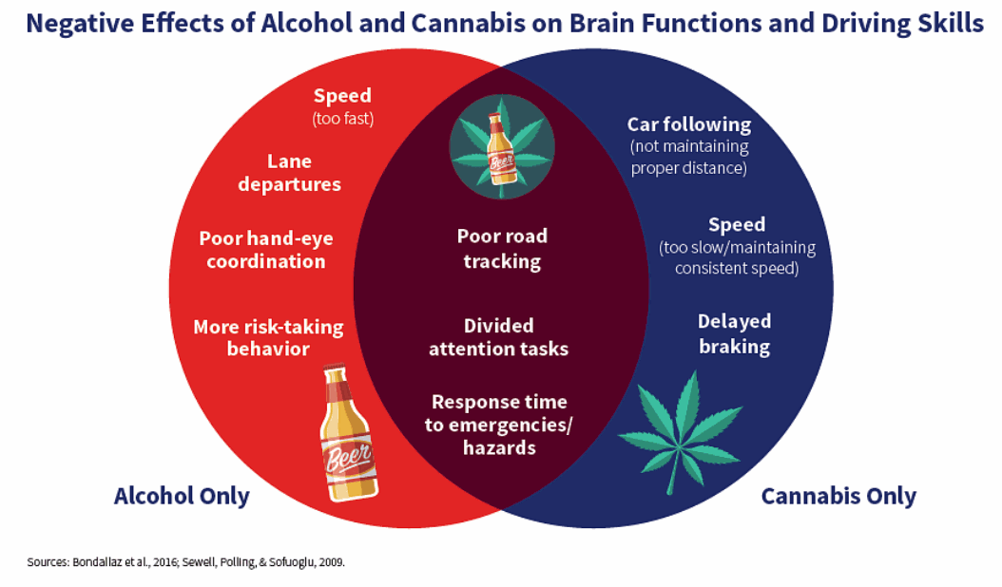
Seven impairments
due to alcohol use
Six impairments
due to cannabis use
source of image: https://www.nhtsa.gov/risky-driving/drug-impaired-driving
Notes:
Details: THC can contribute to six behavior changes that impair driving ability: poor road tracking, distracted with driving tasks, impaired response time to emergencies, poor distance with car you are following, too slow or inconsistent speed, and delayed breaking.

Slide 43
Use of THC and Driving Safety: What Do the Experts Say?
National Institute on Drug Abuse (2014):
  “High level of confidence” that use of THC significantly increases the likelihood of motor vehicle accidents
National Academy of Sciences (2017):
  “Substantial evidence” that THC use increases the risk of motor vehicle crashes
International panel of health experts (2022):
  “Substantial to moderate evidence” that THC use causes acute impairment and elevated risk of crash involvement, including injury or death
Notes:
Additional note: There is a lingering perception that THC does not contribute to unsafe driving: A recent national survey by SAMHSA indicate that nearly 42% of 19 – 24-year-olds to say “driving after using cannabis is not dangerous”.

Slide 44
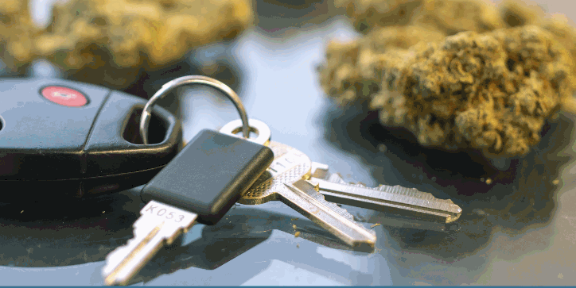
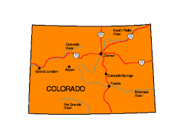
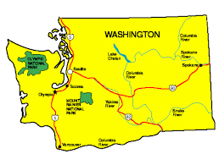
Trend Data from Two Legalization States
In WA and CO, traffic deaths in which drivers tested positive for THC has dramatically increased since legalization for adults:
  CO: 12% in 2013, 18% in 2018
  WA: 9% in 2012, 21% in 2017
source: https://learnaboutsam.org
Notes:
Discuss the results from this slide.

Slide 45
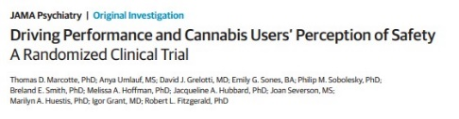
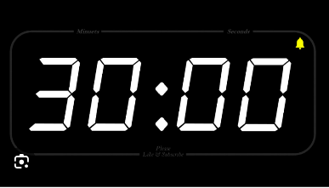

THC Intoxication and Driving Safety: Controlled Study
Study of driving impairment via a driving simulator
Three “smoking” groups: placebo, 6% THC, and 13% THC
Compared with placebo, both THC groups showed
  significant decline in driving performance
  decline started at 30 minutes and continued for about 90 minutes
source: Marcotte et al., 2022, doi:10.1001/jamapsychiatry.2021.4037
Notes:
Highlight that low-end THC potency is associated with driving impairments.
Additional findings:
Some performance declines lasted up to 4.5 hours
Tendency for participants in the THC group to report a “readiness to drive” during the significant decline period

Slide 46


Video 1
https://youtu.be/fz9MjS5j-mk
Notes:
Click on video button. This is 3-minute overview on the basics of teen brain development and its implications to substance use risk.
U of Penn researcher discusses adolescent brain development.
Discussion questions:
1.What surprised you about what your learned from the video?
2.In what ways does the information from the video remind you of your teenager?

Slide 47

Video 2
Effects of Cannabis on Adolescent & Young Adult Brain (Dr. Andrew Huberman)
https://www.youtube.com/watch?v=lMlnLSLpW2Y
Notes:
Click on video button. This is a 5-minute overview on the effects of cannabis on the developing brain.
This Stanford neuroscientist discusses the potential harms on the adolescent and young adult brain od using cannabis.
Discussion questions:
1.What surprised you about what your learned from the video?
2.In what ways does the information change your views of cannabis?

Slide 48

Parents as Prevention Agents
See this list of 6 ways to reduce the likelihood that your teen will use cannabis. Which on the list do you try to include in your parenting? Which are very challenging?
Support your teen’s interests in healthy hobbies and extracurricular activities.
Encourage your teen to have friendships with non-drug-using peers.
Communicate that you do not approve of your teen using drugs.
Encourage your teen to succeed with school work.
Participate frequently in activities for the whole family.
Be a good role model about your own legal substance use.
sources: Catalano et al., 2011; Hawkins et al., 1992; Scheier et al., 2019; Dunn & Klump, 2023
Notes:
Read each and engage a discussion.
Slide 48
Copyright © 2008 The Mentor Foundation
The Developing Brain, Adolescence and Vulnerability to Drug Abuse

Slide 49
If You are Legally Using Cannabis, Sound Prevention Practices
Not supplying cannabis to your teen.
Avoid using when your teen is present.
Store products in a secure place, including medicinal cannabis.
Avoid glamorizing cannabis.
Express disapproval of underage use.
source: Motivating Parents, Oregon Research Institute research team
Notes:
After you read the list, seek a group discussion:
What do you think of these suggestions?
Do they make sense?
Have you tried them? What was it like?
What do you see as challenges to implement these steps?

Slide 50
Signs of a Teen Drug Problem
Losing interest in activities they once enjoyed.
Dropping old friends for a new group.
Resisting feedback, being defensive when you discuss drug use.
Breaking rules, making excuses.
Several physical signs
  change in appearance
  glazed or bloodshot eyes
  pupils smaller or larger than usual
  change in mood or attitude
sources: https://youth.gov/youth-topics/substance-abuse/warning-signs-adolescent-substance-abuse
https://www.hazeldenbettyford.org/articles/warning-signs-teen-substance-use
Notes:
Seek a discussion. Have you observed any these signs in your teenager?
Remind parents that these signs are not specific to drug use problems. They can be part of normal adolescence.

Slide 51
Seeking Help
Have the mind set that help is out there.
Start with seeking a professional assessment.
  schools
  community mental health center
  family health plan
  call 211, Your First Call for Help
  call 988 for crisis
Take advantage of the provided resources
Notes:
Seek a discussion

Slide 52

Summary
Here are the main themes and issues we have discussed.
  Cannabis products can have very potent levels of THC.
  Use of THC can disrupt brain development and increase likelihood of health and safety problems.
  Parents can be an important prevention force in the home.
What surprised you the most in what you learned?
What challenged your prior viewpoints?
Notes:
Provide a summary.
See the last two bullets and seek a discussion with these questions.

Slide 53
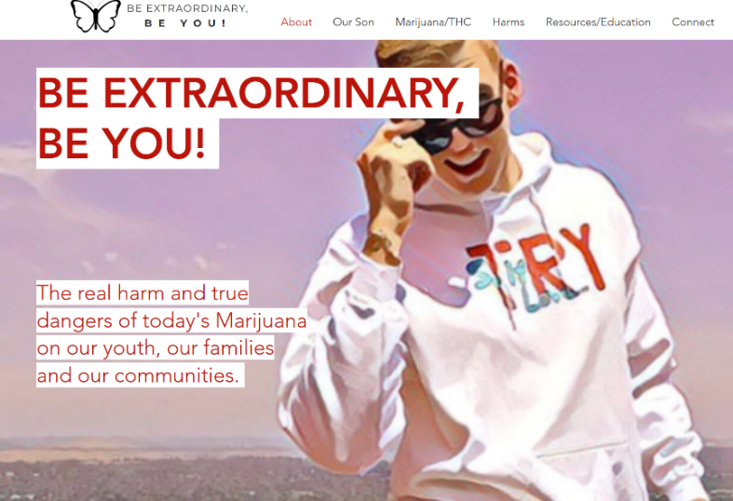
Resources
See Handouts in Facilitator’s Guide
The Bacchus’ lost their son to the devastating effects of cannabis induced psychosis.
Their family tragedy provides a cautionary tale of what can happen when a teen uses high potency cannabis, and offers guidance and hope if a parent is faced with a teen who is using cannabis.
If you want to invite them to your community to give a presentation, visit https://www.beextraordinarybeyou.com .
Notes:
Review this resource. A reminder: handouts are provided in the Facilitator’s Manual – Appendix.

Slide 54
Resources
See Handouts in Facilitator’s Guide
  1. https://teens.drugabuse.gov/parents
  Information provided by the National Institute on Drug Abuse aimed at parents about youth drug abuse; it includes ways to talk with your teen about cannabis and its effects.
  2. https://learnaboutsam.org/pan/
  The Parent Action Network, an affiliate of Smart Approaches to Marijuana, was created to educate parents that today’s cannabis is harmful in ways not appreciated.
3. https://johnnysambassadors.org/
This resource aims to educate teens, parents, and communities about the dangers of today’s high-THC cannabis on adolescent brain development and mental health.
Notes:
Review this resource. A reminder: handouts are provided in the Facilitator’s Manual – Appendix.

Slide 55
Resources
See Handouts in Facilitator’s Guide
  4. https://poppot.org/
Parents Opposed to Pot counters the false narrative that cannabis is harmless by educating parents.
5. https://momsstrong.org/
Moms Strong is group of moms who tell their stories about how they saw cannabis severely damage their teenager or young adult.
6. Motivating Parents
This resource helps parents on how to talk with your son or daughter about cannabis and its potential harms.
7. https://www.gobi.support/
Gobi is a free online, self-directed early intervention program for parents and their teenager who has started to use substances.
Notes:
Review this resource. A reminder: handouts are provided in the Facilitator’s Manual – Appendix.

Slide 56
Resources
See Handouts in Facilitator’s Guide
  8. https://parentshelpingparents.org/
This resources offers support groups and a helpline for parents seeking discussions about problems with their children and education about parenting strategies from one another.
9. https://theconversation.com/cannabis-legalization-has-led-to-a-boom-in-potent-forms-of-the-drug-that-present-new-hazards-for-adolescents-219779
This brief by Professor Ty Schepis highlights major issues about the health risks of cannabis use by adolescents.
10. Parenting Guide (source: winte001@umn.edu)
These 5 keys to effective parenting are described: Monitoring, Appropriate Role Modeling, Building a Warm and Supportive Relationship, Establishing Appropriate Parent-Child Communication, and Maintaining Awareness of Who Your Teen Affiliates.
Notes:
Review this resource. A reminder: handouts are provided in the Facilitator’s Manual – Appendix.

Slide 57

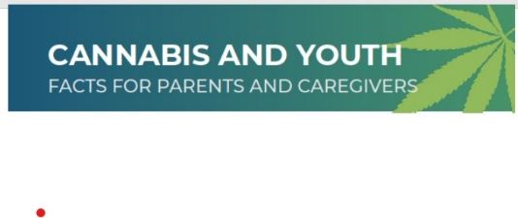
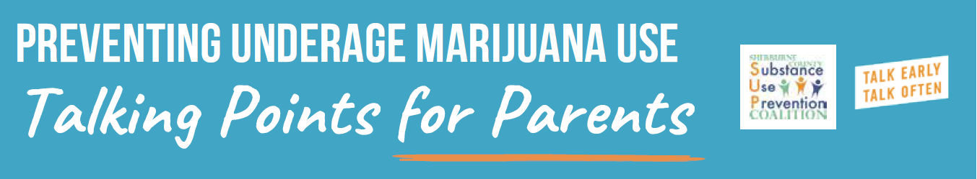
Resources
See Handouts in Facilitator’s Guide
Resources Prepared by Sherburne County Minnesota
Prevention Coalition
Notes:
Review this resource. A reminder: handouts are provided in the Facilitator’s Manual – Appendix.

Slide 58
Feedback
  What did you like about this presentation?
  What would you have liked to be different?
  Would you recommend this presentation to other parents?
Notes:
Seek feedback with an open discussion.

Slide 59
THANK YOU!
______________________
contact
Notes:
Insert your contact info.

